Slide 1
Advanced Analytics of Digital Data: A focus on sensor data
Kirsty Hicks
Senior Statistics Director

Slide 2
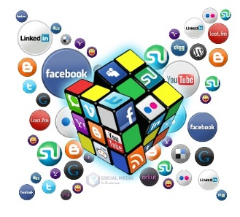
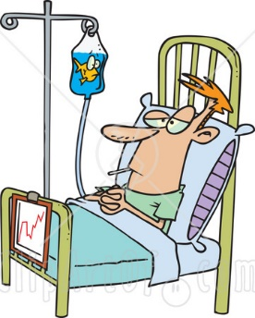
What is Digital Data?
eConsent
Wearable sensors
App’s
Big data
Virtual patient visits
Tablets / mobile devices
Electronic medical records
Post marketing surveillance
Compliance trackers
Real world evidence
Social media
Data warehouse
Visualisation
eSample tracking
Ethnographics
ePROs
Cloud

Slide 3
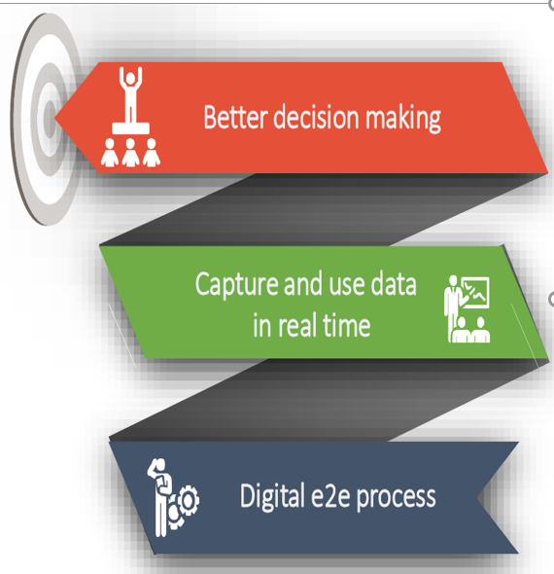
What is Digital Data?
Most of us will be:
wearing a watch monitoring some aspect of our movement
use phone apps that collect health information
Digital data can be used to collect information on:
sleep patterns
respiration rate
step count
continuous monitoring of heart rate and energy expenditure
patient adherence
Collecting data through digital devices increases patient engagement and can provide real time data
Regulations for use of digital technologies in clinical trials are still evolving

Slide 4
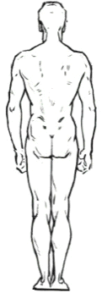
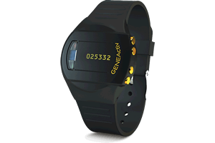
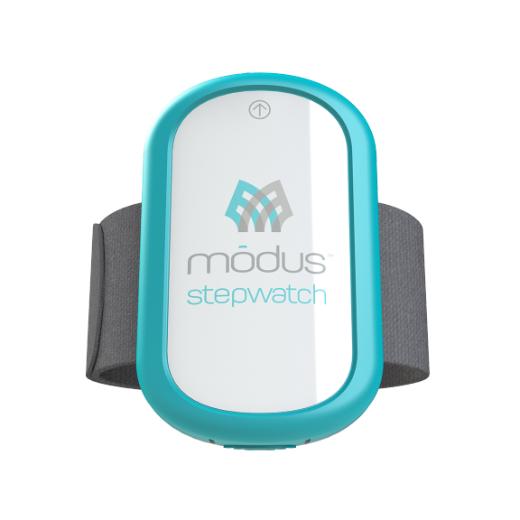
Sensor data: Actigraphy
Many diseases limit patients ability to perform physical activity
Actigraphy is a non-invasive method of monitoring human activity
A small actigraph unit (actimetry sensor) is worn for a week or more to measure gross motor activity
Movements the actigraph unit undergoes are continually recorded
Utilisation in clinical studies provides a great opportunity to better understand patient populations and how diseases limit their mobility
Produce vast amounts of data continuously
e.g. second-by-second or minute-by-minute over one week several times during study
Accelerometers can measure 300 data points per second:
=> In one week this can be 181.44 M data points

Slide 5
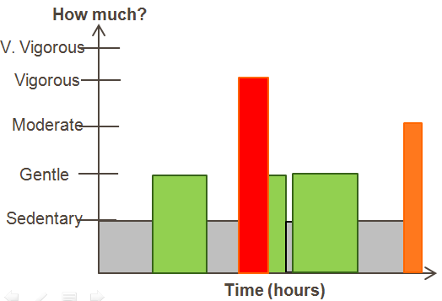
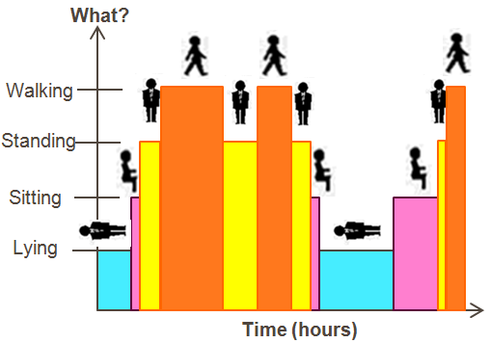
Actigraphy: Clinical trials
Raw accelerometer data is processed utilising machine learning algorithms to obtain more meaningful summaries of activity
Activity counts, Rate of energy expenditure (METs)
Appropriate for the patient population (movement expectations vary)
Data summaries can be produced at different time aggregations
Second-by-second, minute-by-minute, hourly, Daily, etc ….
Transition between or proportion of time:
Type of activity: Lying, sitting, standing, walking
Activity intensity: Sedentary, moderate, vigorous
Raw data
Vertical Axis
Lateral Axis
Forward Axis
Acceleration
Time

Slide 6
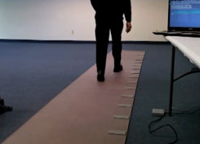
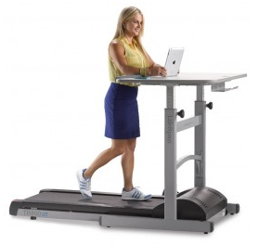
Sensor data: Challenges
How do we choose a sensor type for the trial?
Clinical hypothesis
Patient population studied
Wear location and duration
Does it need to be waterproof?
Design issues
Number of countries
Which country (import of devices, local country regulations)
Ability to charge the device
Data storage: volume of data that is required to be stored
Downloadability of the data: can it be downloaded or backed up onto a phone
Format and content of actigraphy summary dataset may vary by vendor

Slide 7
Sensor data: Challenges
What data processing is required?
Data access to cloud in real time?
Filter data corresponding to clinical visits where actigraphy data collection was planned according to protocol
Apply data quality rules pre-specified in the protocol
eg ≥ 8 hours for ≥ 3 days within the 7 day data collection period prior to the visit
How can we analyse this type of data in a clinical trial to assess if the treatment works?
Identify clinically meaningful endpoints
Summary measures
Consideration of continuous and categorical data on a minute by minute scale
Apply appropriate statistical analysis techniques (eg Generalised Additive Models)
Consideration: all sources of activity data could be correlated
Need to consider computer capabilities

Slide 8
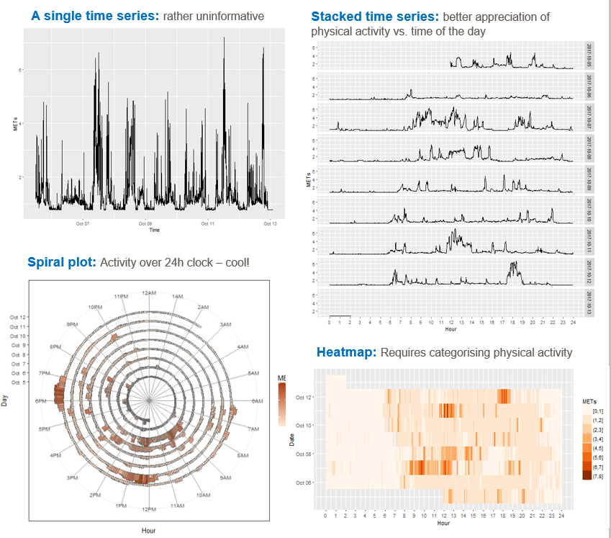
Actigraphy: Clinical trials
Summarise physical activity through indices of:
total activity
time active or sedentary
Producing indices that condense minute-by-minute time-series into one single value => loss of information
Analyse the whole minute-by-minute time series directly

Slide 9
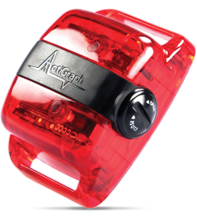
Sensor data: Challenges
How can we analyse this data type in a clinical trial to learn about the patient population, disease progression, etc?
Identification of activity patterns? Differences between populations?
How compare treatment groups
Extensive data collected and what appropriate visualisation techniques should be applied?
Identify appropriate visualisation techniques for representing the data
Activity changes during the day, ie there are diurnal patterns; Or weekday v’s weekend?
Age can affect what happens in the second half of the day
How does the activity in the previous hour affect the activity in the next hour?
Should this be considered in the statistical analysis?
Relationship between novel digital endpoints and clinically standard ones?
eg how are FEV1 and actigraphy related in COPD patients?

Slide 10
Sensor data: Challenges
How to deal with missing data?
Compliance issues: consideration of how could be reduced, and how dealt with in analysis
Sometimes long gaps (up to a few hours) with missing data… in many subjects
How deal with instances where have 0 steps, but non-zero distance
Longitudinal setting?
Device worn at several periods during treatment phase
How compare multiple time series within a patient?
How do we produce a meaningful change from baseline?
How do we ensure that the data is collected appropriately?
Location of sensor – does it make a difference?
How long should the sensor be worn, what volume of data is sufficient? eg how many days? What wear time within a day?
Appropriate data format to fit into reporting systems

Slide 11
Regulatory Perspective
FDA
FDA agreed with Bellerophon Therapeutics on the use of a digital Biomarker as the primary endpoint in their forthcoming pivotal Phase 3 study, measured by a wearable activity monitor (actigraphy).
European Medicine Agency (EMA)
Gave a positive opinion to qualify a digital endpoint (fully measured with sensors) as an adequate secondary endpoint in therapeutic clinical trials in Duchenne Muscular Dystrophy
A critical breakthrough as the first fully digital endpoint to be qualified by either EU/US regulators. EMA now offers advice on Qualification of novel methodologies for medicine development including DBs to ensure endpoint acceptance.
Clinical Trials Transformation Initiative
In collaboration with FDA and large pharma developed and published guidelines to develop novel endpoints based on digital technologies, aiming to standardise methodologies to ensure consistency.

Slide 12
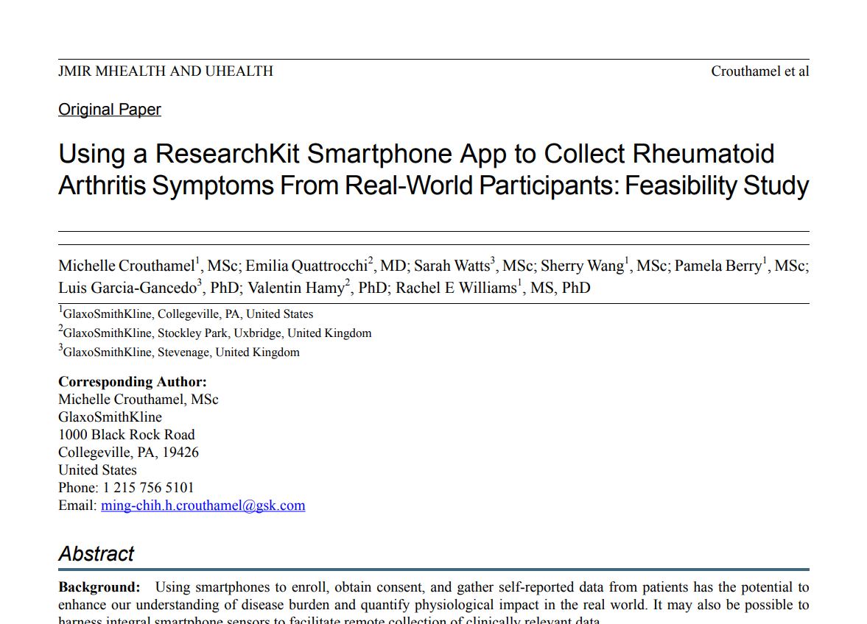
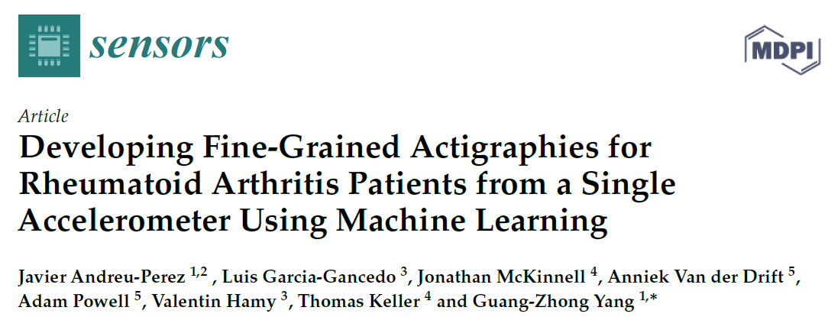
Published digital examples

Slide 13
Sensor data: Collaboration
Advanced Analytics of Digital Data group within GSK
SPIN Article
PSI Data Science SIG

Slide 14
Summary
Actigraphy data contain rich information with huge potential: real-time data, objective, new endpoints, better characterization of patient populations
In process of understanding this type of information and learning how to deal with it
Number of issues with physical activity data from wearables including missing data, development of endpoints (relevant for patients and clinicians), statistical approaches to assess the impact of a treatment, data visualisation
More literature exists on developing actigraphy summaries from accelerometers raw data than on analysis of minute-by-minute data. Further research is needed, especially in context of clinical trials.

Slide 15
Acknowledgements
Juanjo Abellan
Nicky Best
Luis Garcia-Gancedo
Val Hamy
Matthew Heasley
Edoardo Lisi
Ashwin Venkat
Sarah Watts

Slide 16
Any Questions?

