Slide 1
Internal clinical trial data re-use …or what’s data privacy got to do with it?
Katherine Tucker, Roche Products Ltd. (UK), Data Privacy Technical Lead
9th June 2020, PSI virtual conference

Slide 2
Agenda
Internal clinical trial data re-use …or what’s data privacy got to do with it?
Background including Roche context
Data privacy laws and how they apply to clinical trials
Role of anonymization
Putting it all together - the challenges
Practical implementation - how Roche are approaching these issues (work in progress!)
Conclusions
Disclaimer: This presentation reflects the views of the author and should not be construed to represent Roche’s views, policies or endorsements

Slide 3
1. Background including Roche context
Ensure compliance with privacy/legal/ethical obligations associated with data and their re-use
Defining ‘guardrails’ to make decisions on appropriate data use
Ethical considerations
Enable rapid generation of scientific insights from re-use of internal data
Goal of ‘personalised healthcare’
New techniques e.g. ML/AI
New technologies e.g. WGS, digital pathology
New/changing data privacy laws and their interpretation in CT context
Notes:
There has been an increasing recognition in the value of the secondary use of clinical data from clinical trials.
Such data has value beyond the initial purposes and objectives of the protocol.
They can be used internally to inform our understanding of patient populations and disease, validate new targets, methodologies and endpoints and other scientific research thus helping realize the ultimate vision of personalised healthcare (PHC).
However, we have new and changing DP laws and their interpretation for CTs is also evolving with new external guidance in 2018/9 and more expected.
We have a need to provide guardrails to data users so they can make informed decisions about appropriate data use and re-use. For decades this was not an issue as re-use was often confined to uses such as sample size calculations for future trials.
How can we balance these new demands and changing landscape?

Slide 4
1. Background including Roche context
EDIS – Roche programme ‘Enhanced Data and Insights Sharing’.
Maximizing the value of clinical trial data now and in the future
Making data ‘F.A.I.R.’
Findable
Accessible
Interoperable
Reusable
Need another R - responsible re-use including data privacy aspects
Broader considerations when re-using data:
Advancing science in the interest of patient care, using data maximally for the public good, benefits to society, trust in organisations and ethics.
GDPR Recital 4: ‘The processing of personal data should be designed to serve mankind’.

Slide 5
2. Data privacy/protection laws and how they apply to clinical trials
Definitions (simplified)
Personal data: information relating to an identified or identifiable natural person (‘data subject’);
“data about identifiable people”
Pseudonymised: personal data labelled with a pseudonym (data can’t be attributed to a specific data subject without the use of additional information)
<- clinical trial data
Anonymised data: by taking into account all means reasonably likely to be used, data subjects are no longer identifiable (so out of scope of GDPR);
“data about non-identifiable people”
Processing: any set of operations which is performed on personal data (this covers anything you can do with data, including storage in systems);
“anything you might do with data, including just having it”
Notes:
Data privacy (U.S.) or data protection laws (EU) cover the processing and protection of personal data.
In the EU there is the GDPR - General Data Protection Regulation, came into force May 2018.
What is data protection? UK ICO website:
‘Data protection is the fair and proper use of information about people. It’s part of the fundamental right to privacy – but on a more practical level, it’s really about building trust between people and organisations. It’s about treating people fairly and openly … and striking a balance with the wider interests of society.’
GDPR
Clinical trial data is considered ‘personal data’ (labelled with a pseudonym = pseudonymised)
As a company we have the legal means to access data to identify a data subject e.g. site monitors

Slide 6
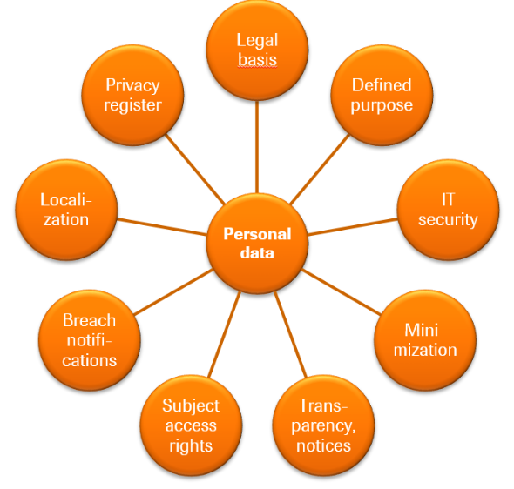
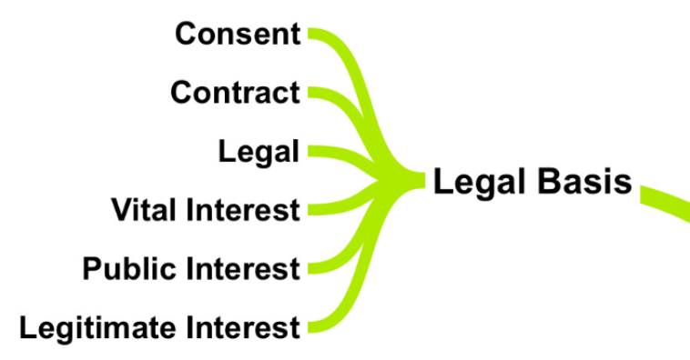
2. Data privacy/protection laws and how they apply to clinical trials
Acknowledgement for diagrams: http://gdprmentor.com/gdprmindmap
Notes:
GDPR fundamental principles (out of scope for today) when processing personal data.
One is that processing should be lawful. This is achieved via one of the ‘legal bases’ (Article 6 + Article 9 for special category data = health data).
Clarification in 2019 - Interplay GDPR/CTR
Legal basis for primary use - split into
reliability and safety purposes (legal obligation)
research activities (consent, public interest or legitimate interest)
Legal basis for secondary use – presumption of compatibility, scientific research exemption (or anonymization) => more guidance coming due to “horizontal and complex nature”
Doc included clarification on consent – legal basis consent is not the same as the ICF consent with which we are all familiar with in clinical trials.
In fact ‘consent’ “will not be the appropriate legal basis in most cases” for data processing in CTs, once reason is due to the perceived ‘imbalance’ between pharma and trial participants, doesn’t meet criteria for ‘consent’. That’s not to say that we don’t have ethical obligations to patients to use personal data in line with statements made in the ICF
Processing personal data comes with a whole host of obligations on organisations as a ‘data controller’.
Next – the role of anonymisation

Slide 7
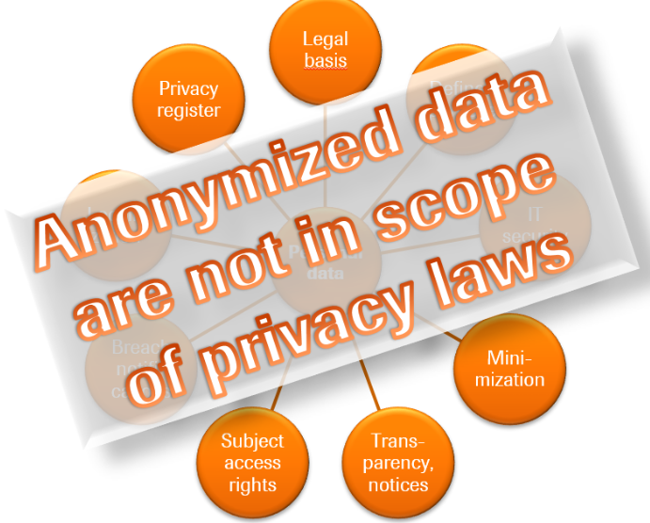
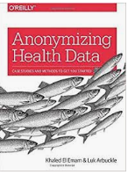
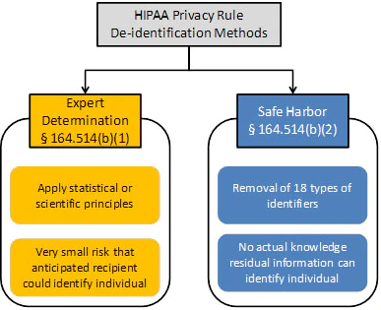
3. The role of anonymisation
Anonymisation – no single aligned definition, terminology, interpretation or philosophy across the world. One reason is varying data privacy laws across jurisdictions/sectors.
GDPR Recital 26 ‘Not Applicable to Anonymous Data’
Anonymised data: ‘by taking into account all means reasonably likely to be used, data subjects are no longer identifiable’; but what does it really mean?
“… account should be taken of all objective factors, such as the costs of and the amount of time required for identification, taking into consideration the available technology at the time of the processing and technological developments”
Plus ‘Breyer’ case (Court of Justice of the EU): IP Addresses & Personal Data Definition – established ‘legal means to identify’
Notes:
GDPR definition: ‘with all means reasonably likely to be used, data subjects are no longer identifiable’
When you anonymise data, it falls out of GDPR.
GDPR: don’t process personal data unless you have to, if anonymised data will do the job, use that (although the process of anonymising data is also processing)
Methodologies:
Not one global definition of anon/de-id (or even terminology) because each country/jurisdiction has their own DP laws and definitions
GDPR definition lends itself to a more context-driven approach.
Breyer case and legal means to identify (2016, dynamic IP addresses).
Definition of Personal Data according to the Court of Justice of the European Union:
Not directly identifiable data are personal data if an entity has the legal means which enable it to identify the individual with additional data another entity has about that individual.
Consequence: If an entity has no legal means to access necessary additional data to identify a data subject, data are not deemed to be personal data for the respective entity.
HIPAA: Health Insurance Portability and Accountability Act – 2 methods
Resources – Khaled el Emam books and resources, UKAN ADF and many others

Slide 8
3. The role of anonymization
“Uniqueness of records within CTs means anon is never achievable”
“Its only about the data and what you do to it”
Anonymisation common misconceptions:
“Need to ensure zero risk of re-identification”
UKAN ADF - Anonymisation is a heavily context-dependent process. Consider data and environment as a total system (‘data situation’).
Five principles:
1. You cannot decide whether data are safe to share/release or not by looking at the data alone
2. But you still need to look at the data
4. Zero risk is not a realistic possibility if you are to produce useful data
3. Anonymisation is a process to produce safe data but it only makes sense if what you are producing is safe useful data
5. The measures you put in place to manage risk should be proportional to the risk and its likely impact

Slide 9
4. Putting it all together - the challenges
Aim: use of clinical trial data for internal secondary re-use purposes, in line with data privacy and ethical constraints
Possible solutions:
Use personal data
Create and use anonymised data
Secondary re-use
Compatible use
Related regulatory activities
Protocol objectives
Use personal data
Purpose of re-use is key
Definitions e.g. primary/secondary use, compatible use, scientific research
Role of ICF & data re-use language
Legal basis (see definitions)
Match planned re-use vs. protocol objectives/ICF language
Who decides

Slide 10
4. Putting it all together - the challenges
Aim: use of clinical trial data for internal secondary re-use purposes, in line with data privacy and ethical constraints
Possible solutions:
Use personal data
Create and use anonymised data
Common to both solutions
Global studies, patients across multiple countries
Systems, processes, infrastructure
Data citizenship & culture, codes of conduct
Awareness, training, knowledge
Changes to external guidance
2) Create and use anonymised data
Definitions e.g. ‘means reasonably likely’ in internal context
Qualitative vs quantitative approach
Data changes (SDTM, other modalities) - balance privacy vs. utility
Define ‘TOMs’ (technical & organisational measures)
Complexity across data modalities, ‘linkability’
Limits on use of anon data (scientific research)

Slide 11
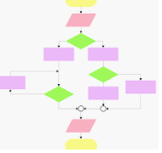
5. Practical implementation - how Roche are approaching these issues – still work in progress!
Definition of anonymisation for internal re-use of Roche clinical trial data
Clinical trial data use/re-use
decision-making flow diagram
Notes:
Philosophy statement
Principles
Purpose
Anonymisation
Primary + compatible use
IDAP
Compliance
Decision making flow diagram
Definition anonymization for internal re-use –self-service complemented by privacy governance for ‘edge cases’
EDIS = building in privacy by design e.g. data anon, place for secondary use, clear info for users, ‘T’ of the TOMs
Data Citizenship = ‘O’ of the TOMs

Slide 12
6. Conclusions: Internal clinical trial data re-use …or what’s data privacy got to do with it?
Responsible data re-use is key in advancing science in the interest of patients and maintaining trust
Clinical trial data is personal data under GDPR
Personal data can be re-used for compatible/scientific research purposes but needs careful consideration to ensure lawful/ethical
The purpose of proposed secondary use is key in knowing what you can and cannot do
Using anonymised data for secondary use, where possible, has advantages and may allow a broader scope of re-use purposes
A changing data privacy landscape and new emerging external guidance means plans will need to evolve over time
Overall: topics are complex, interpretations are evolving, needs a truly cross-functional approach and strong connections between data privacy/legal, IT and the business/data scientists, ideally as part of a comprehensive information/data governance strategy

