Slide 1
Borrowing-strength from indirect evidence in HTA: methods and policy implications
Georgios Nikolaidis
Research Fellow
Centre for Health Economics
University of York, UK

Slide 2
Outline
Background
A case-study
Direct and indirect sources of evidence
Modelling approaches
Impact of different models on relative effectiveness and decisions
Summary and conclusions
Notes:
- What do we mean by direct and indirect evidence

Slide 3
Background
It is crucial in decision-making to define a very specific policy research question and find the `best` treatment for the target population, receiving the treatment of interest, assessed by the means of a specific endpoint etc. [Dias et.al 2018]
In synthesising the available evidence, the Cochrane Handbook suggests:
“meta-analysis should only be considered when a group of studies is sufficiently homogenous in terms of participants, interventions and outcomes to provide a meaningful summary” [Higgings and Green 2008]
But this isn’t always followed in practice, primarily due to evidence sparsity
Notes:
Once a decision RQ is defined, evidence is identified and subsequently synthesised
In synthesizing the available evidence the Cochrane handbook suggests ….
But these two pieces of and particularly the second isn’t always followed in practice, primarily due to evidence sparsity.
For example it is not uncommon in HTA to use evidence from a slightly different population (e.g )

Slide 4
P¹: Evidence on patients
from a different line of treatment
I¹: Evidence on a different dosage of the same intervention
P²: Evidence on patients
of different severity
I²: Evidence on a treatment from the same class
P⁰
I⁰
S¹: Evidence from non-randomised studies
C¹: Evidence on a separate
treatment which is compared
both head to head with the intervention of interest and
with the comparator of interest
S⁰
C⁰
O⁰
S²:Evidence from low quality RCTs
O¹: Evidence on different, correlated, endpoints
O²: Evidence on the same outcome reported at a different time-point

Slide 5
Expanding the evidence-base: Benefits and risks
Potential benefits:
To gain precision
To alleviate suspected internal biases
To better characterise uncertainty and explain heterogeneity
Potential pitfalls:
Additional heterogeneity
Biased relative effectiveness estimates

Slide 6
Lumping vs Splitting are not the only options
Common practice in HTA is to either `Lump` (i.e. treat indirect evidence as if they are direct evidence) or `split` (i.e. totally disregard all indirect sources )
But these two options are just the two extremes of a spectrum
There are many examples in the literature of methods that impose more moderate `strength-borrowing`
`Lumping`
`Splitting`
`degree of information-sharing`

Slide 7
4 main types of relationships
Functional relationships (Meta-Regression approaches, Bias-adjustment, Dose-response curves, Constraints)
Exchangeability-based relationships (Multi-level models, partial exchangeability models, random walks)
Prior-based relationships (Informative priors, Mixtures of priors, Commensurate priors, Power-priors)
Correlation-based relationships (Multi-variate meta-analysis)

Slide 8
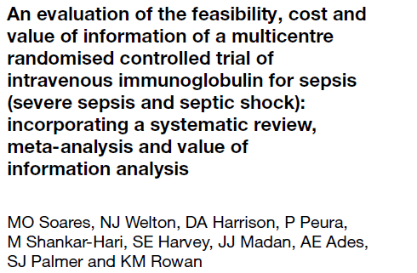
A case-study
Decision Research Question
Population | Adults
Intervention | IVIG or IVIGAM
Comparator | Albumin or Placebo
Outcome | All-cause mortality
Study design | RCTs
Indirect evidence
CHILDREN
IVIG or IVIGAM
Albumin or Placebo
All-cause mortality
RCTs
The authors acknowledged that heterogeneity couldn’t be fully explained, a single best-fitting model could not be concluded and different models yielded quite different estimates for relative effectiveness

Slide 9
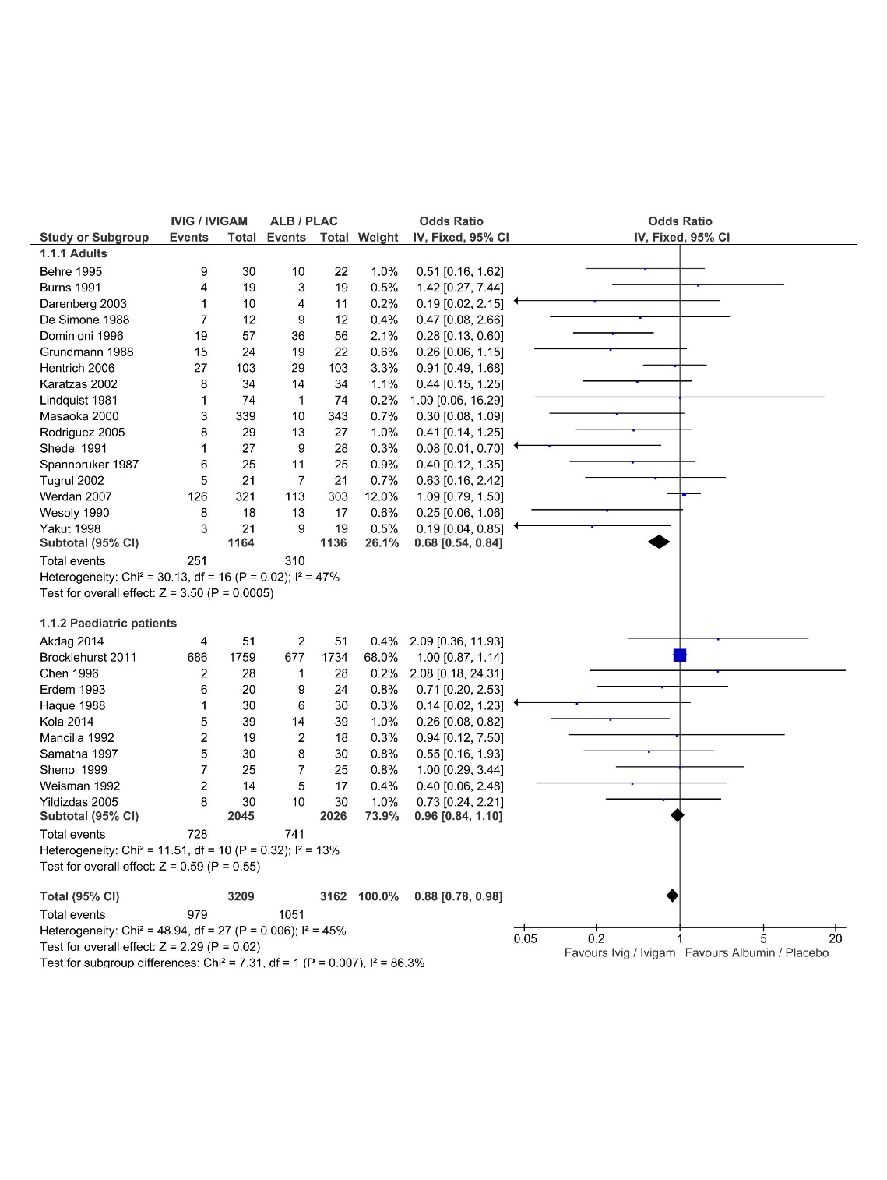
Direct and indirect evidence
A naïve combination under a FE model
Notes:
A simple case of a set of two-arm trials where there is only one indirect source and no study reports for both populations
Despite that being a pairwise ma we ll show the models for NMA

Slide 10
`Splitting`
$$y_{i,k} \sim Bin(p_{i,k}, n_{i,k})$$
Fixed-Effects
Base-model
$$logit\left(p_{i,k}\right)= g_{i,k}= μ_{i}+ d_{kl}$$
$$,s$$
$$+ β_{}X_{i}$$
$$s$$
$d_{kl} =d_{1l} − d_{1k}$
$,s$
$,s$
$,s$
Notes:
Assumes that we have the same network of interventions in all direct and indirect sources and we can obtain the same basic parameters
For simplicity we ll drop k, but we will always be assuming that the relationship can be imposed for all k
Just for the purposes of this presentation we will by using the FE model, but the process is also applicable for a RE model
We will now use the 4 core categories to see what sharing methods we can impose on basic parameters derived from different sources

Slide 11
Summary of applicable synthesis methods
Method
Lumping | $$d_{1k, Dir}= d_{1k, Indir}$$
Multi-level model | $d_{1k, Dir}, d_{1k, Indir} \sim N(d_{1k, global}, τ_{}^{2}$)
Informative priors | $d_{1k, Dir} \sim N (d_{1k, Indir},{se}_{d Indirect}^{2})$
Mixtures of priors | $d_{1k, Dir} \sim p ×N \left(d_{1k, Indir},{se}_{d Indirect}^{2}\right)+(1−p)×N(0, {100}^{2})$
Commensurate priors | $d_{1k, Dir}\sim N(d_{1k, Indir}, η)$ Where $\frac{1}{η^{2}}$
Power-priors | $$π\left(d_{direct}\right|{Data}_{dir}) ∝L\left(d_{direct}\right|{Data}_{dir}) ×\text{π}\left(d_{direct}|{Data}_{indir}, a\right)$$ Where π$\left(d_{direct}|{Data}_{indir}, a\right)∝ \prod_{i=1}^{Indir}{\left[{L\left(d_{ΙΝdirect}\right|{Data}_{indir})}^{a}\right]} ×π_{0}(d)$
0.5
$$\sim N(20,1)$$
0.5
$\sim Gamma\left(0.1, 0.1\right)I(0.1, 5)$
Notes:
-So these are the applicable models in our case.
- Do you know a priori how strongly each one borrows information ? Could we put place them in the Splitting to Lumping spectrum ?

Slide 12
Comparing methods : `Strength-of-borrowing` measures
Point estimate divergence (PED)
_{Precision Increase (PrI)}
_{Kullback-Leibler Divergence}
$${PED}_{j}$$
$$d_{direct} (splitting)$$
$$d_{direct} (sharing−model j)$$
Notes:
We re never going to know the truth
The only thing that we can control is how strongly information is borrowed

Slide 13
Comparing methods : `Strength-of-borrowing` measures
Point estimate divergence (PED)
_{PrI (Precision Increase)}
_{Kullback-Leibler Divergence}
$${PrI}_{j}=1 − \frac{B}{A} , E(−∞,1]$$
A
B
$$d_{direct} (splitting)$$
$$d_{direct} (sharing−model j)$$

Slide 14
Comparing methods : `Strength-of-borrowing` measures
Point estimate divergence (PED)
_{Precision Increase (PrI)}
_{Kullback-Leibler Divergence}
$$D_{KL}\left(p,q\right)= \int{\left[ p\left(x\right) ×\log\left(p\left(x\right)\right) − p\left(x\right)×\log\left(q\left(x\right)\right) \right] dx}$$
$$d_{direct} (splitting)$$
$$d_{direct} (sharing−model j)$$

Slide 15
Results on Relative effectiveness
Notes:
Informative prior lead to lower Point Estimate Divergence, but higher Precision Increase
As expected, Mixtures of priors lead to lower precision gains than Informative priors, but similar point est. divergence
Commensurate prior and Multi-level models impose very low strength of borrowing
Methods cannot be consistently mapped to a single Power-prior value

Slide 16
Results on adoption decisions

Slide 17
Results on research recommendation decisions
Cost of a trial of
the optimal sample

Slide 18
Summary and conclusions
It is not uncommon in HTA to use indirectly related evidence
Lumping and splitting are just the two extremes of the information-sharing spectrum
Using different methods can lead to different decisions
This means that we need to carefully examine the plausibility of their imposed assumptions and make a judgement about the desired degree of information-sharing
In order to guide towards the use of specific methods, we need simulation studies that compare them under different circumstances for the direct and the indirect evidence

Slide 19
Thank you

Slide 20
Back up slides

Slide 21
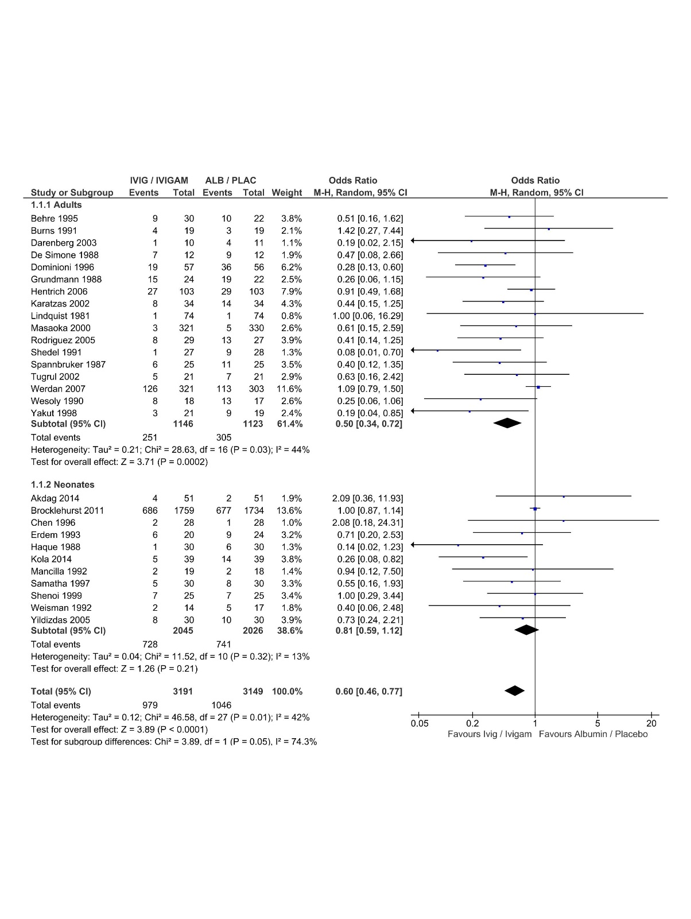

Slide 22
Methods: Direct evidence
Those are the same with the direct evidence of the sepsis case study
(Remember: Of importance is how the indirect evidence relate to the direct, not what the direct evidence actually is)
Dimension | Direct evidence
Number of studies ($Ndirect$) | 17
Nu of patients ($ssdirect$) | 1136
Log-Odds Ratio - RE - (d$direct$) | -0.8 (OR = 0.6)
Between-studies Heterogeneity (τ$direct$) | 0.56

Slide 23
Methods: Dimensions
Dimension | Base-case | Scenarios
Number of studies ($Nindirect$) | 10 | -
Nu of patients ($ssindirect$) | 1136 = $ssdirect$ | $ssdirect$/2, $ssdirect$*4
Log-Odds Ratio - RE - (d$indirect$) | 50% OVL | 5% Overlap, 75% Overlap
Between-studies Heterogeneity (τ$indirect$) | 0.56 (I^2 = 68%) | 0.24 (I^2 = 12.5%), 0.65 (I^2=87.5%)
… So 7 scenarios overall …

Slide 24
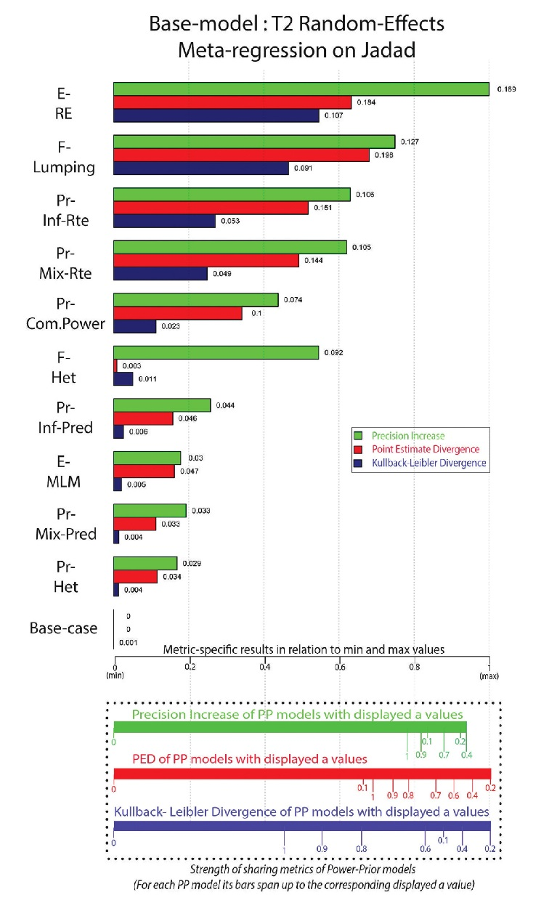

Slide 25
Power prior with
current data

