Slide 1
Estimation of group means using Bayesian generalized linear mixed models
17 November 2020 – PSI Webinar
Amy LaLonde, Senior Research Scientist
Department of Statistics, Data, and Analytics
Eli Lilly & Company

Slide 2
Outline
Motivation
Methodology
Simulations
Summary

Slide 3
Motivation

Slide 4
Motivation: Group Means Which estimand is more meaningful: $f\left(\overline{X}\right)$ or $\overline{f(X)}$?
Primary endpoints in clinical trials assess treatment effects
The typical approach is to fit a regression model of the outcome variable conditional on the randomized treatment group and pre-specified baseline covariates
e.g., difference in incidence of hypoglycemia across two treatment groups at the end of the study
But, clinical practitioners are often also interested in group means, the mean response for each treatment group at a particular time point, taking the baseline covariates into account
e.g., incidence of hypoglycemia within each treatment group during a titration period and a maintenance period
Two approaches for estimating group means:
Prediction at the mean – mean outcome at the mean of the covariates (MMC)
Marginal mean – mean outcome assuming assignment to a particular treatment for each patient within the trial given their observed baseline covariates
Challenge in estimating group means:
Most statistical software packages provide prediction at the mean; however, prediction at a mean covariate oftentimes makes little sense, particularly with categorical predictions (gender, region)
For linear models, these two estimates are equivalent, but for non-linear models, they are NOT.
Qu Y, Luo J. Estimation of group means when adjusting for covariates in generalized linear models. Pharm Stat. 2015;14:56‐62.

Slide 5
Motivation: GLMs
Non-normal data are pervasive in clinical trials
e.g., occurrence of hypoglycemic events in diabetes, blood cell counts in Hodgkin's disease, occurrence of AEs
Generalized linear models (GLMs) are powerful tools to assess treatment effects on non-normal outcomes
e.g., negative binomial regression for count data, logistic regression for incidence and proportions
GLMs allow for adjustment of baseline covariates
Regulatory agencies recommend adjusting for important prognostic factors in analysis models
Adjusting for stratification factors and other baseline covariates may reduce bias and provide larger statistical power while controlling Type I error¹
Qu and Luo (2015) provides an estimate of the group means using the marginal mean approach within the GLM framework alongside a consistent variance estimator
Bartlett (2018) provides an alternative variance estimator for the marginal mean when baseline covariates are treated as random; their approach is the unconditional variance
¹ Luo J, Qu Y. Comparison of negative binomial regression models in analyzing hypoglycemic events. Pharmaceutical Statistics 2013; 12:233–242.

Slide 6
Motivation: GLMMs
The methodology within Qu and Luo (2015) models within-subject correlation through the residuals
This does not allow for subject-specific random effects
Generalized linear mixed models (GLMMs) are powerful tools to assess treatment effects on non-normal outcomes with random effects
Random subject-effects may be necessary in cases where we wish to model the response over time
We need to account for the dependence of the observations from each subject over time
Providing a consistent estimator for the group means in such models is nuanced
LS Means from SAS are even more problematic because it ignores the random effect when computing the estimates
Bayesian GLMMs facilitate estimation of the group means
Estimates of the variability are readily available from the posterior distribution; hence, we do not rely on asymptotics
Duan et al. (2020) provides an approach to group mean estimation in this context from a frequentist perspective¹
¹ Duan, Jiexin, Michael Levine, Junxiang Luo, and Yongming Qu. Estimation of group means in generalized linear mixed models. Pharmaceutical Statistics (2020).

Slide 7
Methodology

Slide 8
Methodology: Group means from mixed models
Let $Y_{it}$ be the response of a non-normally distributed variable for subject $i \left(1≤i≤n\right)$ at time point $t \left(1≤t≤T\right)$. The generalized linear regression models the mean of the response with the independent variables through a link function $g$ such that
$$g\left(μ_{it}\right)=X_{it}^{′}β+Z_{it}^{′}b_{i}$$
where $μ_{it}=E\left[Y_{it} | X_{i}, Z_{i}, b_{i}\right]$
${X_{i}=[X}_{Bi}^{′}, X_{Pi}^{′}]′$ are covariates for the fixed effects $β$
$X_{Bi}^{′}=$ baseline covariates (e.g., baseline hypo rate)
$X_{Pi}^{′}=$dummy variables for treatment*time; equal to 1 for the $k^{th}$ treatment $\left(1≤k≤K\right)$at time $t$
$Z_{i}=$ covariates for random effects, $b_{i}$ (e.g., $Z_{it}=1$ for all $t=1, …, T$ for random intercept)
For GLMM, the group mean for treatment $k$ at time point $t$ is defined as
$$μ_{kt}=n^{−1}\sum_{i=1}^{n}{g^{−1}(}X_{B,i}^{′}β_{B}+β_{P,\left(k−1\right)∗T+t}+b_{i})$$
(1)
(2)

Slide 9
Methodology: Estimation of group means
The least squares mean estimate for the group mean provided by commercial software (e.g., SAS) estimates the MMC:
$${\hat{μ}}_{kt}^{∗}=g^{−1}({\overline{X}}_{B}^{′}{\hat{β}}_{B}+{\hat{β}}_{P,\left(k−1\right)∗T+t})$$
where ${\hat{β}}_{B}$ and ${\hat{β}}_{P}$are consistent estimators of $β_{B}$and $β_{P},$respectively.
The estimator ${\hat{μ}}_{kt}^{∗}$is biased for $μ_{kt}^{∗}$in two ways:
For a nonlinear function $g$, the response at the mean covariate is not equal to the mean response
It ignores the random effect
We propose the use of Bayesian methods for the model in (1) to provide a consistent estimate for the group means in (2).
(3)

Slide 10
Methodology: Motivating GLMMs within a Bayesian framework
Bayesian methods have shown to be preferred in several scenarios in medical product development for various reasons:
Formal means of incorporating prior information
Easily construct predictive model
Ability to circumvent large-sample approximations
In our particular case, the advantage of a Bayesian model is that the MCMC framework facilitates sampling of the random effects, $b_{i}$, providing a full posterior distribution of the group means. Hence, we build a consistent estimator:
$${\hat{μ}}_{kt}=S^{−1}\sum_{s=1}^{S}{n^{−1}}\sum_{i=1}^{n}{g^{−1}(}X_{B,i}^{′}β_{B}^{(s)}+β_{P,\left(k−1\right)∗T+t}^{(s)}+b_{i}^{(s)})$$
where $\left\{β_{B}^{(s)},β_{P}^{(s)},b_{1}^{(s)}, …,b_{n}^{\left(s\right)}, s=1,2,…,S\right\}$ are $S$ posterior samples of ${(β}_{B}^{′},β_{P}^{′},b_{1}, …,b_{n})′$.
The 95% credible intervals are constructed as the 2.5th and 97.5th percentile of the posterior distribution of ${\hat{μ}}_{kt}.$
(4)

Slide 11
Methodology: Bayesian model for the estimation of group means
Diabetes clinical trials almost always track and analyze hypoglycemia, or low blood sugar, which may be a side effect of over-treatment. The endpoints of interest pertaining to hypoglycemia include
Rate of hypoglycemia → negative binomial regression model
Incidence of hypoglycemia → logistic regression model
In the case of the negative binomial regression model, let $Y_{it}$ denote the number of hypoglycemic events for subject $i$at visit $t.$ We construct the following model
$$Y_{it} \sim NB\left(μ_{it}, κ\right)$$
$$g\left(μ_{it}\right)=X_{it}^{′}β+b_{i}$$
$$b_{i} \sim N(0, σ_{b}^{2})$$
where $κ$ is the dispersion parameter s.t. $Var\left[Y_{it} | X_{i}, Z_{i}, b_{i}\right]=μ_{it}+κμ_{it}^{2}$.
(5)

Slide 12
Methodology: Bayesian model for the estimation of group means
We assign the following priors:
$$β\sim N(μ_{β}, Σ_{β})$$
$$κ^{−1}\sim U (a_{κ}, b_{κ})$$
$$σ_{b}^{−1}\sim Γ(a_{b}, b_{b})$$
We use hyperparameter values that correspond to relatively noninformative priors:
$$μ_{β}=0, Σ_{β}=diag\left(0.0001\right), a_{κ}=0, b_{κ}=50, a_{b}=b_{b}=0.00001$$
Following the recommendation in Gelman (2006), we examine two additional variance priors to assess the sensitivity of model results to our prior choice: a uniform prior and a half-Cauchy prior.
(6)
Gelman A, et al. Prior distributions for variance parameters in hierarchical models (comment on article by Browne and Draper) Bayesian Analysis. 2006;1:515–534.

Slide 13
Simulations

Slide 14
Simulations: Motivating scenario
Conforming to the data structure of our motivating data, hypoglycemia rates, we simulate the number of hypoglycemic events with parameter values similar to data observed in real clinical trials. For subject $i$on treatment $k∈\{1,2\}$at visit $t \left(1≤t≤4\right)$,
$$Y_{it} \sim NB\left(μ_{it}, 0.5\right)$$
$$log\left(μ_{it}\right)=0.2 x_{Bi}+β_{P,4\left(k−1\right)+t}+b_{i}$$
$$b_{i} \sim N(0, σ_{b}^{2})$$
where $β_{P}=\text{(0.1, 2.1, 2.0, 2.3, 0.05, 2.05, 1.95, 2.25)}$
$x_{Bi} \sim Bernoulli(0.2)$ represent the baseline hypoglycemic incidence
We consider two missing data scenarios,
MCAR: at any time $t>1$, P(missing data), $π_{MCAR}=0.15$ or $π_{MCAR}=0.25$
MAR: $π_{MAR}= \left\{\begin{aligned}π_{1}, if Y_{t−1}≥3 \\ π_{2}, if Y_{t−1}<3\end{aligned}\right., for t>1$
$$k=1$$
$$k=2$$
e.g., missing data is more likely when a subject’s outcome is poor (excessive number of hypoglycemic events)
MCAR = missing completely at random; MAR = missing at random

Slide 15
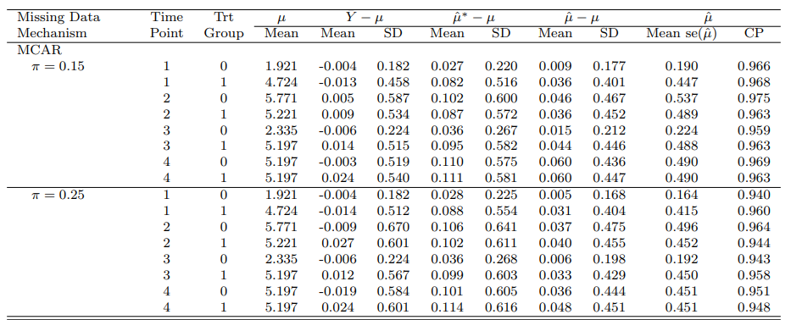
Simulations: Results – MCAR
Group mean estimates for the negative binomial model based on 5,000 simulated samples with n=200 patients per treatment under MCAR missing data mechanisms. ${\hat{μ}}^{∗}$is the mean at the mean covariate estimate, $\hat{μ}$ is the mean estimate under our model, and $μ$ represents the true mean, which differs under each scenario due to the way we simulate our data.

Slide 16
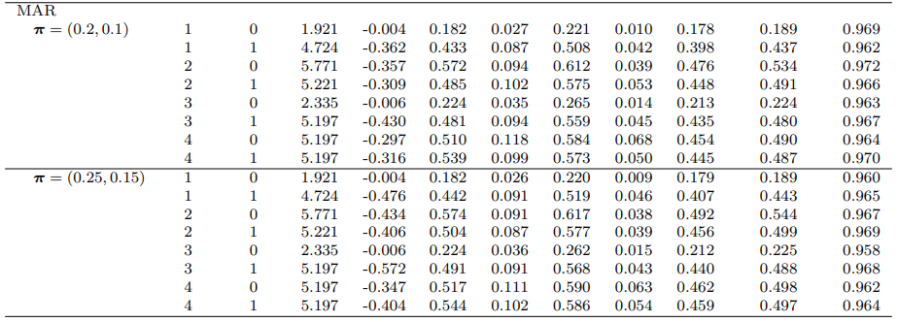
Simulations: Results – MAR
Group mean estimates for the negative binomial model based on 5,000 simulated samples with n=200 patients per treatment under MCAR missing data mechanisms. ${\hat{μ}}^{∗}$is the mean at the mean covariate estimate, $\hat{μ}$ is the mean estimate under our model, and $μ$ represents the true mean, which differs under each scenario due to the way we simulate our data.

Slide 17
Summary

Slide 18
Summary
A real data example assessing hypoglycemia rates
The GLMM modeling the dependence of the repeated measures through the residuals failed to converge
Random effects models are particularly useful in these cases
There are challenges in characterizing the variability of group means estimators when fitting random effects within frequentist GLMMs
We have provided an additional option for analyzing non-normally distributed longitudinal data
The intent of this model is to derive estimates of the group means; however the model can also estimate the treatment effect
Negative binomial model with the log-link: the estimate will be equivalent to the LSMeans estimate
Logistic regression model will NOT
→ The research team must consider the estimand required to answer the question to determine which model is appropriate.

