Slide 1
Tacrolimus (Prograf®) for Lung Transplantation –
Statistical Perspectives
March 22, 2022
Tae Hyun (Ryan) Jung PhD, Senior Statistical Reviewer
Office of Biostatistics, CDER, FDA

Slide 2
Disclaimer
This presentation reflects the views of the presenter and should not be construed to represent FDA’s views or policies.

Slide 3
Outline
Discussions in Prograf Application
Submission Stage
Review Stage
Acquiring Fit-for-Use Patient-Level Data
Assessing RWD Quality
Transparency for RWD Management

Slide 4
Discussions in Submission Stage
Format of Real-World Data are Different from Clinical Trial Data
Various sources and non-uniform format of data
Longer length of variables and labels
No SDTM or ADaM
Limited Guidance
SRTR is a Real-World Data Source
Observational patient-level data
Contains length greater than 8 and 40 characters
No ADSL, ADAE, ADTTE, etc.
Final dataset included all efficacy, safety, and baseline variables

Slide 5
Submission Issues
Data Submission with SAS XPORT (.xpt) version 8
Data Submission through File Transfer Protocol (FTP)
Sending a link to sponsor’s database instead of using Electronic Submission Gateway (ESG)
Code Submission using R Markdown
No SAS codes for data management and analysis
 | Version 5† | Version 8
Variable Name | 8 chars | 32 chars
Variable Label | 40 chars | 256 chars
Variable Length | 200 chars | 32,767 chars
†FDA Study Data Technical Conformance Guide (version 4.5.1, July 2020)

Slide 6
FDA Perspective in Submission
Data Submission with SAS XPORT (.xpt) version 8
Data Submission through File Transfer Protocol (FTP)
Code Submission using R Markdown
Comment: V8 is beneficial for lifting limits of characters. However, it will further increase file size, concerns on no native mechanism for audit trails, referencing source data. Although, it is advertised as nonproprietary, not sure whether it is vendor neutral.
Conclusion: Although FDA cannot require v8, accepting it is different. We decided to accept v8 by reviewing a sample data.
Comment: According to eCTD binding guidance† (section III M), the sponsor must use the FDA electronic submission gateway (ESG) for all submissions that are 10 gigabytes or smaller
†Providing Regulatory Submissions in Electronic Format — Certain Human Pharmaceutical Product Applications and Related Submissions Using the eCTD Specifications (Feb 2020).
Conclusion: FDA does not accept regulatory submissions with File Transfer Protocol (FTP). The FDA ESG enables the secure submission of regulatory information for review and is our preferred method of transmission
Conclusion: FDA agree with the program submission using R markdown. If your programs use R packages, specify alternative packages if applicable.

Slide 7
Discussions in Review Stage
All analyses only include patients who survived until date of discharge
Primary Analysis
Index date: transplant date
Hospitalization: time was included but events were not included in the analysis
Left truncation
Sensitivity Analysis
Index date: discharge date
Hospitalization: time and events were not included in analysis
Left truncation not considered
Modified Analysis (a.k.a. post-hoc analysis)
Index date and hospitalization were equivalent to primary analysis
Did not describe in the Statistical Analysis Plan (SAP)
Shifted 4 early events to Day 10 only in TAC IR + MMF arm of adult population

Slide 8
Review Issues
TAC IR + MMF in adult population
Hospitalization
Primary analysis
Transplant
Date
Discharge
Date
Day 4
Day 5
Day 7
Sensitivity analysis
Discharge
Date
Day 4
Day 5
Day 7
Hospitalization
Post hoc analysis
Transplant
Date
Discharge
Date
Day 10

Slide 9
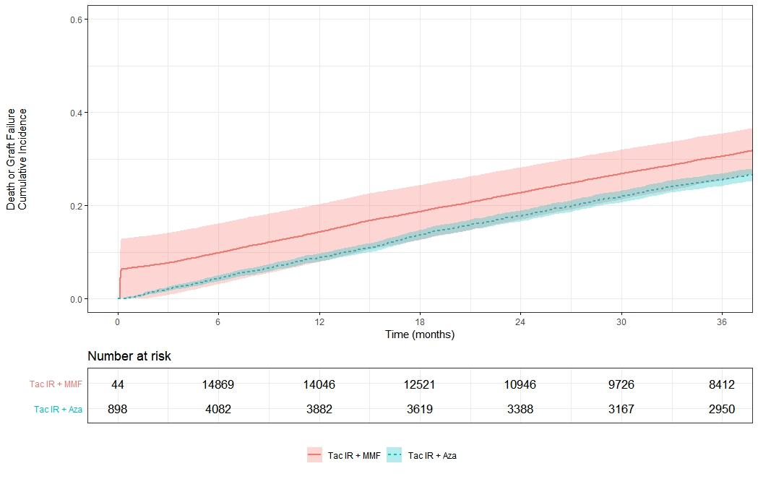
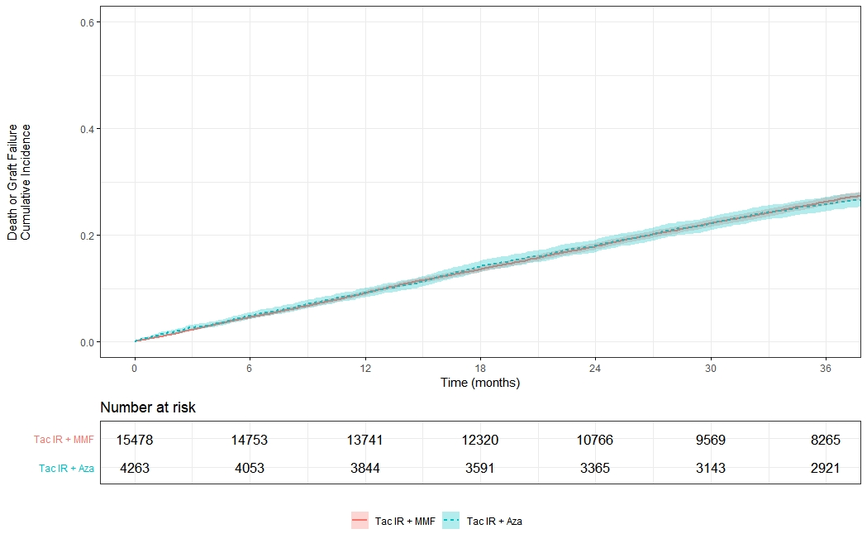
Review Issues – Non-Robust Estimate
Primary analysis
Sensitivity analysis
Index date: Transplant date
Excludes events during hospitalization
Index date: Discharge date
Exclude hospitalization period
14% incidence or 86% survival
9% incidence or 91% survival

Slide 10
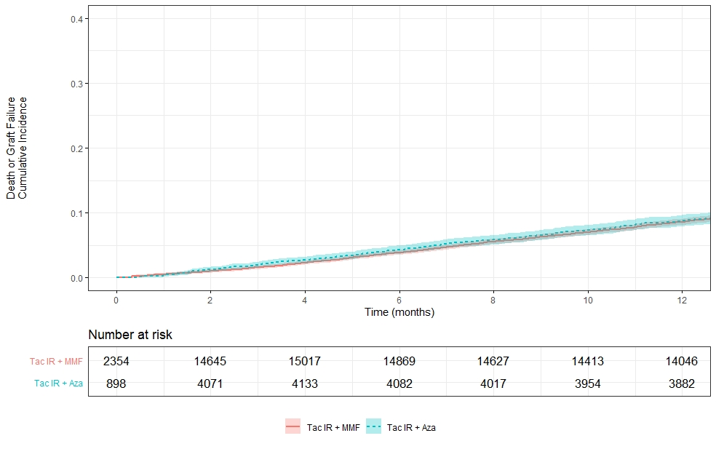
Review Issues – Non-Robust Estimate
Post-hoc analysis
Cumulative Incidence (95% CI) |  | TAC IR + MMF N = 15478
Outcome | Year | Primary | Sensitivity | Post-hoc
Composite | 1 | 14.2 (7.8, 20.2) | 9.1 (8.6, 9.5) | 8.6 (8.1, 9.1)
Index date: Transplant date
Excludes events during hospitalization
Note: Four events are shifted
9% incidence or 91% survival

Slide 11
Statistical Perspectives in Review
Using Post-hoc Analysis as Primary Analysis
In primary analysis, small risk set led to non-robust estimate and 86% survival
Post-hoc analysis manually shifted the four early events that occurred before day 7 to day 10
Demonstrated stable estimate with 91% survival
Not specified in the Statistical Analysis Plan
Conducted only in TAC IR + MMF arm of the adult population
FDA did not agree to the post-hoc analysis and recommend sponsor to use discharge date as index date (sensitivity analysis)
Not sure whether the four events are true or error
Arbitrary to push these event to Day 10 to increase the risk set on purpose
Method is modified after looking the primary results
Treatment group was defined at discharge, so using discharge date is suitable
One-year post-discharge graft survival was 91%

Slide 12
Acquiring Fit-for-Use Patient-Level Data

Slide 13
Assessing Real-World Data
Relevance and Reliability of the Underlying RWD Should be Considered
Relevance
Capture of relevant data on exposure, outcomes, and covariates
Sufficient numbers of representative patients
Reliability
Completeness
Accuracy
Provenance
Traceability
Real-World Data: Assessing Electronic Health Records and Medical Claims Data To Support Regulatory Decision-Making for Drug and Biological Products
Draft Guidance Published in September 2021

Slide 14
Data Quality in Prograf Application
The SRTR SAF contains data on ALL lung transplant candidates, recipients and donors in the US from Oct 1987 onward
The sponsor identified 15,478 adult and 450 pediatric patients receiving TAC IR + MMF during primary lung transplant from Jan 1st, 1999, to Dec 31st, 2017
Sufficient to demonstrate the outcome of TAC IR + MMF
Overall quality of patient-level data was acceptable
Granularity of the data
Adjudication with supplementary data source
No concerns on relevance
Captured all necessary information, adjudication for death outcomes
Less concerns on reliability
Low missing %, most of the variables were coded corrrectly.
However, some length of hospitalization records appear to be not plausible

Slide 15
Data Quality in Prograf Application
Length of Hospitalization in TAC IR + MMF and TAC IR + AZA
Possible Reasons for Unusual Distribution of Length of Hospitalization
Data entry errors, where transplant center staff provided the same date for transplant and discharge
Patient was discharged from inpatient service to another unit and transplant center staff entered that date

Slide 16
RWD Management in Prograf Application
SRTR provide data as SAS files (“sas7bdat” extension)
SAS 9.4 (SAS/STAT 15.1) was used to read SAF sas7bdat files and convert them to csv files
Majority of programming was performed in R-Markdown (.Rmd)
Read the CSV files into R to create dataset of interest
R-Markdown provided both the R code as well as comments and intermittent results
Provided transparent documentation of the process
Efficient in execution
Analysis Data Reviewer Guide (ADRG) and “looks and feels” like Define Document were provided
sas7bdat
csv
.RData

Slide 17
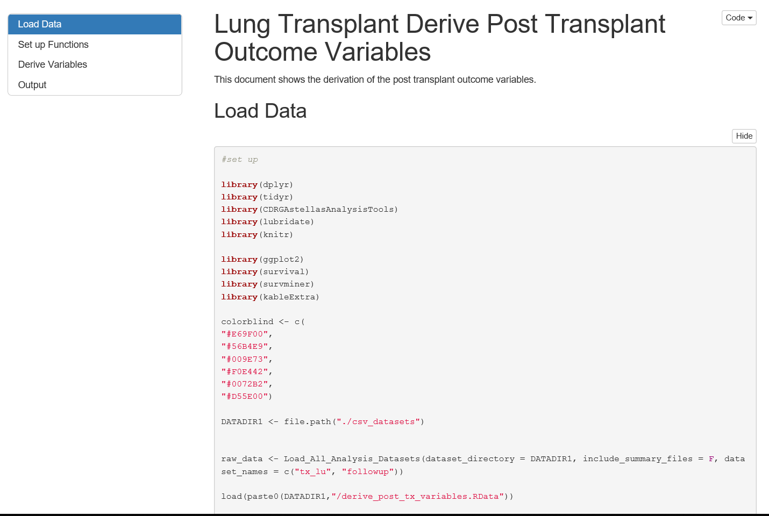
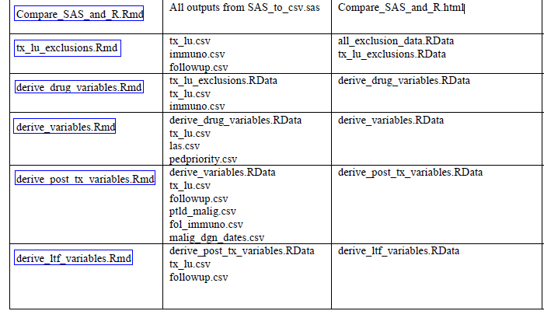
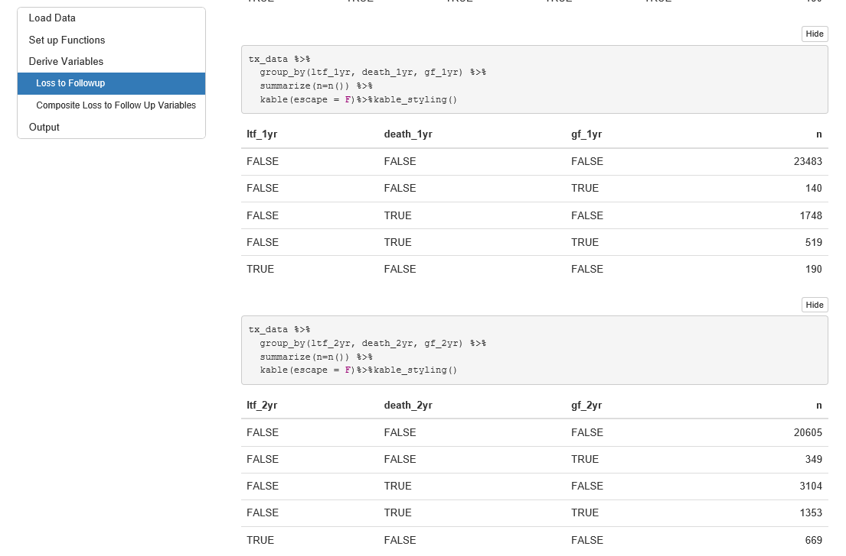
RWD Management in Prograf Application
Processes and Programs

Slide 18
Perspectives on Patient-Level Data
Getting Fit-For-Use Patient-Level Data is Essential
Several attributes of the data need to be reviewed
Provide sample data at Pre-NDA stage
Lesson Learned: RWD Transparency
RWD sources are various and non-uniform
Provide all necessary documents to aid review process
Submit all relevant analytic packages
Complex features are unnecessary and may not be compatible

