Slide 1
Propensity score matched augmented controls in randomized clinical trials: A case study
Junjing Lin [Takeda], Margaret Gamalo [Pfizer], Ram Tiwari [BMS]

Slide 2
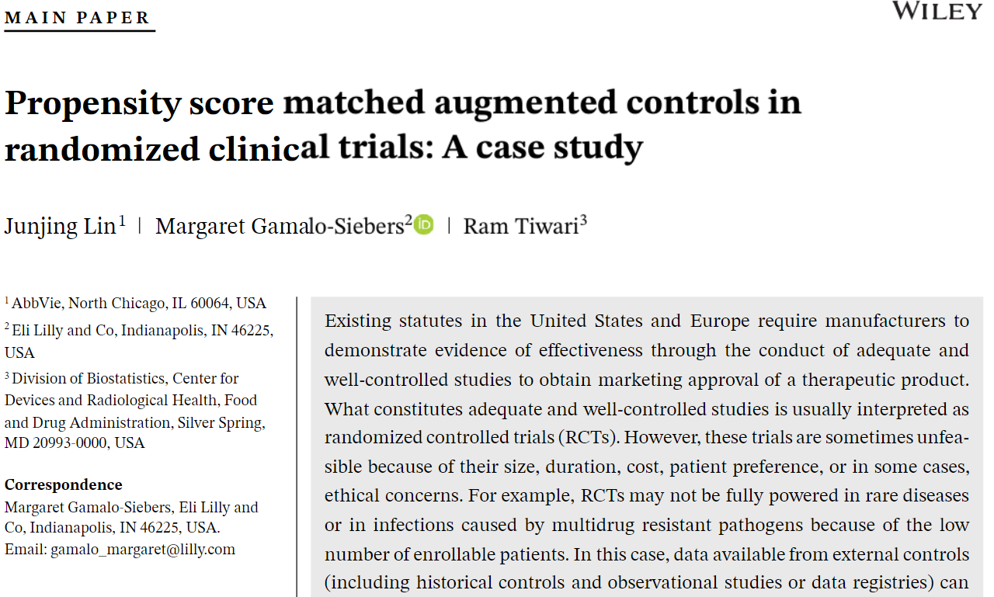

Slide 3
Expanding Real World Evidence in Pre-market Approvals
RWE alone
Update approved medical product labeling for effectiveness claims
Post-marketing commitments
RWE + Single Arm trial
Serve as a data source for an external control in confirmatory trials
for initial indication in limited instances

Slide 4
What Constitutes Externally Controlled Trials?
Studies involving data from a predefined clinical investigation, wherein treatment in a study arm is assigned according to a protocol, and treatment in a control arm is observed using predefined “external” patient-level data from either:
(1) a trial arm of a different interventional study, or (2) defined population from a non-interventional study or a database (RWD)
Studies that use external control data to supplement the control arm in a randomized trial
Not considered as external control:
(1) population-level estimates as a comparator, (2) patients serving as their own controls in analyses; (3) design and analysis of a natural history study as a stand-alone activity; (4) validation of linking real-world data to a regulatory endpoint.

Slide 5
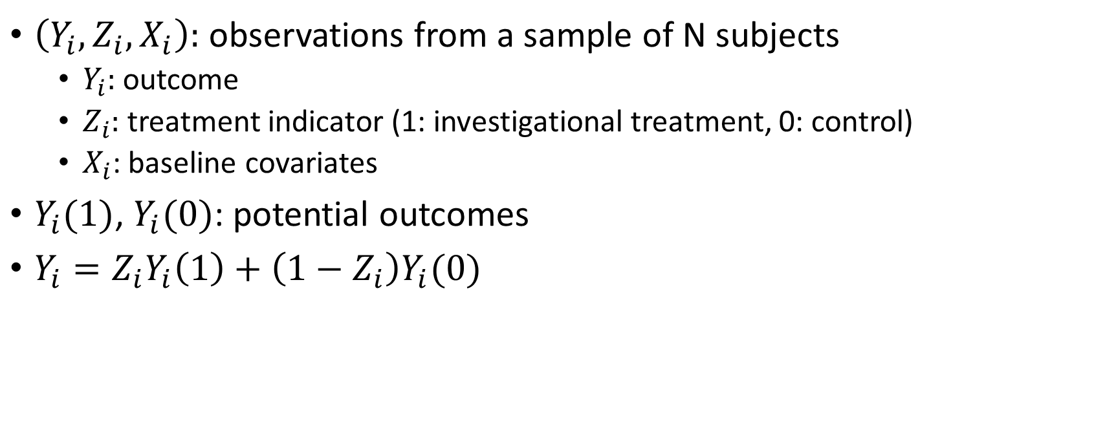
Potential Outcomes Framework
$\left(Y_{i}, Z_{i}, X_{i}\right):$ observations from a sample of N subjects
  $Y_{i}:$ outcome
  $Z_{i}:$ treatment indicator (1: investigational treatment, 0: control)
  $X_{i}$: baseline covariates
$Y_{i}(1)$, $Y_{i}(0)$: potential outcomes
$Y_{i}=Z_{i}Y_{i}\left(1\right)+\left(1−Z_{i}\right)Y_{i}(0)$

Slide 6
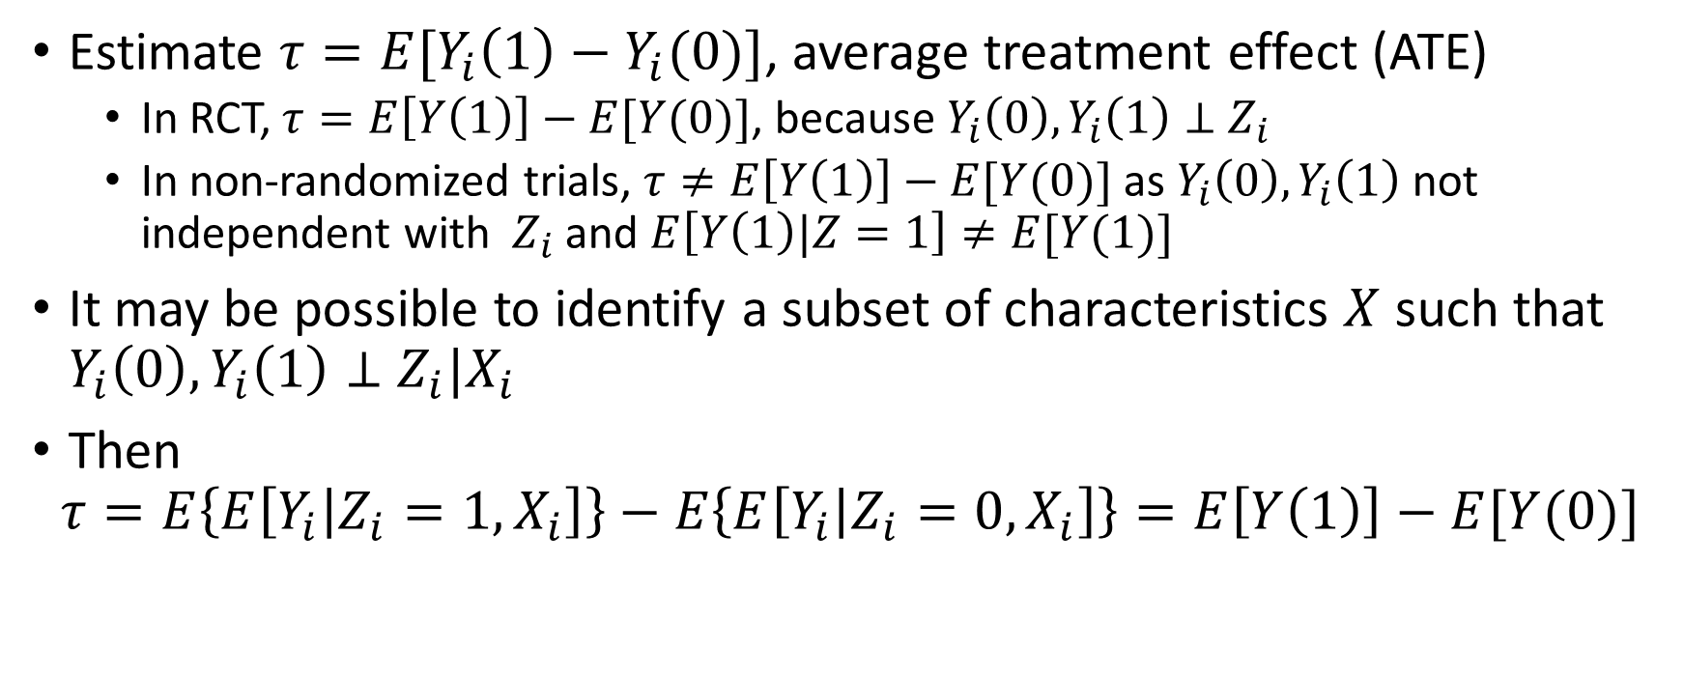
Potential Outcomes Framework
Estimate $τ=E[Y_{i}\left(1\right)−Y_{i}(0)]$, average treatment effect (ATE)
  In RCT, $τ=E\left[Y\left(1\right)\right]−E[Y(0)]$, because $Y_{i}\left(0\right),Y_{i}\left(1\right)⊥$ $Z_{i}$
  In non-randomized trials, $τ≠E\left[Y\left(1\right)\right]−E[Y(0)]$ as $Y_{i}\left(0\right),Y_{i}\left(1\right)$ not independent with $Z_{i}$ and $E\left[Y\left(1\right)|Z=1\right]≠E[Y(1)]$
It may be possible to identify a subset of characteristics $X$ such that $Y_{i}\left(0\right),Y_{i}\left(1\right)⊥$ $Z_{i}|X_{i}$
Then
$$τ=E\left\{E\left[Y_{i} | Z_{i}=1, X_{i}\right]\right\}−E\left\{E\left[Y_{i} | Z_{i}=0, X_{i}\right]\right\}=E\left[Y\left(1\right)\right]−E[Y(0)]$$

Slide 7
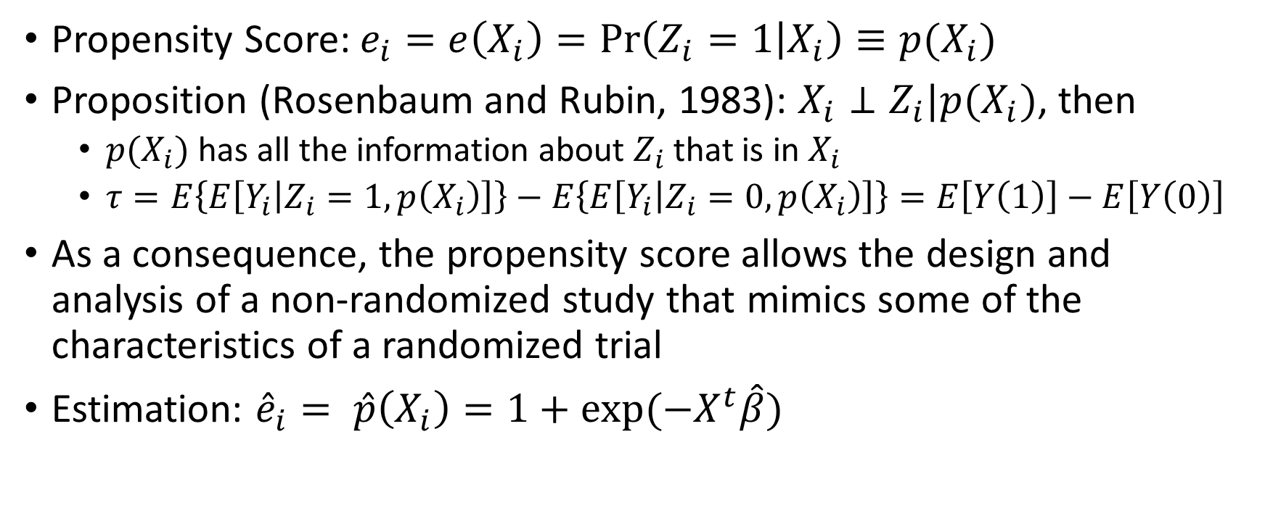
Propensity Score
Propensity Score: $e_{i}=e\left(X_{i}\right)=\operatorname{Pr}\left(Z_{i}=1 | X_{i}\right)≡p(X_{i})$
Proposition (Rosenbaum and Rubin, 1983): $X_{i}⊥Z_{i}|p(X_{i})$, then
  $p(X_{i})$ has all the information about $Z_{i}$ that is in $X_{i}$
  $τ=E\left\{E\left[Y_{i} | Z_{i}=1, p\left(X_{i}\right)\right]\right\}−E\left\{E\left[Y_{i} | Z_{i}=0, p\left(X_{i}\right)\right]\right\}=E\left[Y\left(1\right)\right]−E\left[Y\left(0\right)\right]$
As a consequence, the propensity score allows the design and analysis of a non-randomized study that mimics some of the characteristics of a randomized trial
Estimation: ${\hat{e}}_{i}= \hat{p}\left(X_{i}\right)=1+\exp{(−X^{t}\hat{β})}$

Slide 8
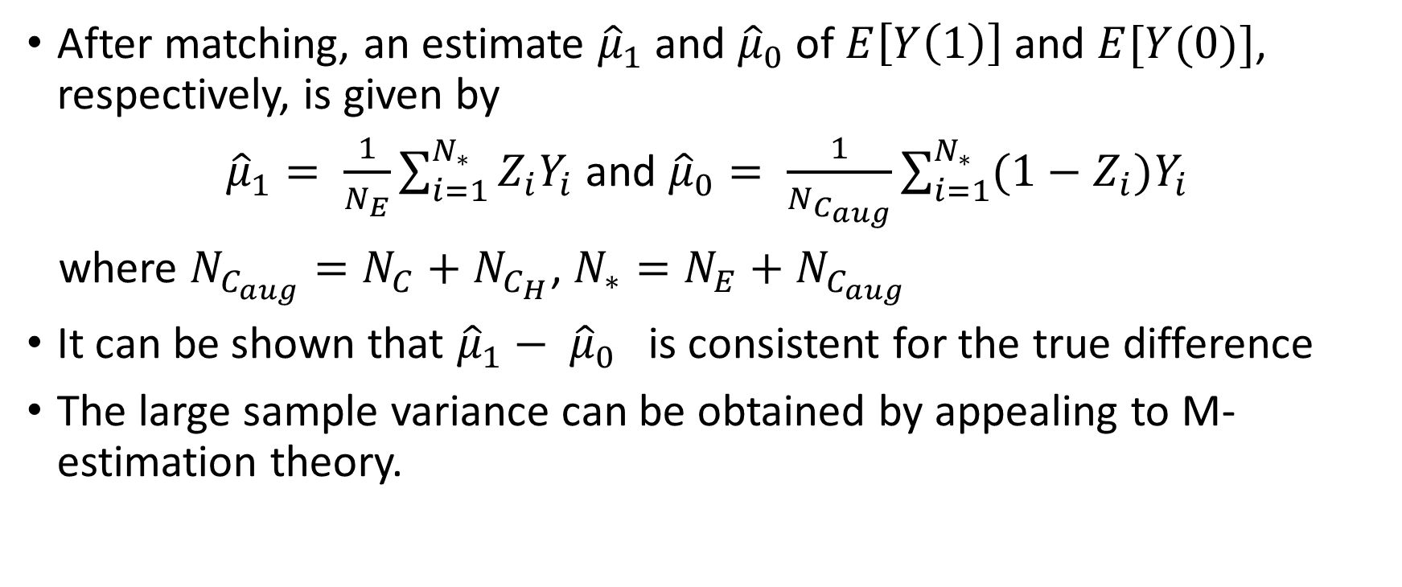
Estimates of Average Treatment Effect
After matching, an estimate ${\hat{μ}}_{1}$ and ${\hat{μ}}_{0}$ of $E\left[Y\left(1\right)\right]$ and $E[Y(0)]$, respectively, is given by
${\hat{μ}}_{1}= \frac{1}{N_{E}}\sum_{i=1}^{N_{∗}}{Z_{i}Y_{i}}$ and ${\hat{μ}}_{0}= \frac{1}{N_{C_{aug}}}\sum_{i=1}^{N_{∗}}{(1−Z_{i})Y_{i}}$
where $N_{C_{aug}}=N_{C}+N_{C_{H}}$, $N_{∗}=N_{E}+N_{C_{aug}}$
It can be shown that ${\hat{μ}}_{1}− {\hat{μ}}_{0}$ is consistent for the true difference
The large sample variance can be obtained by appealing to M-estimation theory.

Slide 9

Scheme 1: Pair-matching
Scores of investigational group in RCT, $T$, are pair-matched with scores of the external control group, $H$.
The number of needed matched observations, $N_{C_{H}}$, are randomly selected from the pair-matched external controls

Slide 10

Scheme 2: Nearest-neighbor matching adjusted by caliper
Scores of investigational group in RCT, $T$, are used to find the nearest control (concurrent and external) subjects in terms of estimated propensity scores.
A caliper that confines the distance of the neighborhood are adjusted until the desired number of valid external controls, $H$, are selected.

Slide 11
Scheme 1.1: Stratified Pair-matching

Slide 12
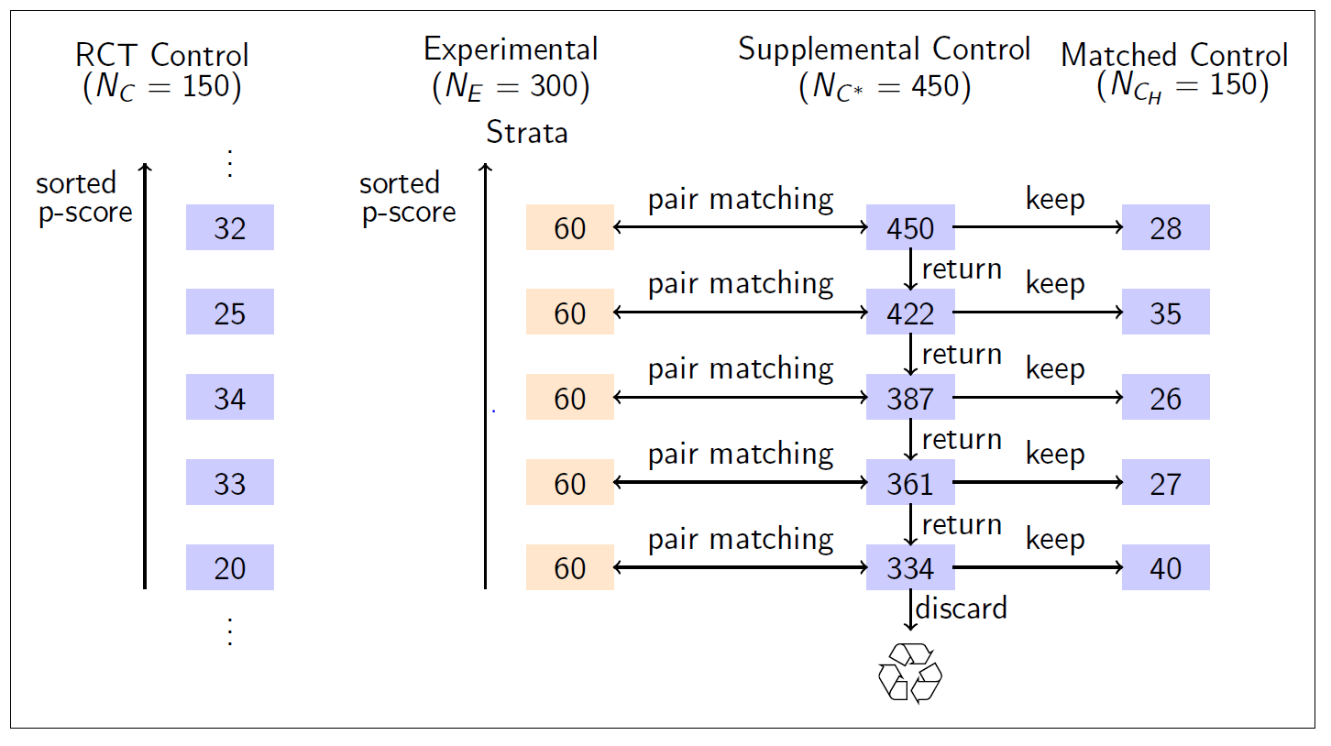
Scheme 1.2: Stratified pair-matching, need-based

Slide 13
Scheme 2.2: Stratified NN-matching, need-based

Slide 14
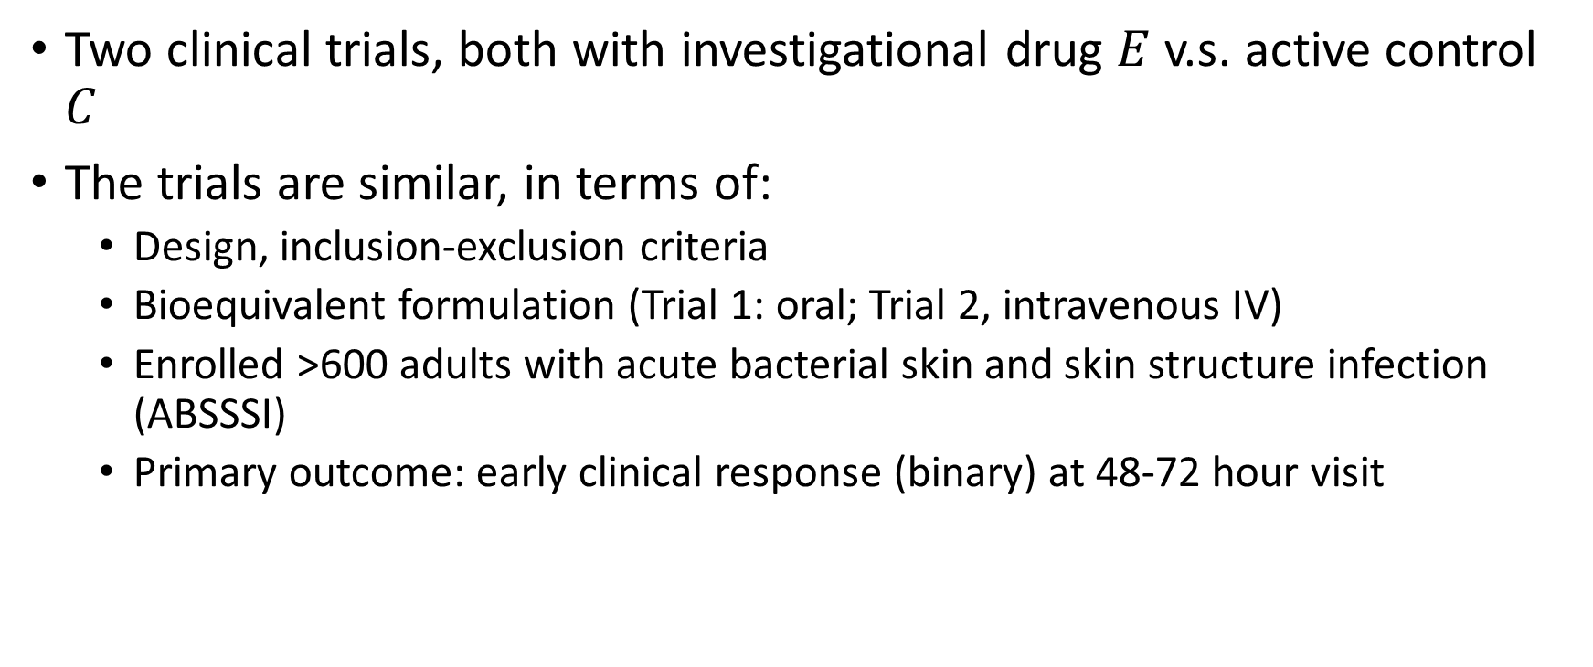
Simulation Experiments: Data
Two clinical trials, both with investigational drug $E$ v.s. active control $C$
The trials are similar, in terms of:
  Design, inclusion-exclusion criteria
  Bioequivalent formulation (Trial 1: oral; Trial 2, intravenous IV)
  Enrolled >600 adults with acute bacterial skin and skin structure infection (ABSSSI)
  Primary outcome: early clinical response (binary) at 48-72 hour visit

Slide 15
Data
The enrolled subjects between the two groups within each trial were well balanced in covariates, e.g.,
  Demographics, some medical history, fever,
  Type, anatomical site of infection
  Prior medications or procedures that have potential impact
  Baseline signs and symptoms
However, between trial balance is not achieved, e.g.,
  In Trial 1, about 41% had cellulitis/erysipelas, about 30% ad infected wound and another 30% have major cutaneous abscess,
  In Trial 2, about 50% had cellulitis/erysipelas, 30% had infected wound and 20% had major cutaneous abscess

Slide 16
Construct Asymmetrically Randomized Data
Repeat 1000 times

Slide 17
Overlaid histograms of estimated propensity scores

Slide 18
Covariate Balance Check (Scheme 1)

Slide 19
Covariate Balance Check (Scheme 2)

Slide 20
Distribution of Estimates of Treatment Effect

Slide 21
Comparison of Matching Schemes

Slide 22
Comparison of Borrowing Sizes

Slide 23
Discussion
While RCTs are ideal, there is interest to look for innovative ways in areas with high unmet need
One approach is a design that relies on historical or supplemental control for data augmentation
  The matched samples come from similar populations, characterized by pre-treatment factors
  The sample selection method does not rely on outcomes (cherry-picking avoided), and can be pre-specified before a trial is conducted
  Partially controlled trials provide advantage of RCT and the use of external control.

