Slide 1

An investigation to improve nonlinear mixed-effects approach for EC50 estimation based on multi-donor dose-response data
Weiliang Qiu¹*, Cheng Wenren¹*, Tamara Slavnic², Els Pattyn¹, Luc Essermeant¹
Non-Clinical Efficacy & Safety
Early Development & Research
Biostatistics & Programming, Sanofi
Photo credits: ©
PSI Pre-Clinical SIG Webinar
¹Non-Clinical Efficacy & Safety, Early Development & Research, Biostatistics & Programming, Sanofi
²IT&M Stats
*Presenters

Slide 2
Discloser
Weiliang Qiu, Els Pattyn, Cheng Wenren and Luc Essermeant are Sanofi employees and may hold shares and/or stock options in the company.
Tamara Slavnic has nothing to disclose.

Slide 3
Outline
Background
Improved approach to estimate EC50
Real data analysis and simulation study
Summary
Future work
R package saemix4PL demonstration

Slide 4
Background
Dose–response relationship is important in assessing the efficacy and potency of a compound
    Potency: amount of a compound that is needed to produce a given effect
    e.g., EC50/IC50 (the concentration of compound that induces a response halfway between the baseline and maximum)
One donor with 3 replicates per concentration
Notes:
dose_response_curves_dat1.pdf (page 4)

Slide 5
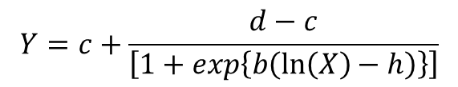
4-parameter logistic (4-PL) model
$$Y=c+\frac{d−c}{\left[1+exp\left\{b\left(\ln\left(X\right)−h\right)\right\}\right]}$$
Response ‘Y’
Upper asymptote ‘d’
Slope factor ‘b’
Y: Response
X: Dose
b : Slope factor
c : Lower asymptote
d : Upper asymptote
h : the logarithm of the concentration at the inflexion point
    log (EC50 relative)
Lower asymptote ‘c’
EC50 relative ‘e=exp(h)’
Dose ‘X’
Notes:
report_dat1.rtf

Slide 6
Multi-donor dose-response data
To capture biological variability, several donors are often used to evaluate dose-response relationship
    Each donor has several (e.g., 3 or 4) replicates at each dose
Question
    How to estimate overall EC50 and its 95% CI based on multi-donor dose-response data?
Notes:
report_dat1.rtf
dose_response_curves_dat1.pdf

Slide 7



Existing methods in literature
Naïve pool method (Naïve)
  Pool all replicates to one pseudo donor and fit one 4PL model
Two-stage approach (TS)
  Use sample mean of individual estimates ${\hat{h}}_{i}, i=1, …, n$ as final estimate
Meta-analysis approach (meta)
  Use meta-analysis to aggregate individual estimates
  ${\hat{h}}_{i}=h_{i}+ε_{i},ε_{i}\sim N\left(0, σ_{i}^{2}\right), i=1, …, n$
  $h_{i}\sim N\left(h, τ^{2}\right)$
Nonlinear mixed-effects model (nlme)
$$Y_{ijk}=f\left(x_{j}|φ_{i}^{\left(b\right)},φ_{i}^{\left(c\right)},φ_{i}^{\left(d\right)},φ_{i}^{\left(h\right)}\right)+ε_{ijk},i=1, …, n, j=1,…,M,k=1,…,K_{j},$$
$$f\left(x_{j}|φ_{i}^{\left(b\right)},φ_{i}^{\left(c\right)},φ_{i}^{\left(d\right)},φ_{i}^{\left(h\right)}\right)=φ_{i}^{\left(c\right)}+\frac{φ_{i}^{\left(d\right)}−φ_{i}^{\left(c\right)}}{1+exp\left[φ_{i}^{\left(b\right)}\left(log\left(x_{j}\right)−φ_{i}^{\left(h\right)}\right)\right]}$$
$$φ_{i}^{∗}=\left(\begin{aligned}\begin{matrix}φ_{i}^{\left(b\right)} \\ φ_{i}^{\left(c\right)} \\ φ_{i}^{\left(d\right)}\end{matrix} \\ φ_{i}^{\left(h\right)}\end{aligned}\right)=\left(\begin{aligned}\begin{matrix}β^{(b)} \\ β^{(c)} \\ β^{(d)}\end{matrix} \\ β^{(h)}\end{aligned}\right)+\left(\begin{matrix}Λ_{11} & 0 & 0 & 0 \\ 0 & Λ_{22} & 0 & 0 \\ 0 & 0 & Λ_{33} & 0 \\ 0 & 0 & 0 & Λ_{44}\end{matrix}\right)\left(\begin{aligned}\begin{matrix}b_{i}^{\left(b\right)} \\ b_{i}^{\left(c\right)} \\ b_{i}^{\left(d\right)}\end{matrix} \\ b_{i}^{\left(h\right)}\end{aligned}\right)=:β^{∗}+Λb_{i}^{∗},$$
$$b_{i}^{∗}\overset{\text{i}\text{.}\text{i}\text{.}\text{d}\text{.}}{\sim } N\left(0, Ω\right),ε_{ijk}\overset{\text{i}\text{.}\text{i}\text{.}\text{d}\text{.}}{\sim } N\left(0, σ^{2}\right)$$
$φ_{i}^{\left(b\right)}$ = slope factor
$φ_{i}^{\left(c\right)}$ = lower asymptote
$φ_{i}^{\left(d\right)}$ = upper asymptote
$φ_{i}^{\left(h\right)}$ = log(EC50)
$n$ = # of subjects;
$M$ = # of concentrations;
$K_{j}$ = # of replicates for $j$-th concentration

Slide 8
Jiang and Kopp-Schneider (2014)
Systematically compared meta-analysis approach and nonlinear mixed-effects approach via simulation study
Main results
  Nonlinear mixed-effects approach has issue of convergence failure, while meta-analysis approach has no such issue
  meta-analysis has similar performance to nonlinear mixed-effects approach in terms of
    bias
    MSE
    Coverage probability of 95% confidence interval
    mean length of 95% confidence interval

Slide 9
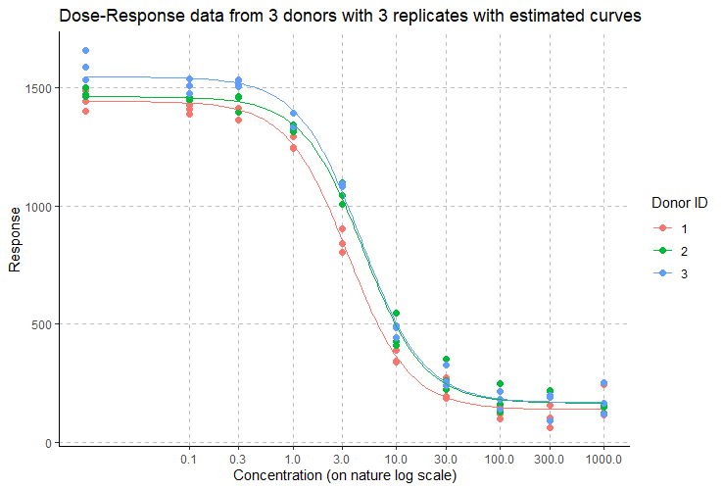
Limitations of Jiang and Kopp-Schneider (2014)
The number of replicates (6 or 12 per concentration level) is much larger than the real data analysis in in-vitro studies (2 or 3 per concentration level)
Data were very “clean” (usually real data are much messier)
Did not investigate ways to alleviate convergence failure issue of nonlinear mixed-effects approach
Notes:
Rplot_3_donors_3_rep_4pl.pdf
dose_response_curves_dat1.pdf (page 32)

Slide 10
Convergence failure issue is well-known for general non-linear mixed effects model
Reasons for convergence failure
  Overparameterization in the mixed-effects 4-PL model when using a general variance-covariance matrix for 4 random effects (Jiang and Kopp-Schneider, 2014)
  Poor starting values, practical lack of identifiability with the specific available data, or other unknown factors (Harring and Liu, 2016)
  Model nonlinearity (Comets et al. 2017; Plan et al., 2012)
Possible Solutions
  Use several sets of starting values (Harring and Liu, 2016)
    Challenge: Need to have good model selection criteria
  Use stochastic approximation EM (SAEM) algorithm (Comets, et al. 2017), instead of linearization, to obtain model parameter estimates
  Note that above 2 possible solutions have not been applied to multi-donor dose-response data, to the best of our knowledge

Slide 11
Our proposals
Alleviate convergence failure issue of nonlinear mixed-effects approach by
  Using multiple starting values, and
  Using SAEM to obtain parameter estimates

Slide 12


Model selection criteria for nonlinear mixed effects approach
Minimize sum of absolute distances to min and max log(dose) from estimated log(EC50)
  $dist=\left|\hat{h}−L\right|+\left|\hat{h}−U\right|$
Minimize mean square distance between residuals and quantiles of N(0, 1)
Minimize BIC
L = Min(log(dose))
U = Max(log(dose))
$$\hat{h}$$
Notes:
dose_response_curves_dat1.pdf (page 25)

Slide 13
Simulation scenarios
Simulate data from nonlinear mixed-effects model with general variance-covariance matrix for b, c, d, h
21 scenarios
  Number of donors (n = 3, 4, 5, 6, 7, 8, 9)
  Number of replicates per donor (k = 2, 3, 4)
8 concentration levels: 1.22e-12, 4.88e-12, 1.95e-11, 7.81e-11, 3.13e-10, 1.25e-09, 5e-09, 2e-08
Each scenario has 1000 simulated datasets
  21,000 datasets in total

Slide 14
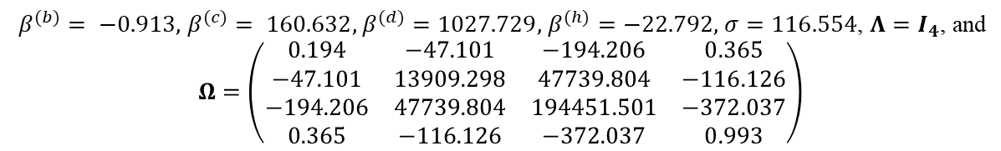
True parameter settings
Real dataset used to get true parameter values
A simulated dataset
8 donors
3 replicates per donor
8 concentration levels: 1.22e-12, 4.88e-12, 1.95e-11, 7.81e-11, 3.13e-10, 1.25e-09, 5e-09, 2e-08
b: slope factor
c: lower asymptote
d: upper asymptote
h: log(EC50)
$β^{(b)}= −0.913,$ $β^{(c)}= 160.632,$ $β^{(d)}=1027.729,$ $β^{(h)}=−22.792,$ $σ=116.554$, $Λ=I_{4}$, and
$$Ω=\left(\begin{matrix}0.194 & −47.101 & −194.206 & 0.365 \\ −47.101 & 13909.298 & 47739.804 & −116.126 \\ −194.206 & 47739.804 & 194451.501 & −372.037 \\ 0.365 & −116.126 & −372.037 & 0.993\end{matrix}\right)$$
Notes:
dose_response_curves_dat1.pdf (page 32)
dose_response_curves_simDat1.pdf (page 32)

Slide 15
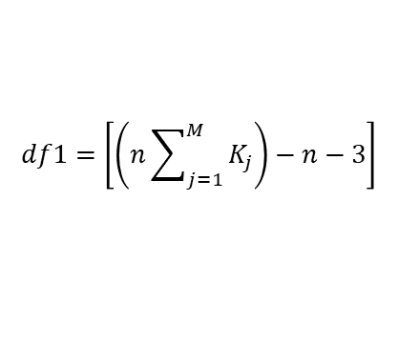

18 methods to be compared
Two-stage approach (TS)
Weighted fixed-effects meta-analysis (FE)
Meta-analysis approach (meta)
  8 random-effects meta-analysis models were used ("DL", "HE", "SJ", "ML", "REML", "EB", "HS", "HSk")
  Knapp and Hartung's (2003) method used to construct 95% confidence interval
nlme
  nlmeMLHEonly
  nlmeREMLHEonly
  nlmeML5ini
  nlmeREML5ini
saemix
  saemixDiagHEonly
  saemixFullHEonly
  saemixDiag5ini
  saemixFull5ini
95% CI based on nlme internal function, t test with df1, or t test with df2;
Assuming diagonal variance-covariance matrix of random effect
$$df1=\left[\left(n\sum_{j=1}^{M}{K_{j}}\right)−n−3\right]$$
$$df2=\left[n−rank\left(Λ\right)\right]$$
95% CI based on saemix internal function, t test with df1, or t test with df2
ML: LME-ML approximation of log-likelihood
REML: LME-REML approximation of log-likelihood
5ini: 5 sets of initial values (naïve, TS, FE, HE, SJ)
HEonly: Only one set of initial values obtained by HE meta-analysis
Diag: Assuming diagonal variance-covariance matrix of random effect
Full: Assuming general variance-covariance matrix of random effect

Slide 16
Results for real data
Notes:
dose_response_curves_dat1.pdf (page 32)
combine_plots_realDat1_Els_v3.pdf

Slide 17
Results for simulated datasets
N=18
N=18
N=3
N=12
N=7
N=139
N=18
N=18
N=2266
N=154
N=2370
N=8
N=8676
N=788
N=3
Total number of simulated datasets = 21,000
Notes:
plots_results_comparison_simData_1_full_v10.pdf (page 40)

Slide 18
saemixFull5ini
saemixFullHEonly
saemixFull5ini
saemixFullHEonly
HE
saemixDiag5ini
saemixDiag5ini
HE
saemixDiagHEonly
saemixDiagHEonly
Notes:
plots_results_comparison_simData_1_full_v10.pdf (page 7, page 15)

Slide 19
nlmeMLHEonly.df2/
nlmeREMLHEonly.df2
saemixFullHEonly.df2/
saemixDiagHEonly.df2
saemixFullHEonly.df2
saemixFull5ini.df2
nlmeML5ini.df2/
nlmeREML5ini.df2
saemixFull5ini.df2/
saemixDiag5ini.df2
SJ
nlmeMLHEonly.df2/
nlmeREMLHEonly.df2
saemixDiag5ini.df2
nlmeML5ini.df2/
nlmeREML5ini.df2
HE
saemixDiagHEonly.df2
Notes:
plots_results_comparison_simData_1_full_v10.pdf (page 31, page 23)

Slide 20
Summary of Results
Nonlinear mixed-effects model approach
  Using multiple starting values alone or using saemix alone could not improve mixed-effects approach satisfactorily
  saemixFull5ini can substantially reduce convergence failures and reduce estimation bias
Comparing nonlinear mixed-effects model approach and meta-analysis approach
  saemixFull5ini seems better in terms of median bias
  For large sample size nDonor ≥ 7, saemixFull5ini seems better in terms of CP
  For small sample size nDonor < 6, meta-analysis approach seems better in terms of CP
TS approach
  Relatively small absolute bias, great coverage of 95% CI
  Relatively large median squared error and length of 95% CI

Slide 21

Future Work
Investigate degree of freedom when constructing 95% CI for nlme and saemix
Relax the homoscedasticity assumption $ε_{ijk}\sim N\left(0,σ^{2}\right)$ to allow heterogeneity e.g., $ε_{ijk}\sim N\left(0, σ_{j}^{2}\right)$
Investigate Bayesian methods
Investigate if saemix could be used in comparing EC50 between 2 or more groups

Slide 22
Acknowledgement
PSI Preclinical SIG committee
Ezgi Tanriver-Ayder
Emily Stanton
Els Pattyn
Tamara Slavnic
Luc Essermeant
Veronique Onado
Rene Kubiak

Slide 23
References
Baty F, Ritz C, Jensen SM, Kern L, Tamm M, Brutsche MH. Multimodel inference applied to oxygen recovery kinetics after 6-min walk tests in patients with chronic obstructive pulmonary disease. PLoS One. 2017;12(11):e0187548
Celeux, G. and Diebolt, J. (1985) The SEM algorithm: A probabilistic Teacher algorithm derived from the EM Algorithm for the mixture problem, Computational Statistics Quarterly, 2, 73-82
Comets, E., Lavenu, A., & Lavielle, M. (2017). Parameter Estimation in Nonlinear Mixed Effect Models Using saemix, an R Implementation of the SAEM Algorithm. Journal of Statistical Software, 80(3), 1–41
Delyon B, Lavielle M, Moulines E (1999). “Convergence of a Stochastic Approximation Version of the EM Algorithm.” The Annals of Statistics, 27(1), 94–128
Dvoretzky A. On stochastic approximation. In Proceedings of the Third Berkeley Symposium on Mathematical Statistics and Probability. University of California Press, 1956
European Pharmacopoeia 7.0 (Section 5.3). 01/2008:50300
Harring, Jeffrey R., and Junhui Liu. "A comparison of estimation methods for nonlinear mixed-effects models under model misspecification and data sparseness: A simulation study." Journal of Modern Applied Statistical Methods 15.1 (2016): 27
Jeffrey N. Jonkman & Kurex Sidik (2009) Equivalence Testing for Parallelism in the Four-Parameter Logistic Model, Journal of Biopharmaceutical Statistics, 19:5, 818-837
Jiang X, Kopp-Schneider A. Summarizing EC50 estimates from multiple dose-response experiments: a comparison of a meta-analysis strategy to a mixed-effects model approach. Biom J. 2014 May;56(3):493-512
Jiang X, Kopp-Schneider A. Statistical strategies for averaging EC50 from multiple dose-response experiments. Arch Toxicol. 2015 Nov;89(11):2119-27
Knapp, G., & Hartung, J. (2003). Improved tests for a random effects meta-regression with a single covariate. Statistics in Medicine, 22(17), 2693–2710. https://doi.org/10.1002/sim.1482
Plan, Elodie L., et al. "Performance comparison of various maximum likelihood nonlinear mixed-effects estimation methods for dose–response models." The AAPS journal 14.3 (2012): 420-432
Sheiner LB, Beal SL. Evaluation of methods for estimating population pharmacokinetics parameters. I. Michaelis-Menten model: routine clinical pharmacokinetic data. J Pharmacokinet Biopharm. 1980 Dec;8(6):553-71
The United States Pharmacopeial Convention Section <111>: Design and Analysis of Biological Assays / Biological Tests
Vajjha K, Trager B, Shinnar A, Pestun V. Formalization of a Stochastic Approximation Theorem. 13th International Conference on Interactive Theorem Proving (ITP 2022). 237: 31:1--31:18. https://doi.org/10.4230/LIPIcs.ITP.2022.31
Williams, James D. et al. A statistical method to account for plate-to-plate variability in multiple-plate bioassays. Biopharm International 16 (2003): 44-54

Slide 24
Backup Slides

Slide 25
Notes:
compare_3Approach_raw_results_simData_1_full_v9.pdf (page 4)

Slide 26
Summary table of min, Q1, median, Q3, max, nBelow, nAbove, and nNA for 21,000 log(EC50) estimates
method | nBelow | nAbove | nNA | min | Q1 | Median | Q3 | max
TS | 1687 | 726 | 0 | -4291.97 | -23.68 | -23.01 | -22.26 | 7181.16
FE | 10 | 6 | 18 | -91.00 | -23.79 | -23.40 | -23.04 | -0.85
DL | 644 | 170 | 18 | -4290.86 | -23.48 | -23.17 | -22.86 | 7229.88
HE | 1168 | 326 | 3 | -4291.97 | -23.68 | -23.28 | -22.93 | 7184.10
SJ | 1231 | 349 | 0 | -4291.97 | -23.47 | -23.15 | -22.82 | 7184.10
ML | 1114 | 310 | 12 | -4291.97 | -23.50 | -23.18 | -22.87 | 7184.69
REML | 1155 | 327 | 7 | -4291.97 | -23.48 | -23.16 | -22.85 | 7184.10
EB | 1223 | 348 | 139 | -4291.97 | -23.50 | -23.17 | -22.85 | 7184.10
HS | 584 | 139 | 18 | -4290.01 | -23.51 | -23.20 | -22.89 | 7764.28
HSK | 599 | 145 | 18 | -4290.50 | -23.50 | -23.19 | -22.88 | 7702.31
nlmeMLHEonly | 41 | 3 | 2266 | -29.67 | -23.42 | -23.12 | -22.83 | -15.58
nlmeML5ini | 8 | 1 | 154 | -28.98 | -23.44 | -23.14 | -22.84 | -16.57
nlmeREMLHEonly | 10 | 3 | 8676 | -29.67 | -23.39 | -23.11 | -22.82 | -16.29
nlmeREML5ini | 9 | 1 | 2370 | -28.99 | -23.43 | -23.13 | -22.83 | -17.67
saemixDiagHEonly | 263 | 262 | 8 | -32086.41 | -23.32 | -22.98 | -22.52 | 129680.65
saemixDiag5ini | 4 | 96 | 0 | -178.88 | -23.31 | -22.98 | -22.53 | -9.15
saemixFullHEonly | 199 | 238 | 788 | -28396.19 | -23.11 | -22.70 | -22.09 | 111180.98
saemixFull5ini | 13 | 79 | 3 | -3769.19 | -23.11 | -22.71 | -22.11 | 222.07
nBelow: number of estimated h below minimum of log(dose); nAbove: number of estimated h above maximum of log(dose); nNA: number of convergence failures; min, Q1, median, Q3, max are minimum, first quartile, median, third quartile, and maximum estimates of log(EC50)
true value of h = -22.79

Slide 27
Notes:
compare_3Approach_raw_results_simData_1_full_v9.pdf (page 11)

Slide 28
Notes:
compare_3Approach_raw_results_simData_1_full_v9.pdf (page 12)

Slide 29
Notes:
compare_3Approach_raw_results_simData_1_full_v9.pdf (page 1)

Slide 30
Notes:
compare_3Approach_raw_results_simData_1_full_v9.pdf (page 2)

Slide 31
Notes:
compare_3Approach_raw_results_simData_1_full_v9.pdf (page 3)

