Slide 1
Estimands for Overall Survival in Clinical Trials with Treatment Switching in Oncology
Juliane Manitz, Natalia Kan-Dobrosky, Hannes Buchner, Marie-Laure Casadebaig, Evgeny Degtyarev, Jyotirmoy Dey, Vincent Haddad, Jie Fei, Emily Martin, Mindy Mo, Kaspar Rufibach, Yue Shentu, Viktoriya Stalbovskaya, Rui Tang, Godwin Yung, Jiangxiu Zhou
On behalf of the Pharmaceutical Industry Working Group on “Estimands in Oncology” (www.oncoestimand.org) sponsored by PSI and EFSPI and ASA scientific working group of the ASA biopharmaceutical section.

Slide 2
Oncology Estimands WG
initiated and led by Evgeny Degtyarev (Novartis) and Kaspar Rufibach (Roche), first TC Feb 2018
EFSPI Special Interest Group (Nov 2018) and ASA Biopharm Section Scientific Working Group (Apr 2019)
Large number of members from Europe and US representing 24 companies
Goal: A common understanding and consistent implementation across industry in dialogue with regulators from EMA, FDA, Japan, China, Taiwan, Canada, MHRA
Weblink www.oncoestimand.org.
Notes:
The cross-industry Oncology Estimand Working Group
(www.oncoestimand.org) was initiated to foster a common understanding and
consistent implementation of the estimand framework in oncology clinical trials.
Currently 10 task forces: Estimands engagement, principal stratum, patient-reported outcomes, quantification of follow-up, real-world data, Conditional vs. marginal effects, Biomarker, Early development, Safety

Slide 3
Background
ICH E9(R1) guideline introduced the estimand framework in November 2019
Aim:
Increase transparency with respect to data analysis and inference
Align trial objectives and statistical analyses by requiring a precise definition of the population quantity of interest
Strengthen the dialogues between disciplines involved in the formulation of clinical study objectives, design, conduct, analysis and interpretation

Slide 4
What is an Estimand?
Variable (or endpoint)
Treatment condition of interest
Estimand
Population-level summary
Population of patients targeted
Strategies for addressing intercurrent events
Estimand is the target of estimation to address the scientific question of interest posed by the study objective.
An estimand is described by five attributes, defining together the treatment effect of interest.
This definition explicitly accounts for intercurrent events, such as switching to new anticancer therapies for the analysis of overall survival (OS), the gold standard in oncology.
Def.: Intercurrent events occur after treatment initiation but before observing the study endpoint, e.g. the start of new therapy when the endpoint is overall survival

Slide 5
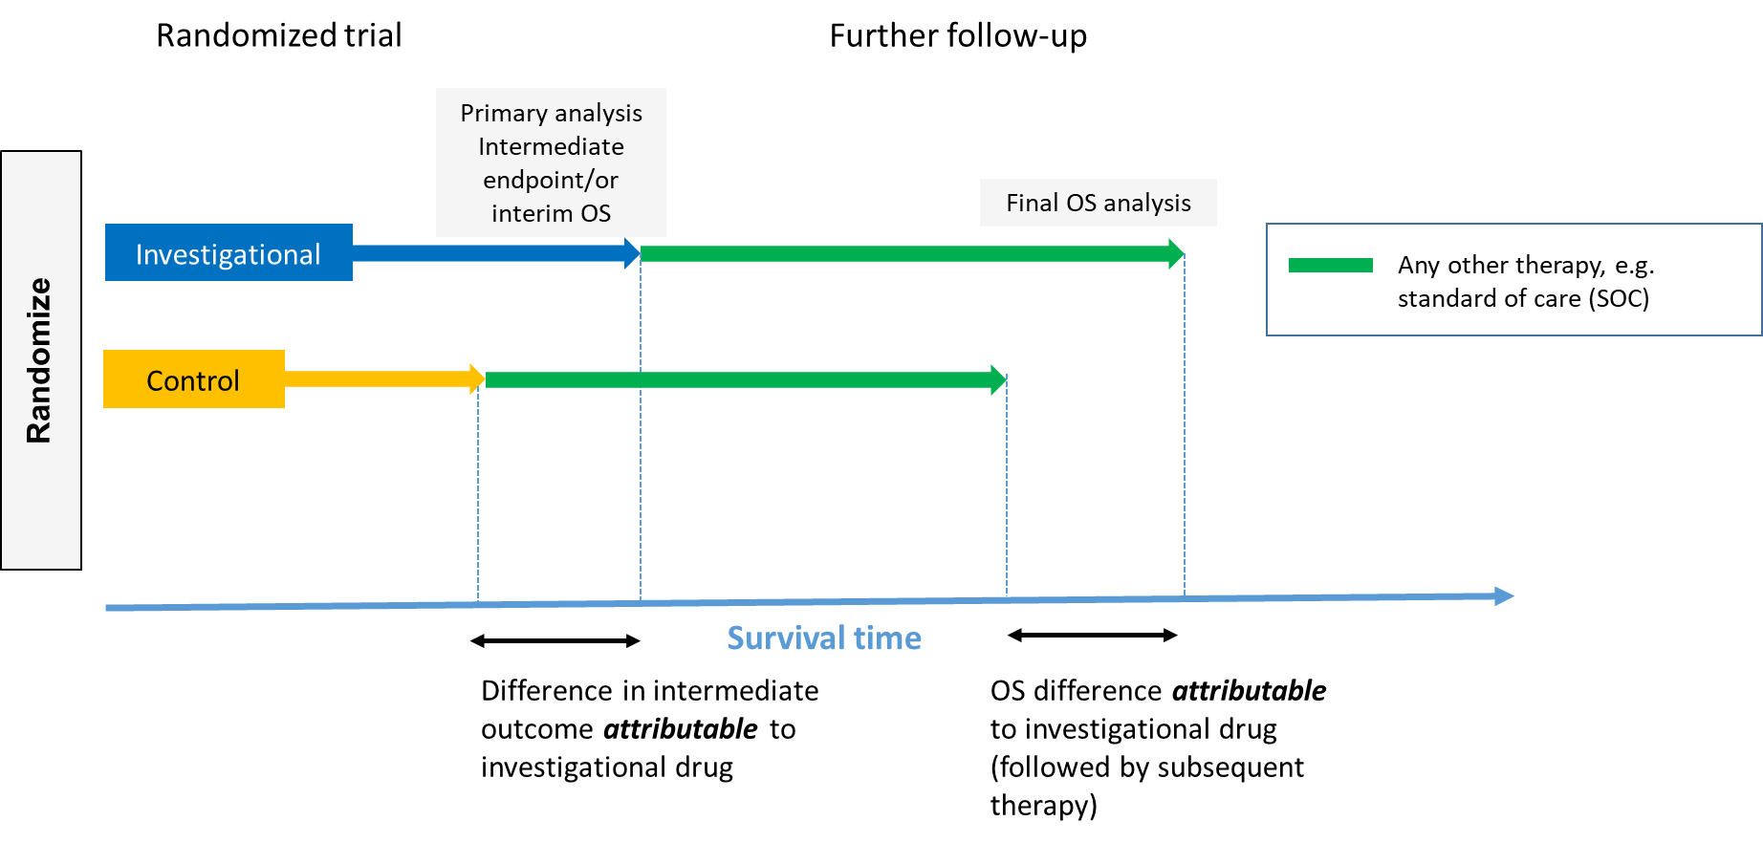
Randomized Clinical Trial in Oncology: A Stylized Example

Slide 6
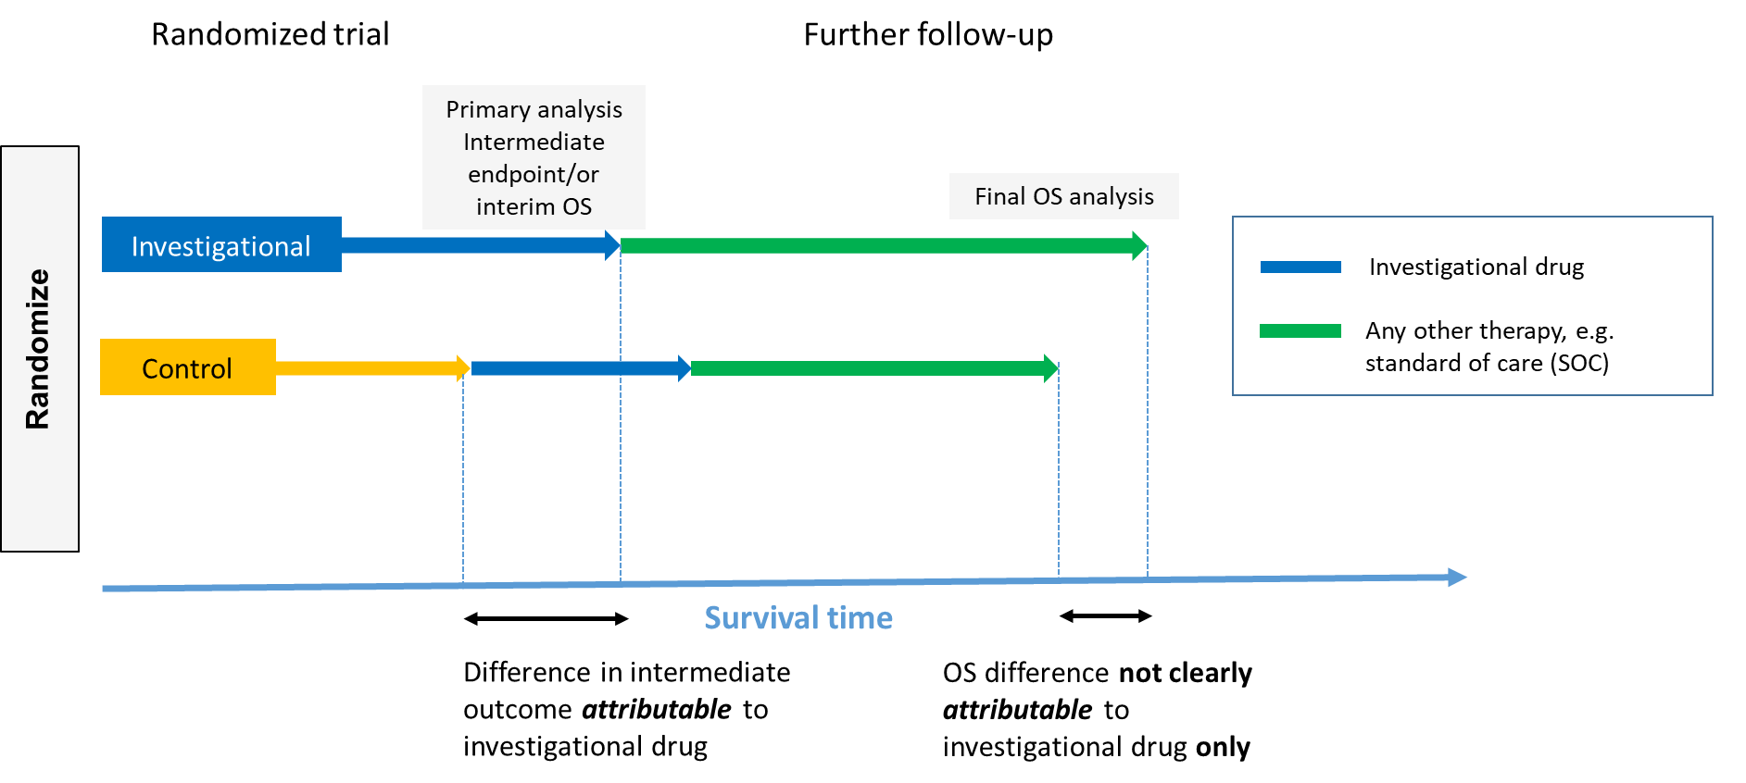
Treatment Switching Scenario 1: Cross-over from Control to Investigational Arm

Slide 7
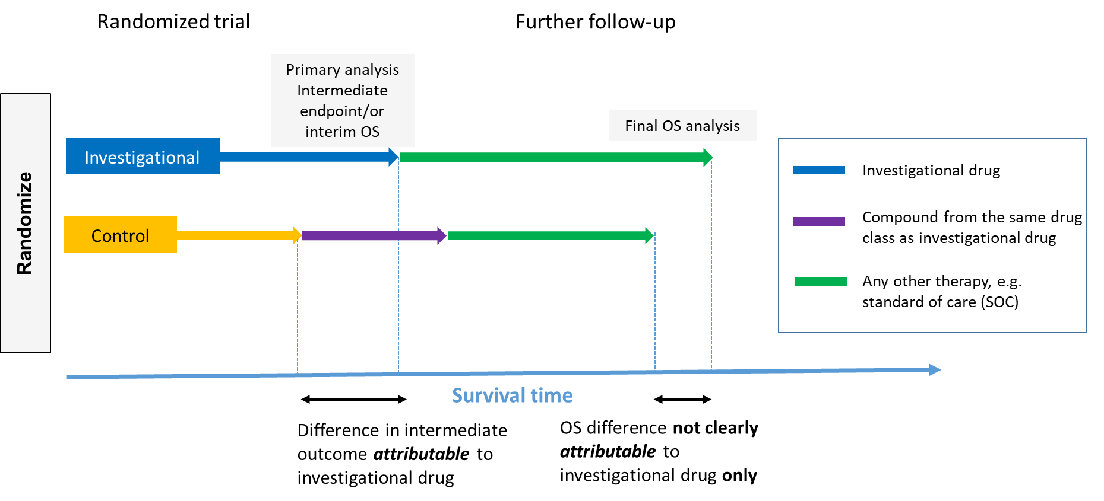
Treatment Switching Scenario 2: From Control to Same Drug Class as of Investigational Arm

Slide 8
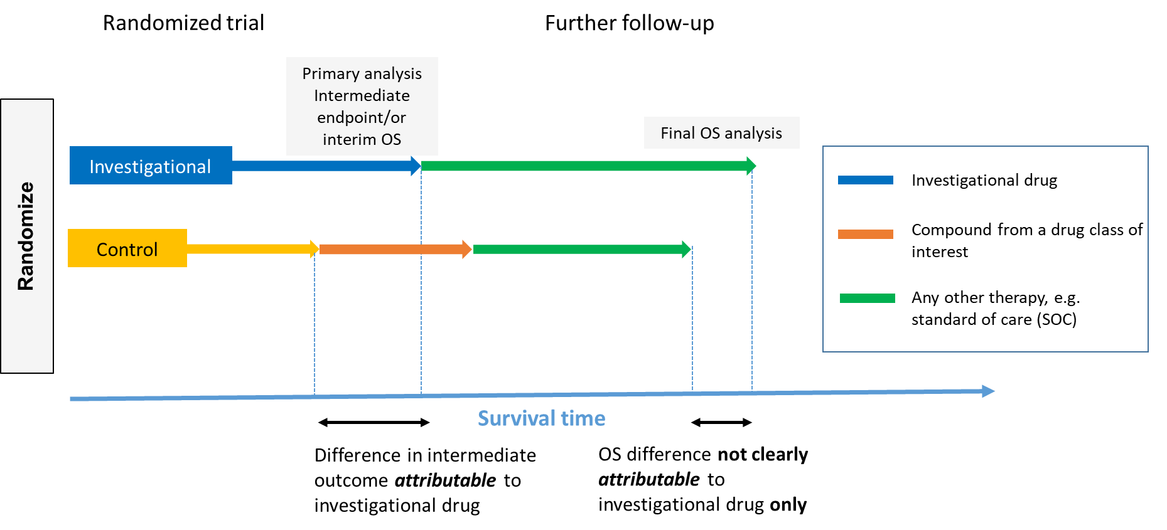
Treatment Switching Scenario 3: From Control Arm to Drug Class of Interest

Slide 9
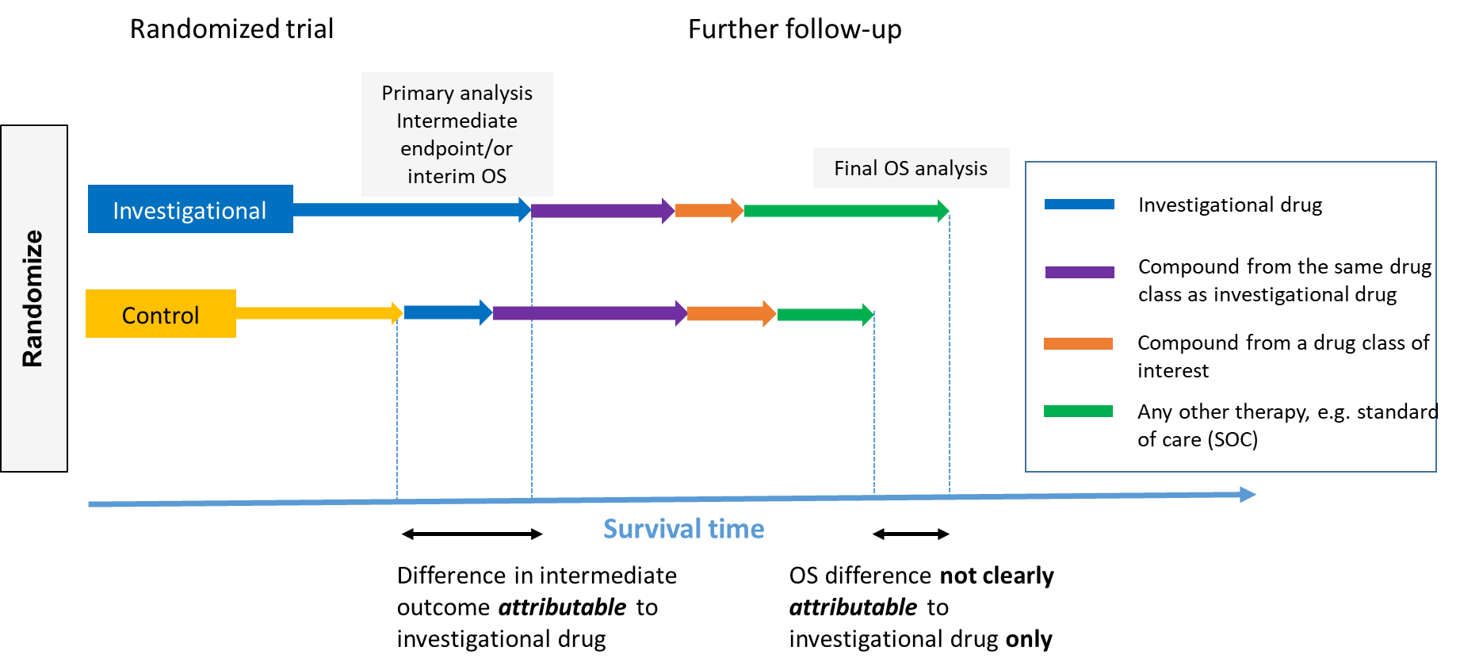
A More Realistic Example: Mix of Treatment Switching Scenarios

Slide 10
What do we actually measure? What are the key questions?
The traditional approach ignores treatment switching and rest on the following assumptions:
Subsequent therapy reflect clinical practice (including investigational drug in later line) in particular decision context
Patients receiving subsequent treatments (from same class as investigational drug and drug class of interest) and dose intensity as expected (as SOC) between investigational and control arm
If these assumptions do not hold, we may consider to estimate the OS benefit that is attributable to the investigational drug
The estimand framework provides a coherent framework to make the arising issues of treatment switching explicit and offers a systematic and transparent approach for assessment

Slide 11
Treatment Policy Strategy for Treatment Switching
Objective: Evaluate OS benefit assuming subsequent therapies represent clinical practice
Estimand:
Population: Defined through appropriate I/E criteria to reflect the target patient population for approval
Variable: Overall survival, defined as the time from randomization to death
Treatment: Sequence of investigational drug + any subsequent therapies vs. sequence of control + any subsequent therapies (including Investigational drug)
Handling of intercurrent events:
Start of subsequent therapy at any time: Treatment policy
Crossover to investigational drug at any time: Treatment policy
Crossover to investigational drug at disease progression: Treatment policy
Population-level Summary: Hazard ratio and confidence interval
Estimate: Cox model and KM estimates using ITT approach

Slide 12
Hypothetical Strategy for Treatment Switching
Objective: Evaluate OS benefit adjusted for treatment switching
Estimand:
Population: Defined through appropriate I/E criteria to reflect the target patient population for approval
Variable: Overall survival, defined as the time from randomization to death
Treatment: Investigational drug vs control (if there were no subsequent therapies)
Handling of intercurrent events:
Start of subsequent therapy at any time: Hypothetical
Crossover to investigational drug at any time: Hypothetical
Crossover to investigational drug at disease progression: Hypothetical
Population-level Summary: Hazard ratio and confidence interval
Estimate: Adjusted HR and CI from IPCW-weighted Cox model

Slide 13
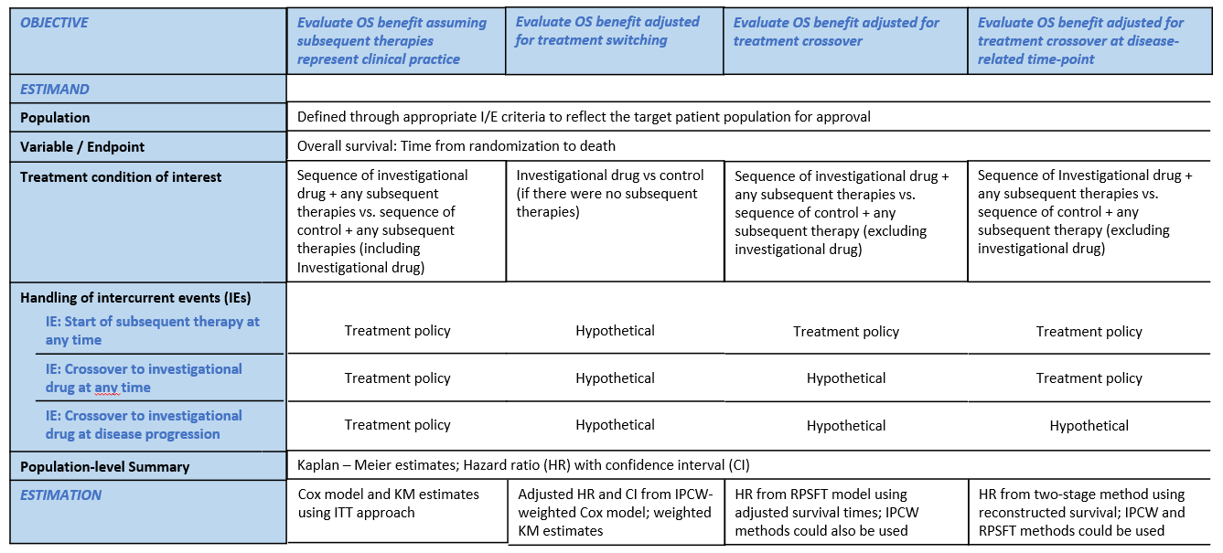
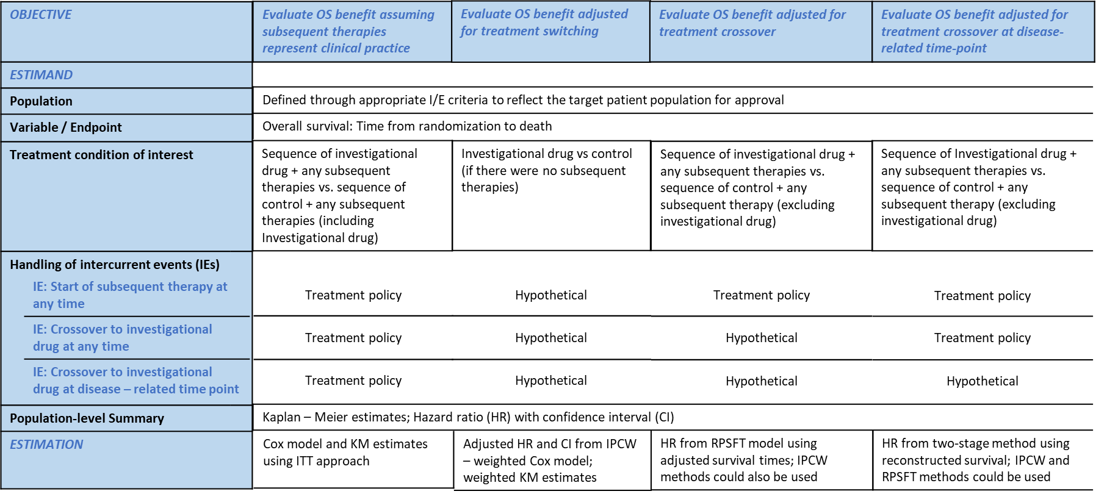
Estimands in Clinical Trials with Treatment Switching

Slide 14
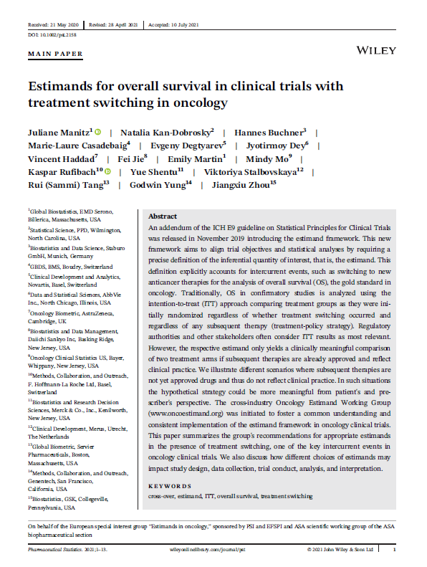
Conclusions & Summary
Treatment policy estimand may not be clinically relevant if subsequent therapy does not represent clinical practice
The estimand framework provides a coherent framework to make the issues of treatment switching explicit and offers a systematic and transparent approach for assessment
Start to think about possible treatment switching scenarios during the planning phase of a trial
Choose appropriate estimand according to pre-specified scientific question of interest
Treatment switching methods which can be applied if the necessary data is collected; assumptions apply
Further reading: Corresponding manuscript published in Pharmaceutical Statistics (DOI: 10.1002/pst.2158)

