Slide 1
Statistical and regulatory perspectives on platform trials
SI / EFSPI / ASA BIOP
Webinar Complex Innovative Designs 21/10/21
Olivier Collignon, PhD
Statistics Leader, GSK

Slide 2
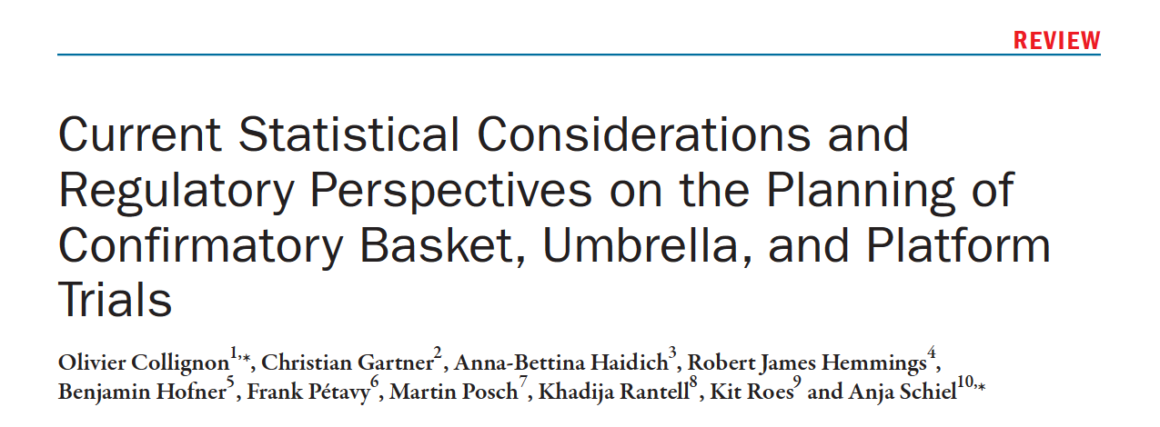

Slide 3
Take-home messages
Platform trials are complex innovative designs
They come in all shapes and forms
There is wide range of statistical techniques to use and issues to think about:
Adaptations
Adding / dropping an arm
Multiple testing
Data borrowing and non-concurrent controls
Their acceptability by regulators and HTAs depends dramatically on:
the rationale
the experimental setting
the complexity of the trial
the clarity of e.g. the briefing documents
Early engagement with regulators via e.g. Scientific Advice is paramount

Slide 4
Outline
Introduction
  Definitions and clinical trial landscape
Platform trials
  Planning issues, logistics and governance
  Statistical methodology
  Multiplicity and different error rates
  Adding a treatment arm and non-concurrent controls
Acceptability of platform trials for regulators, ethic committees and HTAs

Slide 5

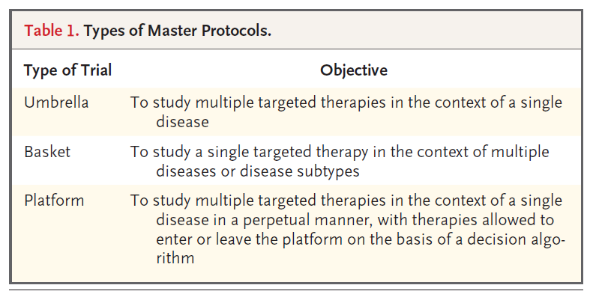
Definitions

Slide 6
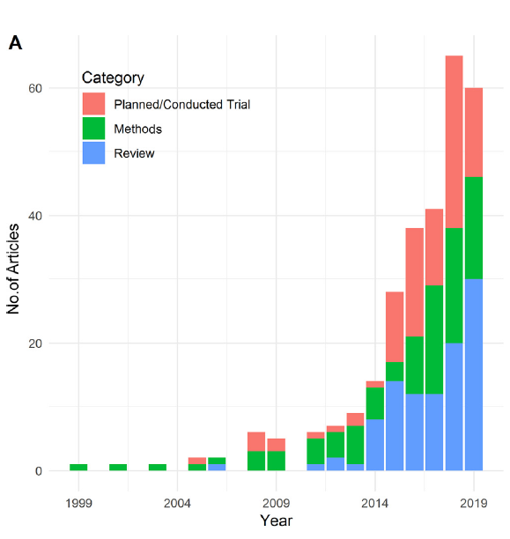
Clinical trial landscape

Slide 7
Platform trial
time
Drug 4
Drug 3
Drug 1
randomization
Drug 2
Control

Slide 8
Planning issues and logistics
  Governance and sponsors’ accountability
  Potentially increased set-up time
  Inclusion / exclusion criteria can differ with the drug
    Population with common denominator difficult to recruit
  Phase 2 platform trial: if a treatment is progressed to Phase 3, potential self-competition if the platform continues as patients might prefer enrolment in Phase 3
  Different reporting needs / timings per drug
  Blinding with multiple dummies
    Practically difficult
    Number of treatments not necessarily known upfront

Slide 9
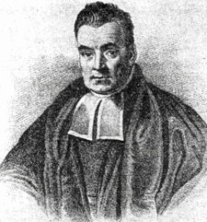
-More conservative
-High regulatory experience
-More innovative
-Less regulatory experience
Series of independent two-arms RCT
Platform trial without any interim analyses
Platform trial with adaptive elements and
GO / NO GO decisions
Platform trial with adaptive elements and
GO / NO GO decisions and Bayesian elements

Slide 10
Which design for which stakeholder?
Optimal platform trial will differ with stakeholder
Regulators and HTAs have more experience with the first two designs
  No bias
  Direct comparisons
  Self-standing evidence as no use of external data
Patients and drug developers might prefer the last two designs
  Faster
  More dynamic
  Data re-use
  But introduction of Bayesian elements is a classically difficult discussion (choice of priors, use of external information, Type I error inflation)

Slide 11
Statistical methodology
Interim analyses
  Early efficacy / futility analyses
  Group sequential and adaptive designs
Multiple treatments and shared control arm
  Hierarchical model over the treatment difference of each drug vs control arm
  Multiple testing
Non-concurrent controls
  Dynamic borrowing of placebo response observed prior to the addition of a new treatment arm
  Modelling time-trends

Slide 12
Multiplicity in confirmatory platform trials
Leaving aside other sources of multiplicity (e.g. endpoints, subgroups, adaptations…), the questions we are all asking:
“Should we allocate 5% Type I error per drug or per trial?”
“Why penalising a study leveraging a common control arm when 5% of Type I error would be allocated to each drug if they were studied separately?”

Slide 13
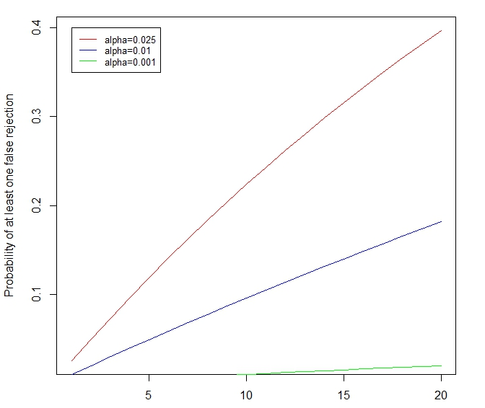
Probability of falsely rejecting the null hypothesis for at least one treatment in a platform trial
number of treatment arms

Slide 14
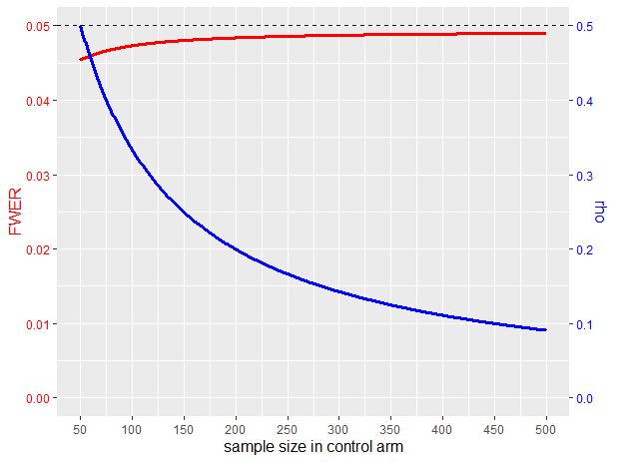
Multiplicity – Family-Wise Error rate
FWER lower in platform trials as compared to series of RCT thanks to positive correlation between the test statistics of the treatment arms
Two treatment arms N=50 per arm
Control arm N=50:500
alpha = 2.5% one-sided per test
FWER: Family-Wise Error Rate
Notes:
Correlation decreases as the sample size in controls increases as compared to treatment (allocation ratio)
Bratton (2020) timing of treatment arms addition and proportion of shared control information between treatment have little impact on FWER

Slide 15
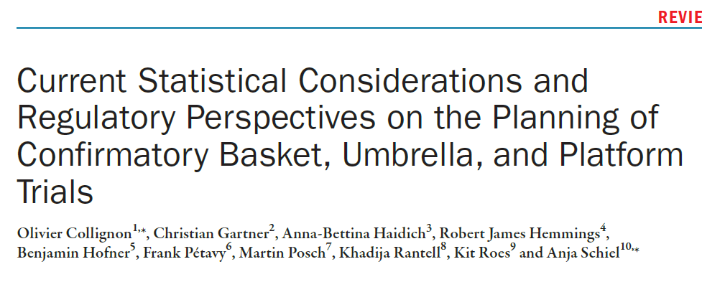
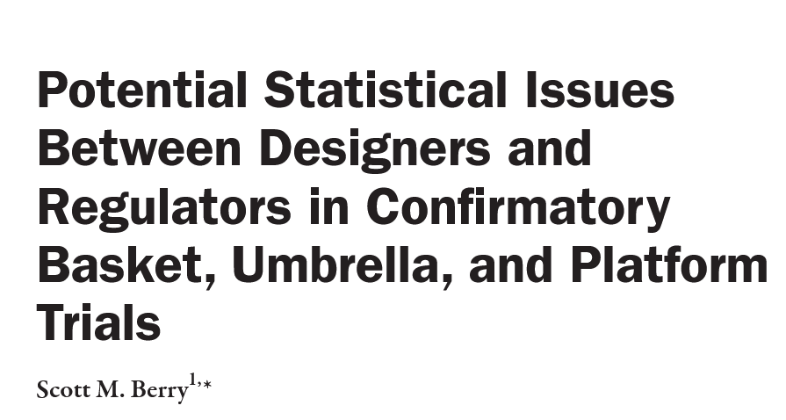
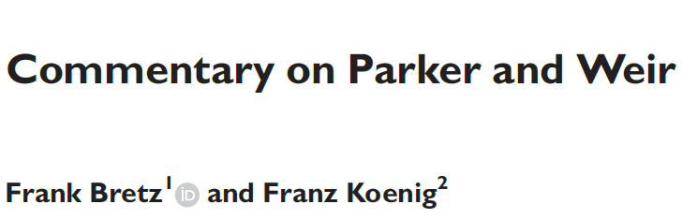
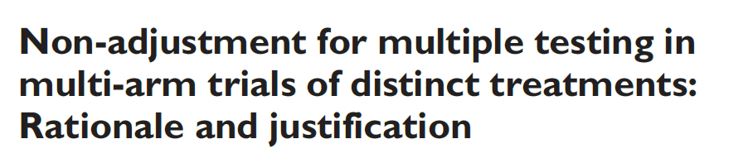
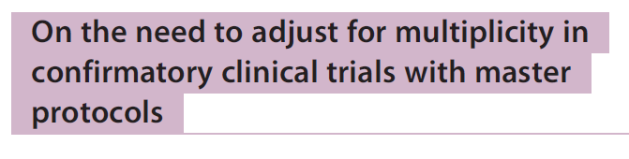
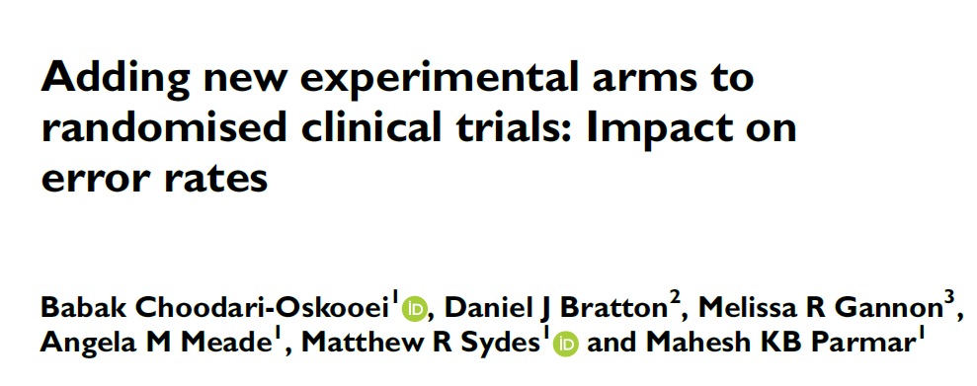
Nigel Stallard et al.

Slide 16
Multiplicity in confirmatory platform trials
Beginning of consensus in current literature:
Different doses, regimens, combinations, formulation, route of administration, duration of a single treatment supporting a single submission
Adjustment might be needed
Different treatments supporting independent submissions and claims of efficacy
Adjustment might not be needed

Slide 17
Multiplicity in confirmatory platform trials
What if the objective is: “success if at least one treatment in the platform is significant?”
  Ex: covid19 trials with drugs already marketed, e.g. RECOVERY, DISCOVERY
Does information from other arms impact the assessment of given comparison?
  Should several drugs with similar mechanism of actions be expected to have similar efficacy? False negative / positive?
  Impact on benefit/risk assessment?

Slide 18
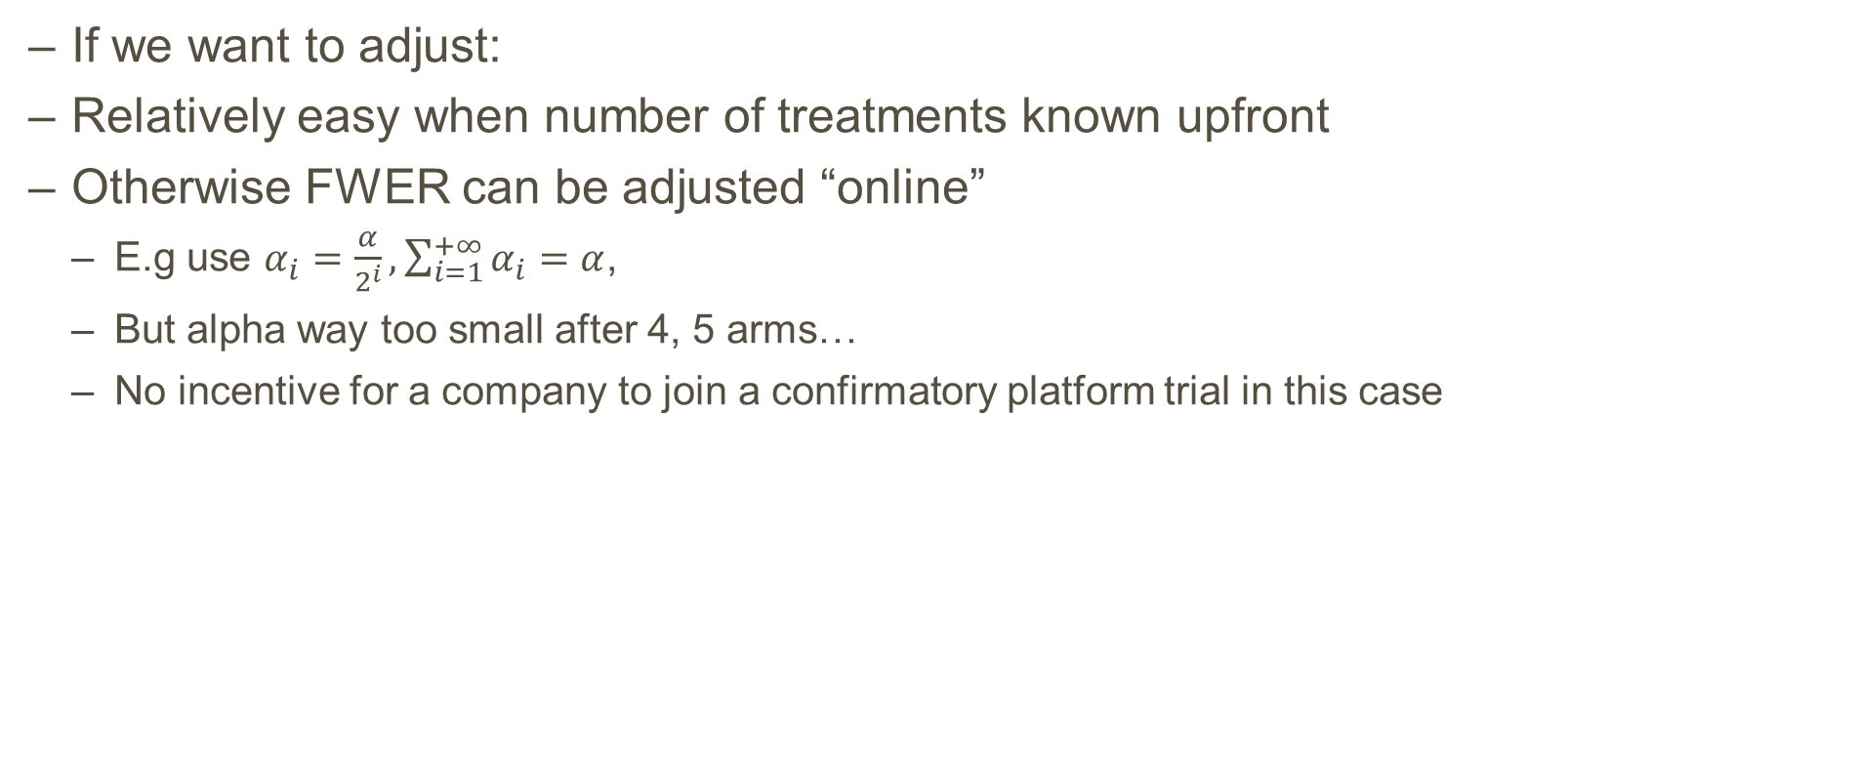
Multiplicity – Family-Wise Error rate
If we want to adjust:
Relatively easy when number of treatments known upfront
Otherwise FWER can be adjusted “online”
  E.g use $α_{i}=\frac{α}{2^{i}}, \sum_{i=1}^{+∞}{α_{i}}=α$,
  But alpha way too small after 4, 5 arms…
  No incentive for a company to join a confirmatory platform trial in this case

Slide 19
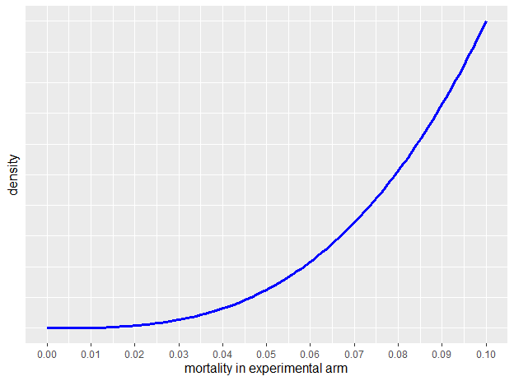
Multiplicity - False Discovery Rate (FDR) and Positive Predictive Value (PPV)
Example: COVID19
Assume 100 drugs investigated in a platform trial
Shared comparator with expected mortality 10%
75% have no efficacy
25% have prior distribution as on figure
Start with platform Phase 2 and positive drugs are progressed to platform Phase 3 trial
Drugs are progressed / positive is p < 0.025 one-sided
After Phase 2 FDR up to 84%
In early discovery, emphasis should be on progressing truly efficacious drugs, i.e. on FDR and PPV?

Slide 20
Multiplicity- probability of multiple superior false positive drugs
If in the control arm by chance a low response is observed, for all the experimental treatments an erroneous significant result becomes more likely
Experimental treatments
Control arm (observed)
Control arm (truth)
Notes:
Not a regulatory mandate to control the probability of declaring multiple superior false positive
However this is regulators’ right to discredit a platform trial results based on a dubious control arm
Can we however spot / define a dubious placebo response?
However historical, non-concurrent controls in the platform help give context

Slide 21
Multiplicity - summary
Error | Platform trial | independent RCTs
FWER | Lower | Higher
average number of false positive drugs | same | same
probability of declaring multiple superior false positive drugs | Higher | Lower

Slide 22
Non-concurrent controls
time
Drug 3
Drug 1
randomization
Drug 2
Control
After the opening of the 3rd treatment arm these patients become “external”
Notes:
The safest option is to restrict the comparison to patients enrolled after the opening of the 3rd treatment arm, especially if recruitment is slow;
However historical controls could potentially be leveraged using a proper hierarchical model, e.g. a (robust) meta-analytic predictive prior (see Schmidli et al);
This is probably less of an issue with Covid19 trials as recruitment will be fast

Slide 23
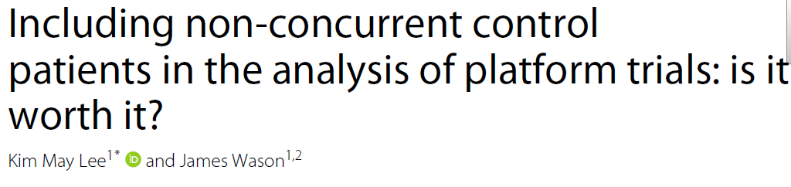
Non-concurrent controls
In the absence of time trend
  Potential gain in power and precision
In the presence of a time trend
  Estimation bias
  Type I error rate inflation
Time-trend can be modelled and accounted for
  Under the right model/assumptions, the Type I error rate is controlled and power gain is maintained
  In general, we don’t know the true model (especially when writing the statistical analysis plan)
Safer to restrict comparison to concurrent controls for confirmatory objectives
  Importance of sensitivity analyses: with / without non-concurrent controls
  Discuss reasons for the time-trend
  Interpretability?

Slide 24
Standard of care - what happens if it changes over time?
time
Drug 4
Drug 3
Drug 1
randomization
Drug 2
Control 1
Control 2
Notes:
To which SOC should D3 be compared to? Initially planned for C1 but C1 is discontinued. Is it still interesting to compare to C2? Protocol amendment?

Slide 25
Acceptability of platform trials for regulators
Regulators:
Phase of study (exploratory vs confirmatory)
Rationale for platform trial and prespecification (as compared to a series of separate studies)
Study design (adaptions, borrowing…)
Type I error control
Concurrent controls
Overall master protocols should meet the same regulatory standards as more classic designs

Slide 26

Acceptability of platform trials for ethics committees and CTAs
Clinical Trials Facilitation and Coordination Group (CTFG): “Recommendation Paper on the Initiation and Conduct of Complex Clinical Trials”
Ethics committees and CTAs tend to be negative because of the complexity and volume of trial documentation

Slide 27
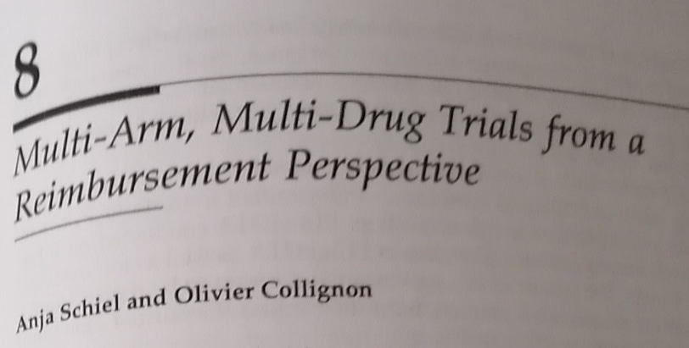

Acceptability of platform trials for HTAs
Lack of exposure from HTAs to platform trials
Inconsistent definitions
High variability in HTA assessment methodology and requirement in Europe
Platform trials relatively welcome as they allow head-to-head drug comparisons
Similarly to regulators
  Importance of rationale
  No reduction of the evidentiary standards

Slide 28
Conclusions
Platform trials are complex innovative designs
They come in all shapes and forms
There is wide range of statistical techniques to use and issues to think about:
Adaptations
Adding / dropping an arm
Multiple testing
Data borrowing and non-concurrent controls
Their acceptability by regulators and HTAs depends dramatically on:
the rationale
the experimental setting
the complexity of the trial
the clarity of e.g. the briefing documents
Early engagement with regulators via e.g. Scientific Advice is paramount

Slide 29
References
Collignon, Olivier, et al. "Current Statistical Considerations and Regulatory Perspectives on the Planning of Confirmatory Basket, Umbrella, and Platform Trials." Clinical Pharmacology & Therapeutics 107.5 (2020): 1059-1067.
Collignon, Olivier, et al.. (2020) Collaborative platform trials to fight COVID-19: methodological and regulatory considerations for a better societal outcome. Accepted (2020)
Berry, Scott. "Potential Statistical Issues Between Designers and Regulators in Confirmatory Basket, Umbrella, and Platform Trials." Clinical Pharmacology & Therapeutics (2020).
Choodari-Oskooei, Babak, et al. "Adding new experimental arms to randomised clinical trials: Impact on error rates." Clinical Trials (2020): 1740774520904346.
Parker, Richard A., and Christopher J. Weir. "Non-adjustment for multiple testing in multi-arm trials of distinct treatments: Rationale and justification." Clinical Trials (2020): 1740774520941419.
Bretz, Frank, and Franz Koenig. "Commentary on Parker and Weir." Clinical Trials (2020): 1740774520941420.
Howard, Dena R., et al. "Recommendations on multiple testing adjustment in multi-arm trials with a shared control group." Statistical methods in medical research 27.5 (2018): 1513-1530.
Stallard, Nigel, et al. "On the need to adjust for multiplicity in confirmatory clinical trials with master protocols." Annals of Oncology 30.4 (2019): 506.
Robertson, David S., and James Wason. "Online control of the false discovery rate in biomedical research." arXiv preprint arXiv:1809.07292 (2018).
Tian, Jinjin, and Aaditya Ramdas. "Online control of the familywise error rate." arXiv preprint arXiv:1910.04900 (2019).
Wason, James MS, and David S. Robertson. "Controlling type I error rates in multi‐arm clinical trials: A case for the false discovery rate." Pharmaceutical Statistics (2020)
Clinical Trials Facilitation and Coordination Group (CTFG): “Recommendation Paper on the Initiation and Conduct of Complex Clinical Trials” https://www.hma.eu/fileadmin/dateien/Human_Medicines/01-About_HMA/Working_Groups/CTFG/2019_02_CTFG_Recommendation_paper_on_Complex_Clinical_Trials.pdf

Slide 30
References
- Woodcock J, LaVange LM. Master protocols to study multiple therapies, multiple diseases, or both. New England Journal of Medicine. 2017;377(1):62-70.
- Beckman R, Antonijevic Z, Kalamegham R, Chen C. Adaptive design for a confirmatory basket trial in multiple tumor types based on a putative predictive biomarker. Clinical Pharmacology & Therapeutics. 2016;100(6):617-25.
- Renfro LA, Mandrekar SJ. Definitions and Statistical Properties of Master Protocols for Personalized Medicine in Oncology. Journal of Biopharmaceutical Statistics. 2017(just-accepted).
- Renfro L, Sargent D. Statistical controversies in clinical research: basket trials, umbrella trials, and other master protocols: a review and examples. Annals of Oncology. 2016;28(1):34-43.
- Cunanan, Kristen M., et al. "An efficient basket trial design." Statistics in medicine 36.10 (2017): 1568-1579.
- Howard DR, Brown JM, Todd S, Gregory WM. Recommendations on multiple testing adjustment in multi-arm trials with a shared control group. Statistical methods in medical research. 2018;27(5):1513-30.
- Sudhop, Thomas, et al. "Master protocols in clinical trials: a universal Swiss Army knife?." The Lancet Oncology 20.6 (2019): e336-e342.
- Clinical Trials Facilitation and Coordination Group (CTFG) – “Recommendation Paper on the Initiation and Conduct of ComplexClinical Trials”
- Blagden, Sarah P., et al. "Effective delivery of Complex Innovative Design (CID) cancer trials—A consensus statement." British journal of cancer 122.4 (2020): 473-482.
- Sridhara, Rajeshwari, et al. "Type I error considerations in master protocols with common control in oncology trials: report of an American statistical association biopharmaceutical section open forum discussion." Statistics in Biopharmaceutical Research (2021): 1-4.
- Lengliné, Etienne, et al. "Basket clinical trial design for targeted therapies for cancer: a French National Authority for Health statement for health technology assessment." The Lancet Oncology 22.10 (2021): e430-e434.

Slide 31
References
Meyer, Elias Laurin, et al. "The evolution of master protocol clinical trial designs: a systematic literature review." Clinical Therapeutics (2020)
Cohen, Dena R., et al. "Adding a treatment arm to an ongoing clinical trial: a review of methodology and practice." Trials 16.1 (2015): 1-9
Dodd, Lori E., Boris Freidlin, and Edward L. Korn. "Platform trials—beware the noncomparable control group." New England Journal of Medicine 384.16 (2021): 1572-1573.
Ren, Yixin, Xiaoyun Li, and Cong Chen. "Statistical considerations of phase 3 umbrella trials allowing adding one treatment arm mid-trial." Contemporary Clinical Trials 109 (2021): 106538.
Bai, Xiaofei, Qiqi Deng, and Dacheng Liu. "Multiplicity issues for platform trials with a shared control arm." Journal of Biopharmaceutical Statistics 30.6 (2020): 1077-1090.
Lu, Chengxing Cindy, et al. "Practical Considerations and Recommendations for Master Protocol Framework: Basket, Umbrella and Platform Trials." Therapeutic Innovation & Regulatory Science (2021): 1-10.
Lee, Kim May, and James Wason. "Including non-concurrent control patients in the analysis of platform trials: is it worth it?." BMC medical research methodology 20.1 (2020): 1-12.
Sridhara, Rajeshwari, et al. "Use of Non-concurrent Common Control in Master Protocols in Oncology Trials: Report of an American Statistical Association Biopharmaceutical Section Open Forum Discussion." Statistics in Biopharmaceutical Research just-accepted (2021): 1-6.
Lee, Kim May, et al. "Statistical consideration when adding new arms to ongoing clinical trials: the potentials and the caveats." Trials 22.1 (2021): 1-10
Lee, Kim May, James Wason, and Nigel Stallard. "To add or not to add a new treatment arm to a multiarm study: A decision‐theoretic framework." Statistics in medicine 38.18 (2019): 3305-3321.

