Slide 1
Expanding Uses for ctDNA in Clinical Trial Design
Rachel Hodge, Director & Biometrics Team Leader
Oncology Biometrics, Oncology R&D, AstraZeneca
PSI Ted type talk
25 May 2021

Slide 2
Disclosure Information – Rachel Hodge
I have the following financial relationships to disclose:
Stockholder in: AstraZeneca, GlaxoSmithKline
Employee of: AstraZeneca
I will not discuss off label use and/or investigational use in my presentation
All views are my own and are not meant to represent any official views of AstraZeneca

Slide 3
Overview
ctDNA biology and potential utility in drug development
Minimal Residual Disease
Response Evaluation Criteria in Solid Tumours by ctDNA ?
Summary

Slide 4
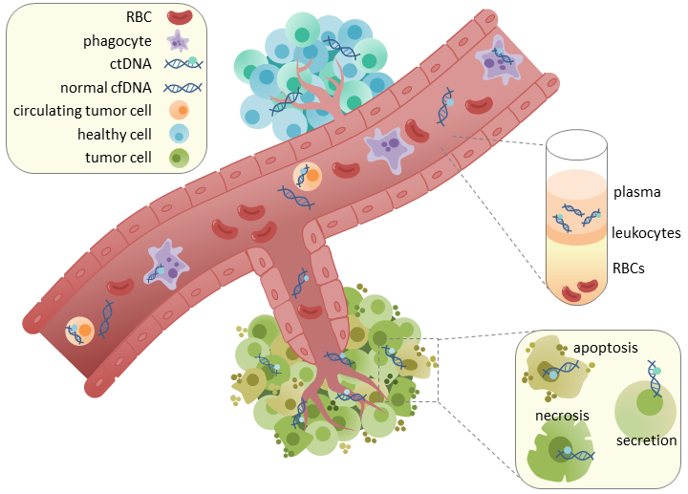
Circulating tumour DNA (ctDNA) can provide critical information about a tumour through non-invasive techniques
Genetic & epigenetic markers characteristic of disease
Patient friendly sampling that can be used in place of tissue for some selection markers and changes can be monitored time with longitudinal analyses
Can represent a small fraction of total circulating free (cf) DNA
Very short t1/2 ~2hrs, quantity influenced by tumor volume, location, aggressiveness
Absolute units: mutation copies, genome equivalents (GE) /ml. Relative units: mutant allele fraction (MAF)
Our vision is to deliver on the promise of ctDNA by changing the ways in which cancer is detected, treated, and monitored by leading drug approvals for new opportunities made possible only with ctDNA analyses.

Slide 5
ctDNA can identify patients whose cancer will recur
Multiple Studies in CRC^{1,2}, BC^{3,4}, NSCLC^{5,6}, UC⁷ demonstrate that the presence of ctDNA after curative intent treatment indicates the presence of residual disease and that the patients cancer will recur
A higher ctDNA level prior to surgery is also prognostic⁶
Figure 3: Personalized ctDNA detection in serial plasma samples predicts recurrence free survival. A. Relapse-free survival according to the detection of ctDNA in the first postsurgical plasma sample [HR: 11.78 (4.28–32.46), p-value <0.001]. B. Relapse-free survival according to the detection of ctDNA in any follow-up plasma sample post-surgery [HR:35.84 (7.9 –161.32), p-value <0.001]. Data are from n = 49 patients
From Coombes et al 2019; DOI: 10.1158/1078-0432.CCR-18-3663. Personalized detection of circulating tumor DNA antedates breast cancer
metastatic recurrence
1 Tie J, et al. Sci Transl Med. 2016. 8(346); 2 Reinert et al. JAMA Oncol. 2019;5(8):1124-1131. 3 Garcia-Murillas et al JAMA Oncol. 2019;5(10):1473-1478; 4 McDonald et al Sci Transl Med. 2019, 11(504). 5 Abbosh et al 2016 Nature. 6 Chaudhuri et al (2017 Cancer Discovery 7:1394–403. 7 Christensen et al J Clin Oncol. 2019 37:1547-155
5
R&D Oncology

Slide 6
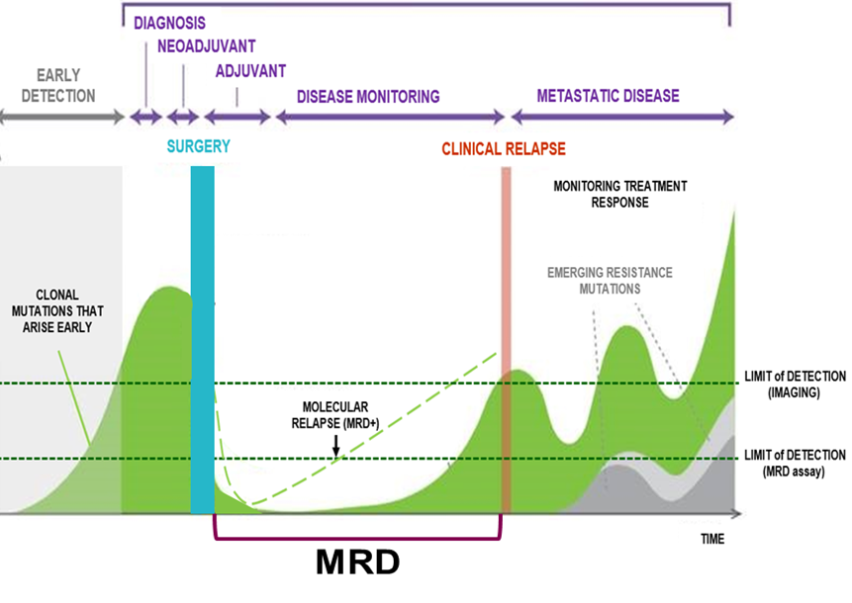
Utility in drug development
 |  |  | Estimate
T stage | T3 | T1c | T1b
Nodule Diameter (cm) | 5.8 | 2.6 | 1.2
Nodule Volume (cm³) | 100 | 10 | 1
MAF (%) | 1.4 (0.62-3.1) | 0.1 (0.06-0.18) | 0.008 (0.002-0.03)
ctDNA level/tumor burden
Estimate require 0.008% MAF to detect
1 cm³ of tumour¹
IMAGING Critical size in 1 location ctDNA Critical number of cells, but can be small deposits in multiple locations
Adapted from Signatera product brochure (Natera)
1. Abbosh C, et al. Nat Rev Clin Oncol 2018;15:577–586; MAF, mutant allele frequency

Slide 7
Overview
ctDNA biology and potential utility in drug development
Minimal Residual Disease
Response Evaluation Criteria in Solid Tumours by ctDNA
Summary

Slide 8
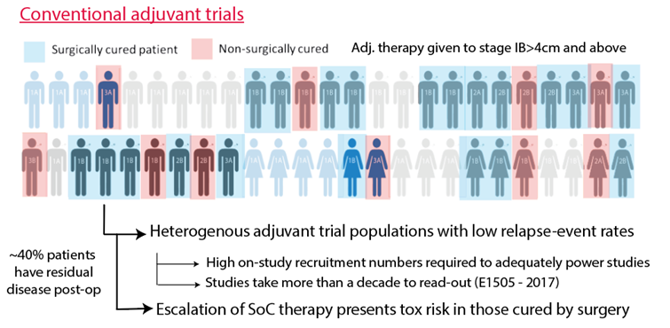
Addressing Challenges of Trial Design in Resectable NSCLC:
All-comers
Adjuvant Trial
Treat only those who need to be treated
MRD+
Adjuvant
Trial
Slide courtesy of Chris Abbosh, UCL, UK

Slide 9
MeRmaiDs Do Exist !
AstraZeneca press release May 26th 2020

Slide 10
Overview
ctDNA biology and potential utility in drug development
Minimal Residual Disease
Response Evaluation Criteria in Solid Tumours by ctDNA
Summary

Slide 11
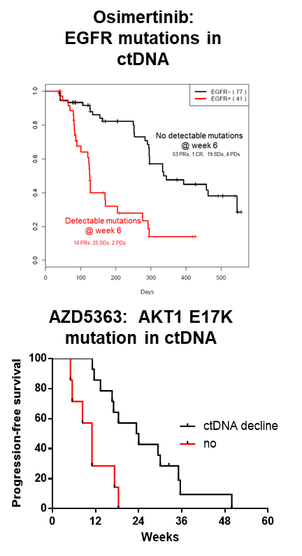
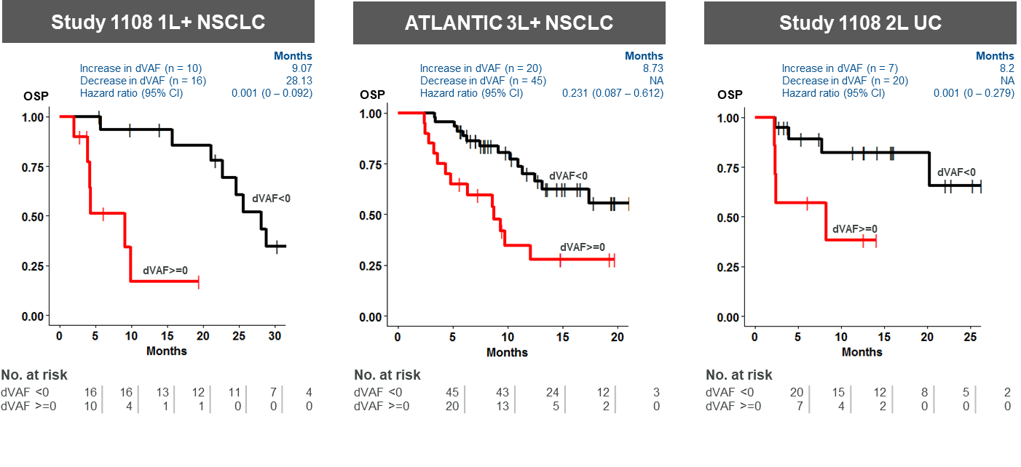
Early decreases in ctDNA levels associate with longer PFS in patients treated with targeted agents and ICI
Thress et al. ASCO, 2017, Hyman et al., JCO, 2017, Raja et al., Clin Cancer Res, 2018)

Slide 12
Response Evaluation by ctDNA ?
Time for collections | Sample type | Wet Method | Output Response criteria ? | What is the added value of ctDNA measure ? Alone or combined with imaging
Up to 2 wks pre-dose 3-6 weeks Confirmation visit/1st scan Align with scans | 10 ml blood Streck | Multiple | Max/med allele fraction Tumor genomes/ml Complete Response Partial Response Stable Disease Progressive Disease Measurable/evaluable disease Confirmatory measurement All mutations, baseline only Max, median, mean CHIP filter | Switch/escalation justification – progressive disease with historical data indicating lack of benefit from continuing specific drug in specific setting New signal finding trial endpoint Active therapy ? Historical comparisons ? Surrogacy – high hurdle, multiple P3 trials with different MoA in same indication

Slide 13
Friends of Cancer Research ctDNA Project for Monitoring Treatment Response
Successfully developed ctDNA metrics to harmonize across various assays in patients with advanced lung cancer treated with ICI
Evaluated ctDNA metrics alongside more standard clinical covariates (pooled dataset of 200 patients across 7 studies with 4 assays)
Max (and mean) percentage change from first ctDNA post-baseline sample within 70 days after treatment *T1 had the strongest association with outcome (at least 50% decrease (yes/no))
Decreases in the maximum Variant Allele Frequency (VAF) from Baseline to *T1 had the strongest association among all clinical covariates considered relative to
Tumor response (PR or Better)
Overall Survival (OS), and Progression-Free Survival at 6 months (PFS6)

Slide 14
Overview
ctDNA biology and potential utility in drug development
Minimal Residual Disease
Response Evaluation Criteria in Solid Tumours by ctDNA
Summary

Slide 15
Expanding Roles for ctDNA
PATIENT QUESTIONS
What is my risk of cancer ?
Have I got cancer ?
What type of cancer have I got and therefore what is my prognosis ?
What treatment is best for me ?
Is my treatment working ?
Will my cancer come back ?
DRUG DEVELOPMENT QUESTIONS
GO-STOP
IF GO – HOW GO ?
What dose ?
What schedule ?
Which patients ?

Slide 16
Conclusions
ctDNA measurements have significant potential to help us detect, quantify and characterise disease to aid decisions in drug development and patient care
ctDNA MRD trials in solid tumours are up and running
Significance of pre-surgical ctDNA detection/levels ?
Value of surveillance and earlier intervention ?
Will we not detect metastasis to brain ?
Room for improvement in sensitivity & specificity and detecting new primary disease
Room for improvement in testing complexity
Endpoint Criteria
Promising data suggesting additional insight from ctDNA measures
The field will benefit from consortia and initiatives such as ctMoniTR (FOCR)

Slide 17
Acknowledgements
Thanks to collaborators and experts who have shared their expertise and the translational, clinical and precision medicine teams at AZ

