Slide 1
U.S. Regulatory implementation of estimand framework: Background and status
John Scott, Ph.D., FDA/CBER/OBE
Joint PSI, EFSPI & ASA BIOP Webinar: Estimands
November 5, 2020

Slide 2
Disclaimer
This presentation reflects the views of the author and should not be construed to represent FDA’s views or policies.

Slide 3
Pre-history
Missing data long-recognized as a problem in medical studies
Bias, power / precision
PDUFA IV commitment (2008) called on FDA to begin to address missing data in clinical trials
Circa 2008, missing data discussions focused on analysis set definitions and often ad hoc single imputation
LOCF widely used
FDA commissioned a National Academy of Sciences study panel to investigate missing data in clinical trials

Slide 4
The NAS report
“The Prevention and Treatment of Missing Data in Clinical Trials”
Avoiding missing data
Analysis methods for missing data
Estimands
Sensitivity analyses
Panel observed that clinical trial practitioners were often vague about what they actually cared to know
Substituting defaults like “ITT” or “per protocol” for spelling out estimand

Slide 5
Translational issues
Much of the missing data literature comes from survey statistics or designed experiments
Not always good fit for clinical trials
Avoiding missing data is intuitive, but doesn’t always make sense
Some “missing” data is meaningless – e.g. pain scores after death
Some data that’s not missing can change meaning – e.g. survival after crossover in an oncology trial
These and related considerations led to ICH E9(R1): Estimands and Sensitivity Analyses in Clinical Trials
Considerable emphasis on intercurrent events

Slide 6
ICH E9(R1) framework
“A framework to align planning, design, conduct, analysis and interpretation”
Primary estimand discussion should achieve alignment on estimand attributes
Treatment condition of interest
Population of patients targeted by the clinical question
Variable / endpoint
Handling of intercurrent events
Population-level summary

Slide 7
Intercurrent event strategies
Treatment policy strategy
Variable value used regardless of intercurrent event
Note: requires value to exist
Hypothetical strategy
“A scenario is envisaged in which the intercurrent event would not occur”
Composite variable strategy
The intercurrent event is absorbed into the endpoint
While on treatment strategy
The observation period ends at the intercurrent event
Principal stratum strategy
The population of interest is those in whom the intercurrent event would not occur

Slide 8
Current status of E9(R1)
Guideline reached Step 4 (final ICH draft) in November, 2019
Still being finalized in regulatory regions
Implemented: EC, Canada, Switzerland
Not yet: U.S.A., Brazil, Asian regulators
Considerable uptake among sponsors
Anticipate more as protocol templates developed and widely adopted
Some FDA review teams currently prompting estimand discussion if not addressed by sponsor
More uptake to come

Slide 9
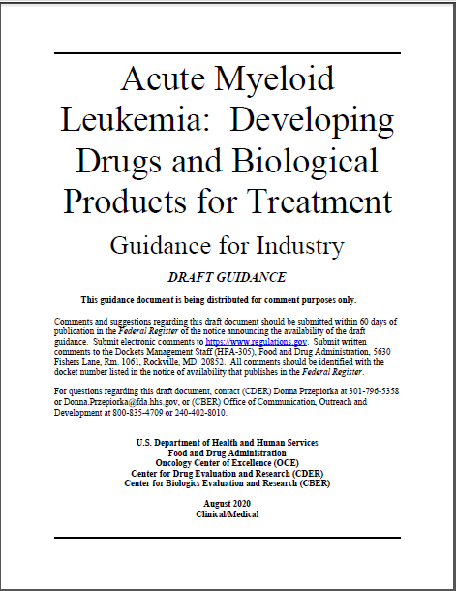
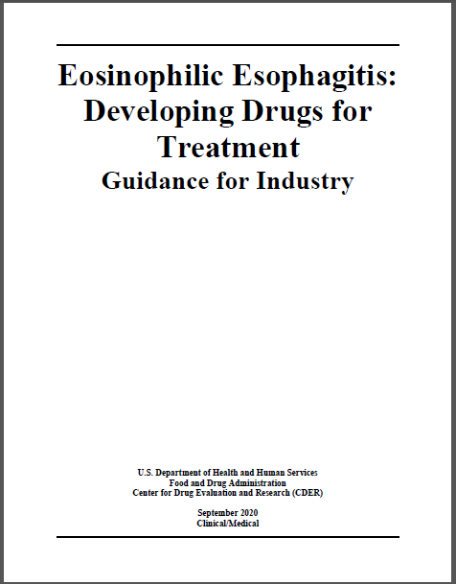
Estimands appearing in guidances

Slide 10
Growing pains
Some elements difficult to communicate between statistical and clinical teams
E.g. hypothetical vs. principal stratum strategies
In some cases, sponsors want to continue business as usual and “backfit” estimand framework to existing practice
It’s even theoretically possible that regulators may succumb to same impulse
For example, consider what used to be ad hoc use of an mITT analysis set now being described as a mTreatment Policy strategy

Slide 11
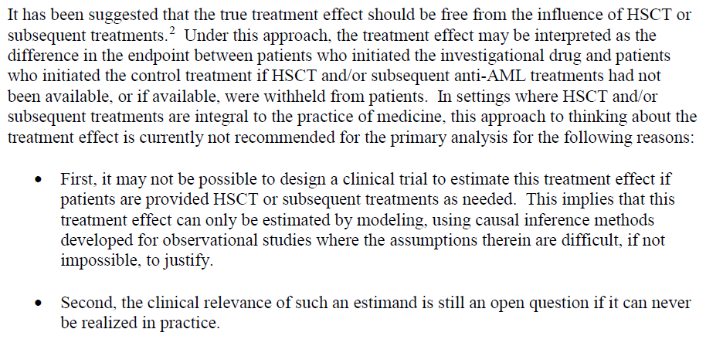
AML guidance excerpt

Slide 12
Hypothetical issues
The existence of hypothetical strategies has become a bit of a temptation to take a somewhat naïve approach to some pretty tough problems
“This intercurrent event is inconvenient, so what if it never happened?”
E.g. AEs, rescue, adherence
Sometimes principal stratum strategies make sense for the underlying, but there seems to be reluctance to invoke the C word
Doesn’t mean hypothetical strategies require fewer unverifiable assumptions than principal stratum approaches
Useful to think ahead to labeling
Picture yourself telling a patient the effect in the label is what they should care about

Slide 13
Using communication as a guide
Sometimes useful to think ahead to labeling
Picture yourself telling a patient the effect in the label is what they should care about
“This is the mean effect among people who wouldn’t need rescue” vs.
“This is the mean effect in everyone if rescue medication didn’t exist”

Slide 14
Fostering discussion

