Slide 1
A promising Adaptive BMK-Based Design for Early Phase Clinical Trials
Alessandra Serra, Sandrine Guilleminot
16th November 2023

Slide 2
Motivation
Goal: Quickly establish that the drug is worth pursuing further, on the overall indication or in a biomarker subgroup
PoC
Approval
Ph I Dose Escalation
Ph Ib Expansion
Ph II
Trial
Ph III
Registration trial
+/- Post Marketing Request
“Traditional” development journey
Putative BMK predictive of treatment responses
Measured on a continuous scale
No predefined cutoff for BMK+ patients
Enrich on BMK + or not ?
No, lack of evidence in patients to support BMK hypothesis
Yes, to avoid the risk of missing an efficacy signal
PoC = Proof of Concept

Slide 3
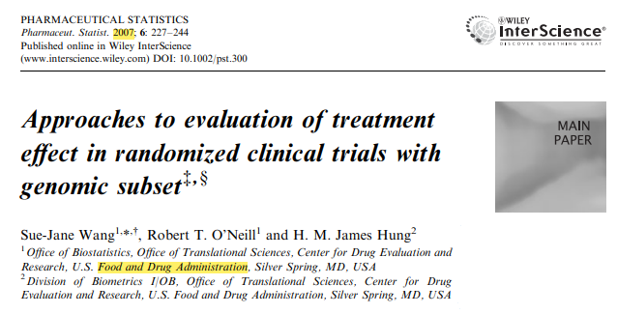
Motivation - Don’t Miss a Signal
Option 1
Option
2
Option
3
No Enrichment
Fixed Design
BMK assessed at the end of the study
Enrichment
Fixed Design
BMK Enrichment at the beginning of the study
ADAPTIVE DESIGN
BMK Enrichment at the interim stage of the study
Risk of missing a signal when treatment benefit is limited to a small BMK+ subgroup
Risk of missing a signal when the cutoff of the BMK is not well established
+
Cannot establish that the BMK-neg patients do not respond
+
Longer recruitment duration
AD offers more power than the non-AD for detecting an effect in a BMK+ subgroup

Slide 4
Many uncertainties at this early stage
Uncertainties about :
The predictive value of the BMK
The cutoff value of the BMK used to identify patients in the BMK+ subgroup
The proportion of patients who are in the BMK+ subgroup
The magnitude of the treatment effect in patients BMK+ and BMK-

Slide 5
Our Design Proposal
Ph Ib Expansion
Interim Analysis
If no robust cutoff found
i.e. 1st data not supportive of the BMK hypothesis
No enrichment strategy
i.e. continue as initially planned (classical design)
Treatment Single-arm study
If robust cutoff found
i.e. 1st data supportive of the BMK hypothesis
Enrichment strategy
i.e. recruit patients likely to respond
Evaluation of the
Predictive value of the biomarker of interest
Robust biomarker cutoff that will guide the next recruitments
Assuming:
No prognostic value of the BMK of interest (as cannot be verified in a single-arm study)
Intermediate clinical endpoint with a reasonable correlation relationship with the clinical endpoint
Preliminary analytical validation of the bioassay used to measure the BMK of interest

Slide 6
Criterion to find a robust cut-off
Comparison of 3 approaches to find a robust cut-off: ‘cut-off‘ or ‘no cut-off‘ based on the following rules:
At least 15% of responses in at least pp% of the population;
Find cut-off by fitting a step function* and then see whether there are at least 15% of responses in at least pp% of the population with this cut-off value;
Find cut-off by fitting a step function*, check if there are at least pp% of the population above the cut-off value and declare to find cutoff if [P(p1 > p0) > diff_thr ] > p_thr.
(*) Same principle (fit a step function) of (**) but with Ordinary Least Squares instead of a Bayesian model (due to convergence issues with the Bayesian model with a small sample size).
Assuming to not have much prior information on the BMK-response shape of the curve and to avoid the issue of misspecified model.
No other method has been used to compare this approach. The aim was initially to assess the feasibility of an adaptive enrichment design at PhI stage.
(**)

Slide 7
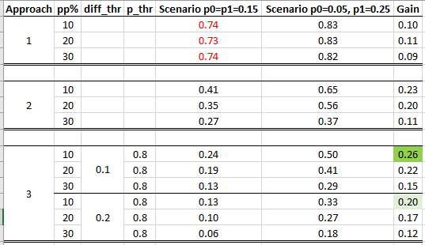
Criterion to find a robust cut-off
Figure: Probability to find a cut-off for the 3 approaches described in slide 6.
The Gain is just computed as the difference between P(find cut-off|p0 = 5%, p1 = 25%) and P(find cut-off|p0 = 15%, p1 = 15%) with
p0=response rate in the BMK- subgroup
p1= response rate in the BMK+ subgroup
Chosen approach
If 80% certain that there is 10% of difference in response rate between the 2 groups
in at least 10% of the population.

Slide 8
BMK-guided design - proposal
Clinical decision rules at final analysis (FA)
No Go: Pr(ORR ≥ TV) ≤ 10% Go: Pr(ORR ≥ LRV) ≥ 80%
Consider: Not a Go or a No Go
Clinical decision rules at the interim analysis (IA)
Futility: Pr(ORR ≥ LRV at FA | data at IA) < 10%
Continue: Pr(ORR ≥ LRV at FA | data at IA) ≥ 10%
…
Efficacy at IA
No
BMK cutoff ?
Yes
Cut-off defined from step function
With at least 10% pop in BMK+ subgroup
P[BMK⁺ - BMK⁻ > 10%] ≥ 80%
P(ORR ≥ LRV at FA| data at IA) in Full pop
P(ORR ≥ LRV at FA| data at IA) in Full pop
< 10%
Stop for futility
≥ 10%
Continue in full pop
< 90%
Check BMK+
≥ 90%
Continue in full pop
P(ORR ≥ LRV at FA| data at IA) in BMK+
< 75%
Stop for futility
≥ 75%
Enrich in BMK+
Design inspired from Tandem two stage design (Antoniou et al., 2016)

Slide 9
Simulation setting
Number of patients: N= 14 at the interim analysis (IA) and 27 at the final analysis (FA)
BMK Normally distributed ~ N(3.46 , σ = 1.3)
based on a Ph Ib expansion on a Servier project
One single cutoff – On/Off relationship between the BMK and the treatment response
other relationships to be tested later on

Slide 10
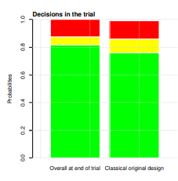
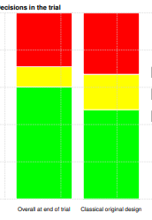
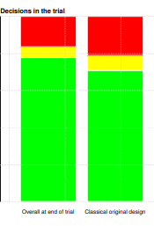
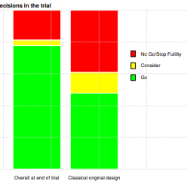
Performance (1/3) Simulations of a better treatment effect in the BMK subgroup
Gain of 6%
Gain of 12%
Gain of 7%
Gain of 30%
0.12
0.13
0.16
0.21
0.18
0.39
0.06
0.10
0.29
0.33
0.06
0.04
0.11
0.08
0.19
0.13
0.82
0.76
0.60
0.48
0.78
0.71
0.78
0.48
Scenario 1
Prevalence 50% BMK+
15% in Overall
25% in BMK+ 5% in BMK-
25% enrichment
Scenario 2
Prevalence 30% BMK+
10% in Overall
28% in BMK+ 3% in BMK-
30% enrichment
Scenario 3
Prevalence 50% BMK+
30% in Overall
41% in BMK+ 19% in BMK-
28% enrichment
Scenario 4
Prevalence 30% BMK+
25% in Overall
60% in BMK+ 10% in BMK-
50% enrichment
TV = 15% and LRV = 5%
TV = 30% and LRV = 19%
Probability to Go, No Go+Futility and Consider regardless of the population (Full pop of BMK+ subgp) and the timing of the analysis (IA + FA) Results obtained using 5000 simulations

Slide 11
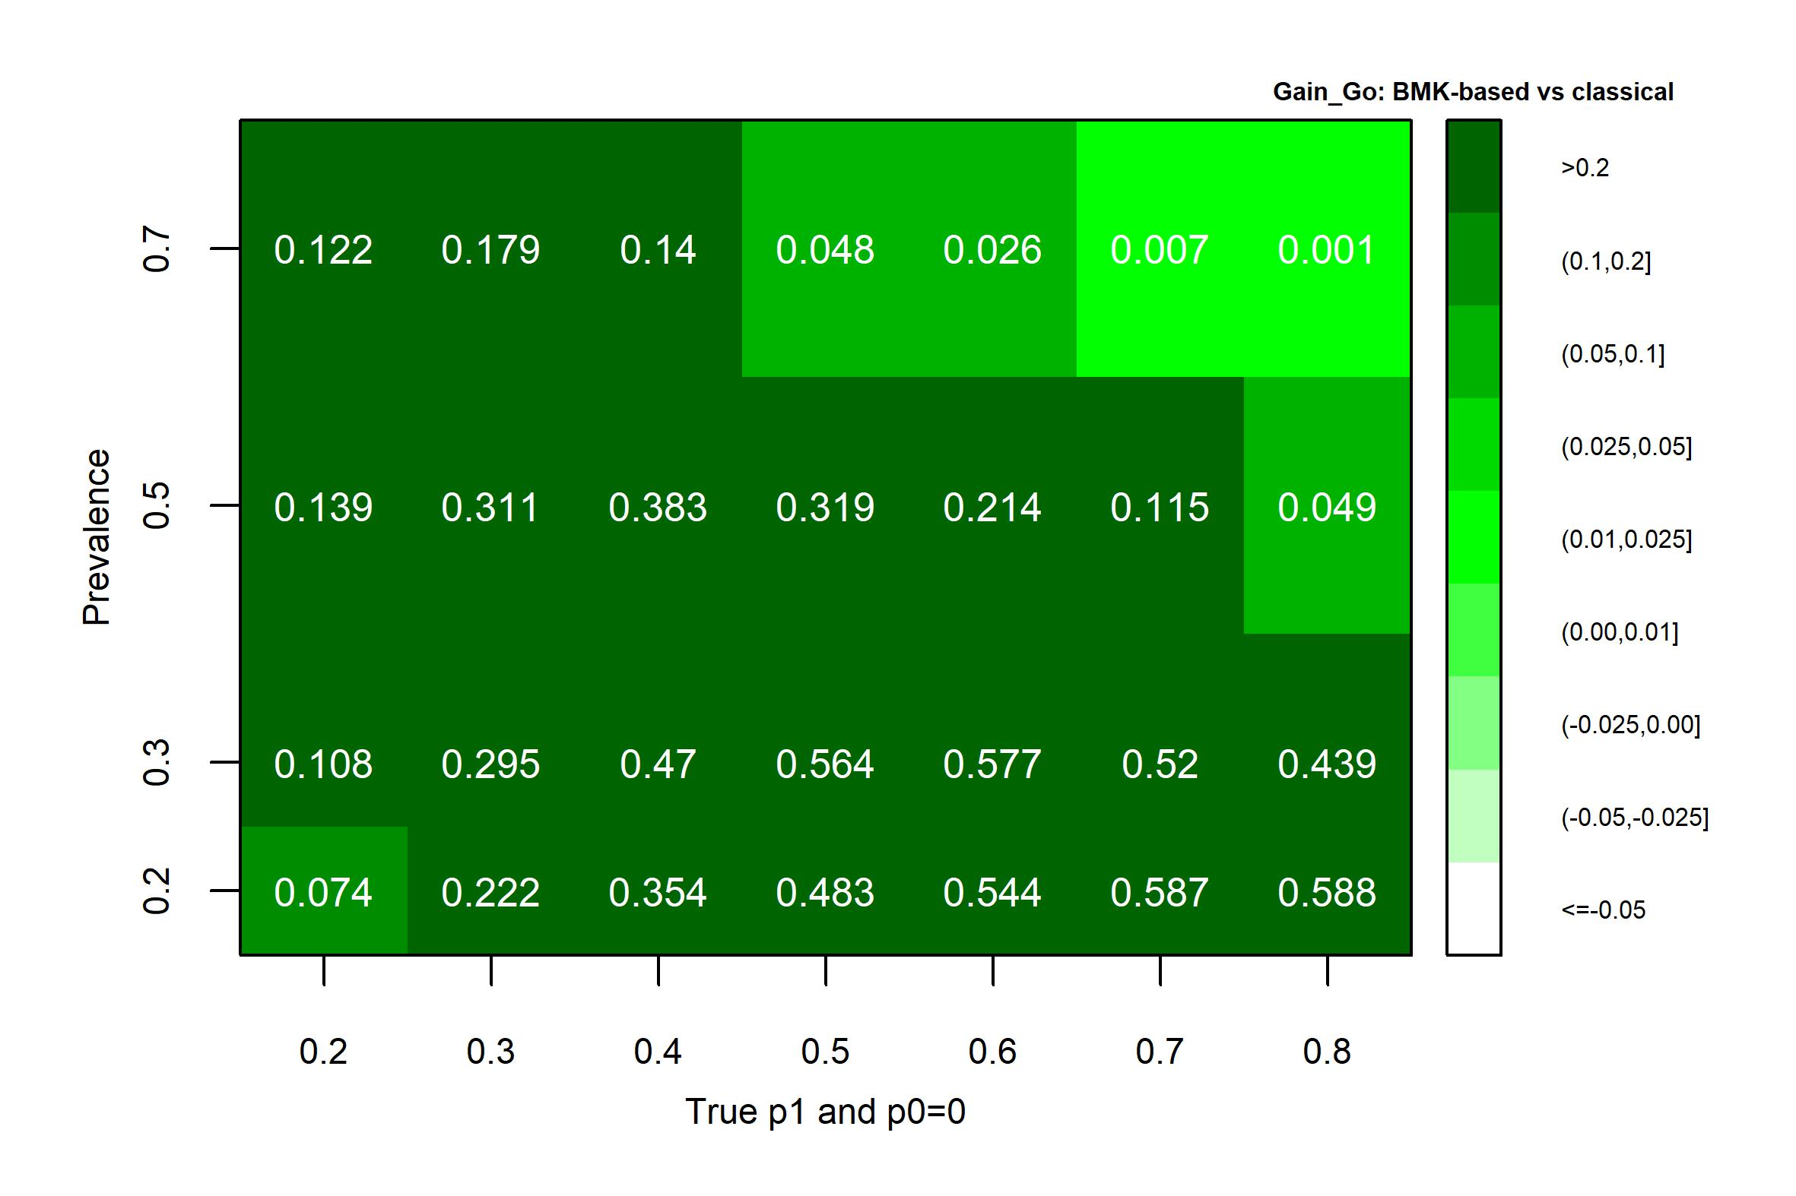
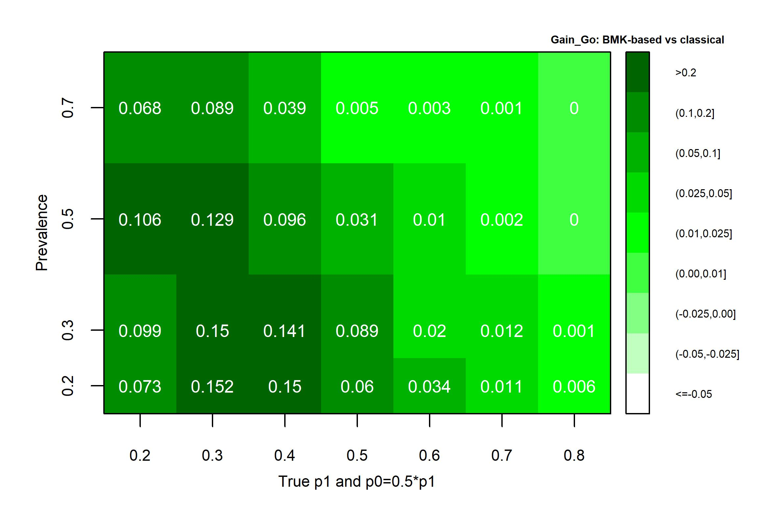
Performance (2/3) Gain according to Prevalence of BMK+ and Magnitude of the treatment effect in patients BMK+/BMK-
When no effect in the BMK- subgroup
Gain up to 60%
When half effect in the BMK- subgroup
Gain up to 15%
TV = 30% and LRV = 19% Results obtained using 5000 simulations

Slide 12
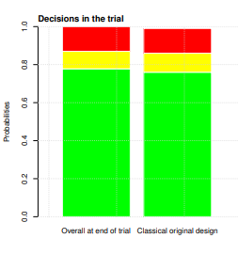
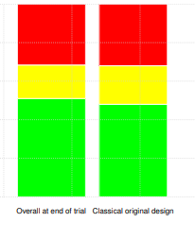
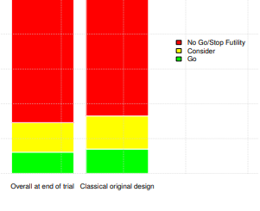
Performance (3/3) Simulations of no better treatment effect in the BMK subgroup
Similar probabilities between
Classical design and
BMK-guided design
Scenario 1
Prevalence 50% BMK+
15% in Overall
15% in BMK+ 15% in BMK-
14% enrichment
Scenario 2
Prevalence 50% BMK+
10% in Overall
10% in BMK+
10% in BMK-
11% enrichment
Scenario 3
Prevalence 50% BMK+
5% in Overall
5% in BMK+ 5% in BMK-
8% enrichment
Probability to Go, No Go+Futility and Consider regardless of the population (Full pop of BMK+ subgp) and the timing of the analysis (IA + FA) Results obtained using 5000 simulations

Slide 13
Discussion
Adaptive approach outperforms the non-adaptive approach. Gain up to 60% in the overall probability to Go compared to the classical design when there is a true BMK cut-off.
Limited false enrichment when there is no true BMK cut-off, and overall, the probability to Go/No Go is almost the same as per the classical design.
If a cut-off is found, then, in most of the considered scenarios, we do not stop for futility.
Step function approach to identify a ‘BMK cut-off‘ works quite well under all scenarios and considering such a small sample size. Further work is needed to compare this approach to other classical approaches (Min pvalue, Youden index, SIDES approach…).

Slide 15
A promising Adaptive BMK-Based Design for Early Phase Clinical Trials
BACK UP

Slide 16
BMK-guided design - proposal
Efficacy at IA
N=14 - Common sample size for PhIa trials
No
BMK cutoff ?
Yes
Cut-off defined from step function
With at least 10% pop in BMK+ subgroup
P[BMK⁺ - BMK⁻ > 10%] ≥ 80%
P(ORR ≥ LRV at FA| data at IA) in Full pop
LRV = 5%
P(ORR ≥ LRV at FA| data at IA) in Full pop
< 10%
Stop for futility
≥ 10%
Continue in full pop (*)
< 90%
Check BMK+
≥ 90%
Continue in full pop
= 0/14 resp
≥ 1/14 resp
≤ 2/14 resp
≥ 3/14 resp
eg, with BMK prevalence at 30%
= 1/5 resp in BMK+ and 0/9 resp in BMK- = 0/5 resp in BMK+ and 1/9 resp in BMK- = 1/5 resp in BMK+ and 1/9 resp in BMK-
= 0/5 resp in BMK+ and 2/9 resp in BMK-
…
P(ORR ≥ LRV at FA| data at IA) in BMK+
< 75%
Stop for futility (**)
≥ 75%
Enrich in BMK+
eg, with BMK prevalence at 30%:
≥ 1/5 resp in BMK+ but to satisfy the cutoff criterion we have:
= 2/5 resp in BMK+ and 0/9 resp in BMK-
Design inspired from Tandem two stage design (Antoniou et al., 2016)

Slide 17
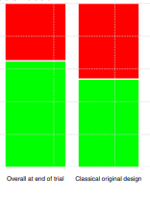
Performance (1/2) Simulations of a better treatment effect in the BMK subgroup
0.12
0.13
0.16
0.21
0.18
0.39
0.19
0.06
0.10
0.29
0.33
0.35
0.46
0.06
0.04
0.05
0.11
0.08
0.19
0.13
0.82
0.76
0.60
0.48
0.65
0.54
0.78
0.71
0.78
0.48
0.76
Scenario 1
Prevalence 50% BMK+
15% in Overall
25% in BMK+ 5% in BMK-
25% enrichment
Scenario 2
Prevalence 30% BMK+
10% in Overall
28% in BMK+ 3% in BMK-
30% enrichment
Scenario 2bis
Scenario 2 with N=20 at IA (instead of 14)
Scenario 3
Prevalence 50% BMK+
30% in Overall
41% in BMK+ 19% in BMK-
28% enrichment
Scenario 4
Prevalence 30% BMK+
25% in Overall
60% in BMK+ 10% in BMK-
50% enrichment
Scenario 4bis
Scenario 4 with only 50% of patients enriched after IA
TV = 15% and LRV = 5%
TV = 30% and LRV = 19%
Probability to Go, No Go+Futility and Consider regardless of the population (Full pop of BMK+ subgp) and the timing of the analysis (IA + FA) Results obtained using 5000 simulations

Slide 18
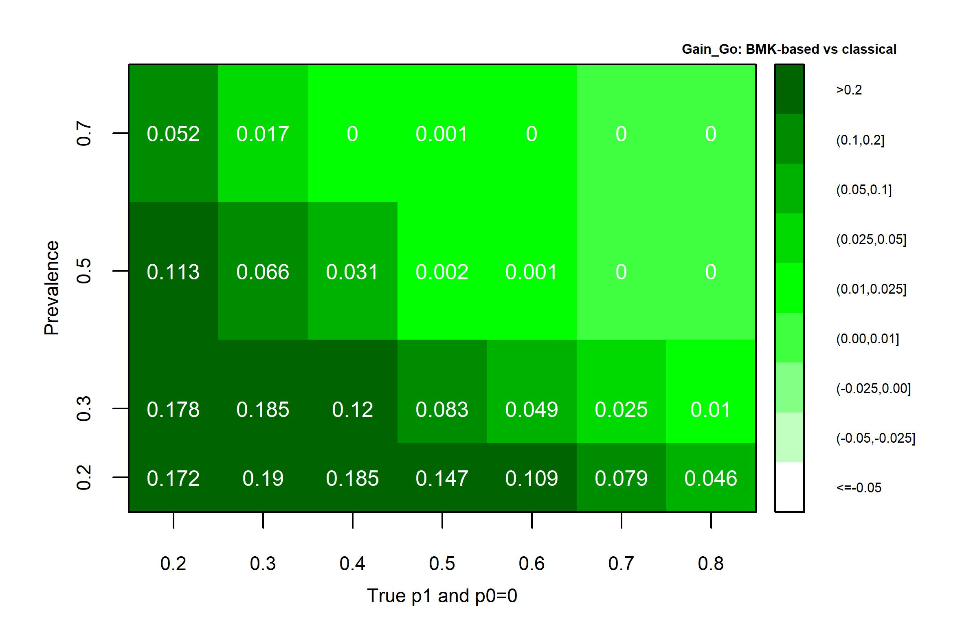
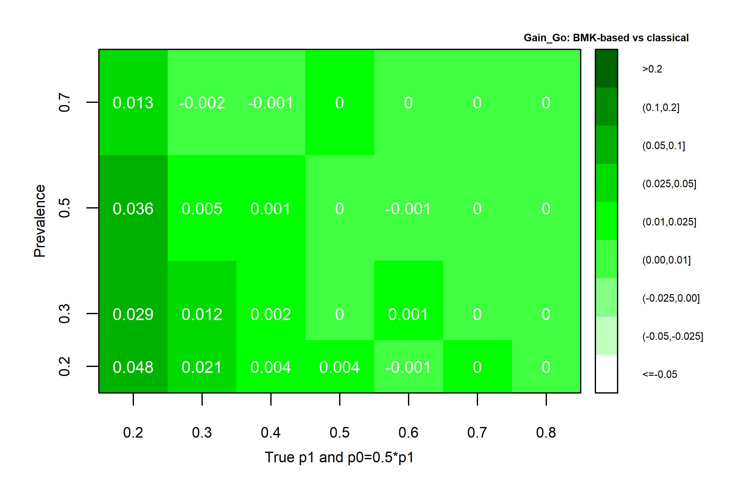
Performance (2/3) Gain according to Prevalence of BMK+ and Magnitude of the treatment effect in patients BMK+/BMK-
When no effect in the BMK- subgroup
Gain up to 19%
When half effect in the BMK- subgroup
Gain up to 5%
TV = 15% and LRV = 5% Results obtained using 5000 simulations

