Slide 1
Operational Considerations in Platform Trials
Kristine Broglio, Statistical Science Director Innovation Statistics
PSI Webinar: Master Protocols – theory, application and regulatory considerations
23 September 2020

Slide 2
Traditional Approach
Each drug is studied in it’s own stand-alone trial
Think of each trial as a house
All the houses have many of the same requirements (infrastructure)
Source: Wikipedia/Tract_housing

Slide 3
Platform Trial Approach
All the drugs come to live in the same house
Share the common infrastructure of the house
Drugs move in and out
Live by house rules that are for the good of everyone
Source: Wikipedia/North_American_fratermity_and_sorority_housing

Slide 4
Examples of Platform Trials
ISPY-2
perpetual phase 2 trial ongoing since 2010. 22 agents in the neoadjuvant setting for LABC
GBM-Agile
Phase 2/3 trial in glioblastoma
DIAN-TU
phase 2/3 trial in dominant inherited Alzheimer’s disease
EPAD
phase 2 trial in Alzheimer’s disease
Healy ALS
phase 2 or phase 3 trial ALS
REMAP-CAP
comparative effectiveness trial in community acquired pneumonia and COVID19

Slide 5
Operational Considerations
Protocol Development
Data Monitoring Committees
Special Considerations For Shared Control

Slide 6
Considerations in Protocol Development

Slide 7
Common Concerns in Protocol Development (1)
Regulatory acceptance
Want the platform to study regimens in a way that would acceptable to regulatory authorities
Engage regulatory authorities well in advance
ISPY2 is an example of a platform that has had drugs graduate and receive accelerated approval from the FDA

Slide 8
Common Concerns in Protocol Development (2)
Statistical and Operational Complexity
Platforms are more complex
More time to develop than a traditional trial and statistical modeling and simulation work can be extensive
More operationally complex to evaluate multiple regimens at time as apposed to a single regimen
Operational efficiency:
The common trial infrastructure reduces start-up time for a new regimen because all processes already in place and running
Statistical efficiencies:
Sample size savings from the common control arm
Fewer total patients on the control arm
Accelerated development time

Slide 9
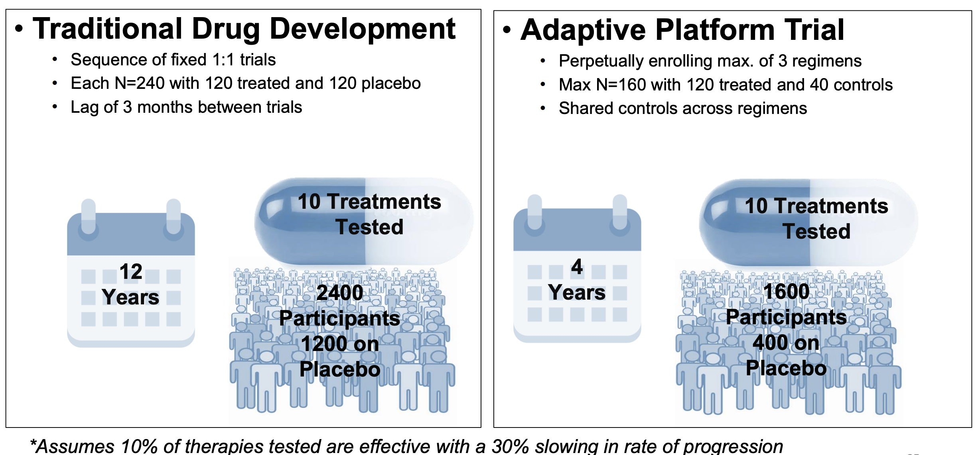
Platform Efficiencies: Healy ALS Platform Example
Source: https://www.massgeneral.org/assets/MGH/pdf/neurology/als/healey-prize-presentation-2019.pdf

Slide 10
Common Concerns in Protocol Development (3)
Loss of autonomy
Sponsors must live under “house rules” and they may not view those as optimal to their drug development program
Some platforms offer more flexibility to the sponsor than others
ISPY2 and GBM-Agile: discourage deviations from the master protocol in the appendix
EPAD and Healy ALS: allow some customization in the appendix

Slide 11
Master Protocol vs The Appendix
Master Protocol
Appendix

Slide 12
Master Protocol vs The Appendix
Master Protocol
Trial Eligibility Inclusion/Exclusion
Appendix
Additional minor restrictions for safety

Slide 13
Master Protocol vs The Appendix
Master Protocol
Trial Eligibility Inclusion/Exclusion Visit Schedule & Data Collection
Appendix
Additional minor restrictions for safety Additional data collection at the visits -> last to be collected

Slide 14
Master Protocol vs “The Appendix”
Master Protocol
Trial Eligibility Inclusion/Exclusion Visit Schedule & Data Collection Sample Size Minimums and Maximums Minimum and maximum follow-up time Statistical Analyses Primary Endpoint Interim Analyses Success and Futility Criteria
Appendix
Additional minor restrictions for safety Additional data collection at the visits -> last to be collected May be allowed to choose different endpoint, sample size, and decision criteria depending on the trial. Can certainly specify own subgroups of interest

Slide 15
Considerations For Data Monitoring Committees

Slide 16
DMC Configuration
One DMC for the entire platform trial
Have at least one statistician with expertise in adaptive designs
May add expertise as necessary for specific regimens or issues
Reviews unblinded safety and efficacy data
Charged with protecting the safety of trial participants and the integrity of the trial
DMC reports more complex given the multiple drugs. Report must provide an overview of the platform as well as the necessary details by drugs.

Slide 17
DMCs and Adaptive Platform Trials
The platform may have adaptive elements beyond arm adding and dropping. Interim analyses to update randomization probabilities or assess early success/futility
Important that key variables are reviewed and monitored in real time
Adaptive analyses can be performed by an unblinded group of statisticians and report sent to DMC
Smaller report focused on only the primary outcomes and adaptive decisions
May not coincide with planned DMC meeting times
Full meeting to review the adaptions not always necessary
The DMC can always make recommendations based on safety concerns and recommend changes that are within the scope of the design

Slide 18
Special Considerations For Shared Control

Slide 19
Issues with Inclusion/Exclusion
Consider how differing inclusion/exclusion by arm affects enrollment to the other arms and the population in the shared control
Some situations may be handled through a stratified randomization and/or a stratified analysis
Some situations may be too disruptive to the other regimens in the platform to be allowed
Inclusion/exclusion modifications for safety should be allowed
Major inclusion/exclusion based on efficacy need more careful consideration
As the populations across regimens differ more and more, the platform will loose the efficiency of the shared control

Slide 20
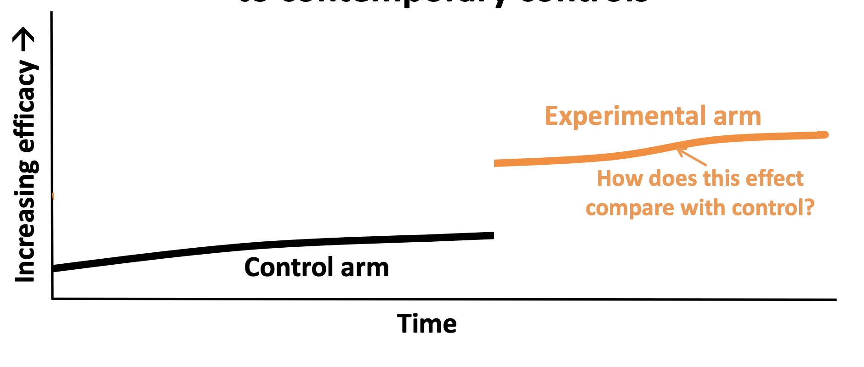
Issues with Time
Drift in the patient population
If control arm is getting better, non-concurrent controls could inflate the treatment difference and vice versa
Account for time trends in the analysis
ISPY2 and REMAP CAP are two examples that use non-concurrent controls and model the affect of time
Source: Viele JSM 2019

Slide 21
Issues with Blinding
If trial must be blinded and each regimen has a different placebo and/or mode of administration
Patients can be randomized to the active treatment or its matching placebo
Consider whether placebo effects are plausible given the endpoint
May propose to pool all placebos together for the analysis or to adjust for mode of administration in the analysis
DIAN-TU is an example of a platform trial with different modes of administration

Slide 22
Issues with Ownership, Sharing, and Use of Data
Will need a data sharing plan and data use agreements with sponsors up front
During the conduct of the trial
Data disclosed to the DMC
Data may not be disclosed to the sponsor
Accrual could be unblinding to efficacy if platform has RAR
Pooled data could be unblinding if control arm is previously known
The trial design time is the sponsor’s opportunity to make decisions as they may not receive data as their regimen is ongoing

Slide 23
Issues with Ownership, Sharing, and Use of Data
When an arm completes
The sponsor will likely receive the the patient level data from their own arm as well as the data from the shared control
Some trial analyses include data from other’s sponsors arms in the final analysis.
ISPY2 uses both active and control patients to model trends over time
A sponsor would never receive other’s data and could not recreate this analysis

Slide 24
Thank you!
Special thanks to Berry Consultants, especially Kert Viele and Michelle Detry

