Slide 1
Biomarkers European SIG: November 16th 2023 Webinar
Nicole Krämer¹ & Guillaume Desachy²
on behalf of the Biomarkers ESIG
¹Global Biostatistics & Data Science, Boehringer Ingelheim GmbH & Co. KG, Biberach, Germany ²Biometrics, Late-stage Development, Respiratory and Immunology, BioPharmaceuticals R&D, AstraZeneca, Gothenburg, Sweden

Slide 2
Disclaimer
The opinions expressed in this presentation are those of the authors, and do not necessarily reflect the official policy of any of the employers listed.

Slide 3
Biomarkers ESIG

Slide 4
3 Goals: Methods, interactions & connections
Establish advanced analytical methods to analyse biomarkers for clinical development
Increase interaction with other disciplines (medicine, biology, academic research)
Connect with other Special Interest Groups

Slide 5
A diverse group coming from industry & academia
👥 45+ members
🤩 Strong interest in biomarkers, with a focus on clinical development
👬 Co-Leads: Guillaume Desachy (AstraZeneca) Nicole Krämer (Boehringer Ingelheim)

Slide 6
SIG kicked off in early 2022 & 3 priority topics identified!
🤝 Kick-off meeting in April 2022 - since then, monthly meetings
🔎Priority topics so far:
Biomarker-based designs
Machine Learning for Biomarkers
Identification of publicly available biomarker datasets

Slide 7
What a journey since 2022! 😍
📻 The Effective Statistician podcast with Alexander Schacht
https://bit.ly/3rqtA4I
📰 Poster presentation at the 2022 PSI conference
📺 PSI Webinar in January 2023
https://bit.ly/3Xo9ohw
🎤 Biomarker ESIG Session at the 2023 PSI conference

Slide 8
Where to find us? 👇
bit.ly/bm-esig

Slide 9
Biomarkers ESIG Co-Leads
https://www.linkedin.com/in/dr-nicole-kraemer/
https://www.linkedin.com/in/guillaume-desachy/

Slide 10
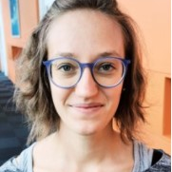
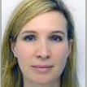
“A promising adaptive biomarker-based design strategy for early phase clinical trials”
Alessandra Serra Research Associate Saryga / University of Cambridge
Sandrine Guilleminot Head of Translational Statistics Servier

Slide 11
Questions?
👇

Slide 12
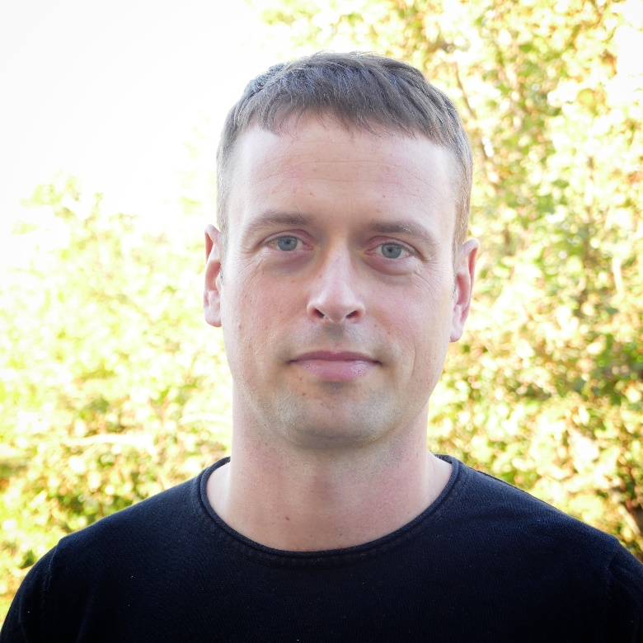
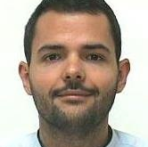
“Machine Learning as an enabler of precision medicine”
Karl Köchert Head of Biomarker & Data Insights Bayer
Nils Ternès Statistical Biomarker Leader Sanofi

Slide 13
Questions?
👇

Slide 14
Where to find us? 👇
bit.ly/bm-esig

Slide 15
Biomarkers ESIG Co-Leads
https://www.linkedin.com/in/dr-nicole-kraemer/
https://www.linkedin.com/in/guillaume-desachy/

