Slide 1
Probabilities of success
Gaelle SAINT-HILARY (Servier)
PSI/EFSPI SIG QDM – Webinar 2, 10 December 2019

Slide 2
Introduction
Past
Present
Future
Contextual evidence
Expert opinion, historical and co-data, literature
Observed data
Clinical trials
Updated evidence
→ Decision-making, Go/No-Go decision
Future evidence
Predictions
Clinical trials in the same context
Extrapolations
Clinical trials in a different context
Prior distribution
Likelihood
Posterior
distribution
Predictive distribution
Inspired from Wandel and Neuenschwander, 2017

Slide 3
Power, Probability of Success, Assurance…
They are all means to quantify how confident we are to meet the success criteria
But what do we mean by success?
Do we want to assess:
How confident we are that the new treatment adds value for patients?
Takes into account available evidence and uncertainties
How confident we are that our development plan permits to show it?
Takes into account available and future evidence and uncertainties

Slide 4
Power, Probability of Success, Assurance…
Definition of the success criteria
Considering available and/or future evidence and uncertainties

Slide 5
Power, Probability of Success, Assurance…
Definition of the success criteria
Considering present and/or future evidence and uncertainties
Cf. previous presentation on QDM frameworks
Often based on one or several of the following conditions:
Statistical significance
“Good” confidence that treatment effect is larger than minimal value ($δ>MV$)
“Good” confidence that treatment effect is larger than target value ($δ>TV$)

Slide 6
Power, Probability of Success, Assurance…
Definition of the success criteria
Considering available and/or future evidence and uncertainties
For example:
Today, what is our confidence level that the treatment effect is large enough?
We consider the posterior distribution of the treatment effect
What is our confidence level that the treatment effect is large enough and that the future studies in the development plan permit to show it?
→ We consider the predictive distribution of the future results in the next study

Slide 7
Power, Probability of Success, Assurance…
Posterior Probability (“Post Prob”) quantifies the level of confidence in the targeted result (e.g. that the treatment effect is large enough) considering the available evidence (posterior distribution)
Power is the PPoS when success criterion in the future trial = statistical significance, conditional on a hypothesis on the treatment effect (fixed value)
Predictive Probability of Success (“PPoS”) is the probability of meeting success criteria in the future trial(s)(predictive distribution)
Predictive Power is the unconditional PPoS when success criterion in the future trial = statistical significance
Assurance is an other name for the PPoS
Spiegelhalter et al. 2004. O’Hagan et al. 2005.
Gasparini et al. 2013. Walley et al. 2015

Slide 8
Motivating example: Alzheimer's disease
Indication: Alzheimer's disease
Primary endpoint: 11-item ADAS-Cog total score change from baseline at W24
Phase II (completed):
125 patients/arm (3 doses vs control, Bonferroni adjustment)
Treatment effect estimate for the selected dose (Mean (SE)): 2.7 (0.76)
Phase III (planned):
1 dose vs control, 100 patients/arm (84% power if $δ=2.5$, with $σ=6$)
We are here
Phase II (completed)
Phase III (planned)
In most cases, in clinical trials, there exists an estimate of the treatment difference reasonably assumed to be normally distributed
→ We will focus on Normal distributions in this presentation

Slide 9
Prior, posterior, predictive distributions Notations
Prior and likelihood
Before development: prior distribution $δ \sim N\left(δ_{0},s_{0}^{2}\right)$
Past study: Estimate (var) $d_{1} \left(s_{1}^{2}\right)$, Likelihood (sampling distribution) $d_{1} | δ \sim N(δ,s_{1}^{2})$
We denote $d=\frac{s_{0}^{2}}{s_{0}^{2}+s_{1}^{2}}d_{1}+ \frac{s_{1}^{2}}{s_{0}^{2}+s_{1}^{2}}δ_{0}$ and $s^{2}=\frac{s_{0}^{2}s_{1}^{2}}{s_{0}^{2}+s_{1}^{2}}$
Today
Posterior distribution $δ | data \sim N\left(d,s^{2} \right)$
Future study
Estimate (var) $d^{∗} \left(s^{∗2}\right)$
Likelihood (sampling distribution) $d^{∗}| δ \sim N(δ, s^{∗2})$
Predictive distribution $d^{∗} \sim N\left(d,s^{2}+s^{∗2}\right)$
Simplified case-study using normally distributed data, assuming trial exchangeability, common known variance for the two groups and no between-study heterogeneity

Slide 10
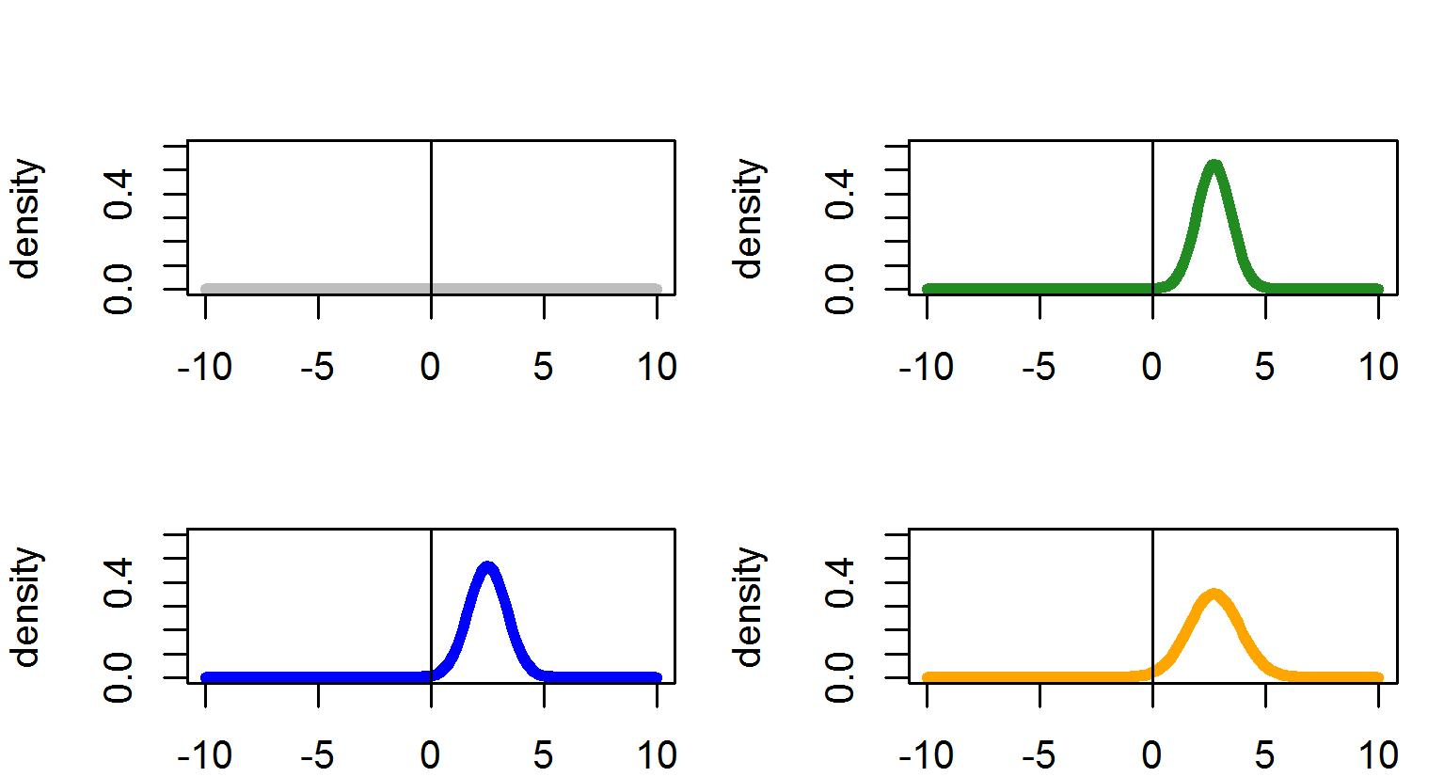
Prior, posterior, predictive distributions Example: Alzheimer's disease
Prior
$δ \sim N\left(0,10^{6}\right)$
Posterior
$$δ|d\sim N\left(d,s^{2}\right)$$
Vague prior
Likelihood next study
$d^{∗}|δ=2.5\sim N(2.5, s^{∗2})$
Predictive
$d^{∗}\sim N(d,s^{2}+ s^{∗2}$)

Slide 11
Prior, posterior, predictive distributions Example: Alzheimer's disease
Prior
$δ \sim N\left(0,10^{6}\right)$
Posterior
$$δ|d\sim N\left(d,s^{2}\right)$$
Vague prior
Likelihood next study
$d^{∗}|δ=2.5\sim N(2.5, s^{∗2})$
Predictive
$d^{∗}\sim N(d,s^{2}+ s^{∗2}$)
2.5
2.7

Slide 12
Prior, posterior, predictive distributions Example: Alzheimer's disease
Prior
$δ \sim N\left(0,10^{6}\right)$
Posterior
$$δ|d\sim N\left(d,s^{2}\right)$$
Vague prior
Likelihood next study
$d^{∗}|δ=2.5\sim N(2.5, s^{∗2})$
Predictive
$d^{∗}\sim N(d,s^{2}+ s^{∗2}$)
Var (predictive) = Var (posterior) + Var (likelihood)

Slide 13
Posterior Probability to support today’s decision from available evidence and uncertainties
$δ$ = treatment difference
Posterior distribution: $δ | data\sim N\left(d,s^{2} \right)$
MV = 2, minimum value of treatment effect for the new medicine to add value for patients
Example of decision criterion:
GO if “we are confident enough that the treatment effect is clinically meaningful”
E.g. GO if “Post Prob” =$P\left(δ>MV ∣ data\right)>0.8$
Otherwise STOP
How confident are we that the new treatment adds value for patients?
$$Post Prob=P\left(δ>MV | data\right)=1 −Φ\left(\frac{MV −d}{s}\right)$$

Slide 14
Predictive Probability of Success (PPoS) to support today’s decision from available and future evidence and uncertainties
$δ$ = treatment difference, $d^{∗}$ = estimate of $δ$ in the next trial, which is planned and designed
Predictive distribution: $d^{∗} \sim N\left(d,s^{2}+ s^{∗2}\right)$
MV = 2, minimum value of treatment effect for the new medicine to add value for patients
Example of decision criterion:
GO if “we are confident enough that the null hypothesis H₀ : $δ≤0$ will be rejected at level $α$ and that the estimated treatment effect will be clinically meaningful in the next study”
E.g. GO if PPoS = $P\left((d^{∗}>z_{α}s^{∗}) ∩(d^{∗}>MV)\right)>0.6$
Otherwise STOP
How confident are we that our future study permits to show that the new treatment adds value for patients?
$$PPoS=P\left(d^{∗}>max(z_{α}s^{∗},MV)\right)=1 −Φ\left(\frac{max(z_{α}s^{∗},MV)−d}{√\left(s^{2}+s^{∗2}\right)}\right)$$
$z_{α}$= $\left(1−α\right){100}^{th}$ percentile of the standard normal distribution

Slide 15
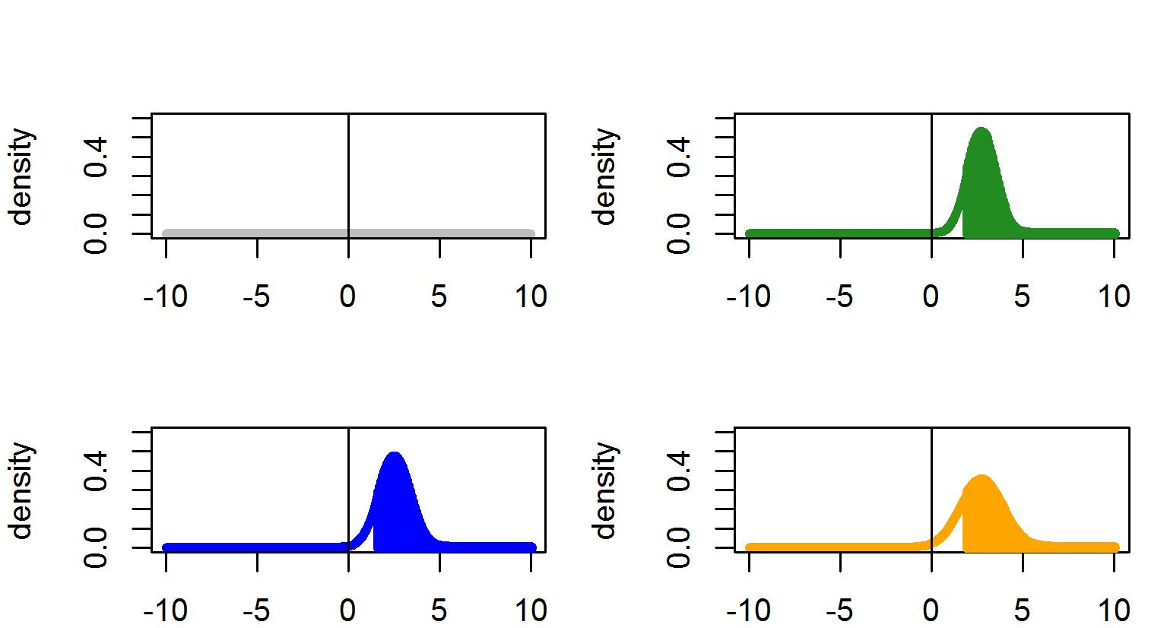
Power, Posterior Prob, PPoS Example: Alzheimer's disease
Prior
$δ \sim N\left(0,10^{6}\right)$
Posterior
$$δ|d\sim N\left(d,s^{2}\right)$$
Vague prior
Post Prob= 82%
Likelihood next study
$d^{∗}|δ=2.5\sim N(2.5, s^{∗2})$
Predictive
$d^{∗}\sim N(d,s^{2}+ s^{∗2}$)
Power next study = 84%
PPoS= 73%
Probability of statistical significance in next study, conditional on a hypothesis on the treatment effect
(fixed value, 2.5 here)
Critical value
≈ 1.66
MV=2

Slide 16
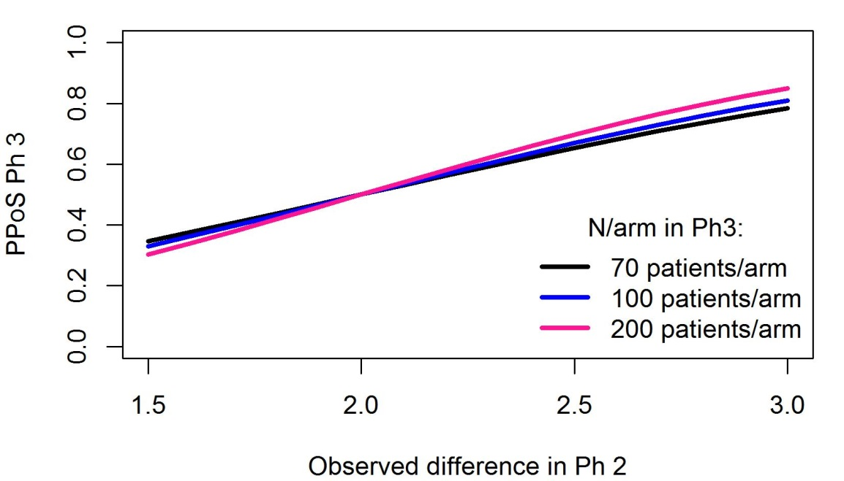
Operating characteristics, sample size planning Example: Alzheimer's disease
Operating characteristics based on Posterior Probability and PPoS are useful to design studies
Conditional operating characteristics before Phase II
Prob(“Post Prob” > 0.8 | true mean)
PPoS Phase III versus observed treatment difference in Phase II
N/arm in Phase II | N=60 /arm | N=125 /arm | N=150 /arm
False GO, if true mean = 0 | 0.4% | 0% | 0%
False STOP, if true mean = 3 | 47.2% | 31.7% | 27.4%
Correct STOP, if true mean = 0 | 99.6% | 100% | 100%
Correct GO, if true mean = 3 | 52.8% | 68.3% | 72.6%
PPoS could be used for sample size planning at the development level
E.g. sample size planning for phase II based on PPoS for Phase III
Götte et al. 2015

Slide 17
What level of Posterior Probability/PPoS is needed to support a Go decision?
The Post Prob and PPoS depend on the success criteria, the design of the studies (in particular, the sample size) and the amount of uncertainty about the treatment effect
The target level for a Go decision should be chosen based on
What is achievable (assessed using operating characteristics, conditional on fixed values or using informative priors)
What is desirable in the context: what level of risk is acceptable to make a decision? E.g.
Well understood disease, highly competitive environment → Low level of acceptable risk
High unmet need, high risk of development failure → Higher level of acceptable risk
Note on classical Power vs Predictive Power
Power in confirmatory trials is usually 80% or 90%
Based on an assumption about the treatment effect
Could always be increased by increasing the sample size
Predictive Power takes into account uncertainties about the treatment effect
There is a limit of how high it can be, which depends on the amount of available uncertainty
Crisp et al. 2018

Slide 18
Extensions, other settings
Several prior studies: estimate based on (network-) meta-analysis
Several future studies: probability to reach the criteria in each study
Interim analysis: probability to reach the criteria at the end of the study given the results at the interim (independent increments)
Multiple endpoints / Multiple doses
Type 1 error adjustment for multiple comparisons if needed
Joint distributions
Bias: selection of doses or populations → overestimation of treatment effect → overestimation of probabilities of success → bias correction needed
Decision-making based on surrogate endpoints
Patient-level or trial-level surrogacy (Saint-Hilary et al. 2019)

Slide 19
Discussion
Posterior Probability and PPoS help decision-making
At the study level (planning, interim analyses,…)
At the development level when assessing
Development strategies
Strategic milestones
Due-diligences
Global project value assessment
Choosing between Posterior Probability or PPoS to define the Go/No-Go criteria depends on the question of interest (related to the treatment effect only, or also to the success of future trials) and the context (future studies already planned and designed?)

Slide 20
Lessons learned from the webinars Quantitative Decision-Making in Drug Development
QDM provides value to trial level, program level and portfolio level decision-making
There is an awareness of QDM methods among statisticians and, to a lesser extent, also among non-statisticians and decision-makers
However, statisticians are not seen as leaders in decision-making processes
Many quantitative methods exist but some of them still remain unknown or unused
QDM is currently used mainly in clinical development
Pre-specification of QDM frameworks with quantitative criteria is a driver for better decision-making
Statistical methods e.g. probabilities of success permit to quantify uncertainty
QDM facilitates better cross-functional communication and planning

Slide 21
References
Wandel, S, and Neuenschwander, B (2017). Bayesian Clinical Trials Workshop, Ulm University, Germany, October 4-5.
Spiegelhalter, DJ, Abramsn, KR, and Myles, JP (2004). Bayesian approaches to clinical trials and health-care evaluation. John Wiley & Sons Ltd, Chichester, UK.
O Hagan, A, Stevens, JW, and Campbell, MJ (2005). Assurance in clinical trial design. Pharmaceutical Statistics 4, 187–201.
Walley RJ, Smith CL, Gale JD, Woodward P (2015). Advantages of a wholly Bayesian approach to assessing efficacy in early drug development: a case study. Pharm Stat. 14(3):205-15. doi: 10.1002/pst.1675.
Gasparini, M, Di Scala, L, Bretz, F, and Racine-Poon, A (2013). Predictive probability of success in clinical drug development. Epidemiology Biostatistics and Public Health 10-1, e8760-1-14.
Götte, H, Schüler, A, Kirchner, M, and Kieser, M (2015). Sample size planning for phase II trials based on success probabilities for phase III. Pharmaceutical Statistics; 14: 515– 524. doi: 10.1002/pst.1717.
Crisp, A, Miller, S, Thompson, D, Best, N. (2018). Practical experiences of adopting assurance as a quantitative framework to support decision making in drug development. Pharmaceutical Statistics; 17: 317– 328. doi: 10.1002/pst.1856
Saint‐Hilary, G, Barboux, V, Pannaux, M, Gasparini, M, Robert, V, and Mastrantonio, G (2019). Predictive probability of success using surrogate endpoints. Statistics in Medicine; 38: 1753– 1774. doi: 10.1002/sim.8060

