Slide 1
Time to Say “Goodbye” to Statistical Significance
Ron Wasserstein
(with grateful acknowledgment to my extraordinary collaborators Allen Schirm and Nicole Lazar)

Slide 2
Example
New treatment compared to placebo to improve TKV (a measure of health in kidney patients, in ml)
After one year, difference in median TKV (treatment – placebo) = 96.8
95% confidence interval 10.8 to 182.7
P-value computed to be 0.027, round off to 0.03
https://journals.plos.org/plosmedicine/article?id=10.1371/journal.pmed.1002777

Slide 3
To compute the p-value
We assumed a bunch of stuff
One key assumption: no difference between the treatment and the placebo

Slide 4
What does the p-value mean?
If there is no difference between the treatment and the placebo
If everything else we assumed is also true
Then the probability that we would observe the difference we found (97 ml), or one even larger, is 0.03

Slide 5
So, our p-value was p=.03
That’s smaller than .05
So it is…statistically significant

Slide 6
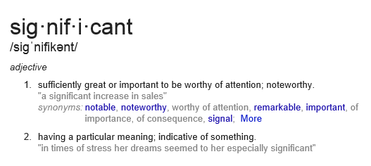
R. A. Fisher called such results “significant”
To Fisher, this meant that the result was worth further scrutiny.

Slide 7
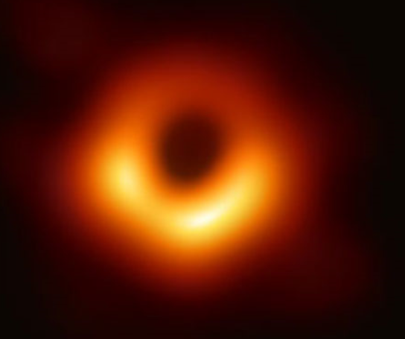
insignificant
unimportant
meaningless

Slide 8
significant increase
significant event
significant other

Slide 9
mole
The amount or sample of a chemical substance that contains as many constitutive particles, e.g., atoms, molecules, ions, electrons, or photons, as there are atoms in 12 grams of carbon-12

Slide 10
“You keep using that word. I don’t think that it means what you think it means.” – Inigo Montoya
“Just a Theory”: 7 Misused Scientific Words, Scientific American, April 2, 2013 https://www.scientificamerican.com/article/just-a-theory-7-misused-science-words/

Slide 11
Word #1
Hypothesis
A proposed explanation that can be tested

Slide 12
Word #2
Theory
An explanation of some aspect of the natural world that has been substantiated through repeated experiments or testing

Slide 13
Word #6
Significant

Slide 14
0.03
P-value

Slide 15
My experimental results are interesting. I should spend more time with them, maybe repeat the experiment. I may be on to something, but it will take time to be sure.

Slide 16
You tiny, beautiful p-value. You are the result that I want to spend the rest of my life with. Let’s publish and get grants together. I love you!

Slide 17
p equal or nearly equal to 0.06
almost significant
almost attained significance
almost significant tendency
almost became significant
almost but not quite significant
almost statistically significant
almost reached statistical significance
just barely below the level of significance
just beyond significance
Notes:
If you think bright-line thinking is not going on, and that it isn’t clustered around 0.05, consider these quotes, taken from actual research articles
Rosnell, R.L. and Rosenthal, R. 1989. Statistical procedures and the justification of knowledge and psychological science. American Psychologist 44: 1276-1284

Slide 18
p equal or nearly equal to 0.08
a certain trend toward significance
a definite trend
a slight tendency toward significance
a strong trend toward significance
a trend close to significance
an expected trend
approached our criteria of significance
approaching borderline significance
approaching, although not reaching, significance
Notes:
If you think bright-line thinking is not going on, and that it isn’t clustered around 0.05, consider these quotes, taken from actual research articles
Rosnell, R.L. and Rosenthal, R. 1989. Statistical procedures and the justification of knowledge and psychological science. American Psychologist 44: 1276-1284

Slide 19
p close to but not less than 0.05
hovered at nearly a significant level (p=0.058)
hovers on the brink of significance (p=0.055)
just about significant (p=0.051)
just above the margin of significance (p=0.053)
just at the conventional level of significance (p=0.05001)
just barely statistically signiﬁcant (p=0.054)
just borderline significant (p=0.058)
just escaped significance (p=0.057)
just failed significance (p=0.057)
Notes:
If you think bright-line thinking is not going on, and that it isn’t clustered around 0.05, consider these quotes, taken from actual research articles
Rosnell, R.L. and Rosenthal, R. 1989. Statistical procedures and the justification of knowledge and psychological science. American Psychologist 44: 1276-1284

Slide 20
Thanks to Matthew Hankins for these quotes
https://mchankins.wordpress.com/2013/04/21/still-not-significant-2/

Slide 21
It is well past time for change
"It has been widely felt, probably for thirty years and more, that significance tests are overemphasized and often misused and that more emphasis should be put on estimation and prediction.”
Cox, D.R. 1986. Some general aspects of the theory of statistics. International Statistical Review 54: 117-126.
A world of quotes illustrating the long history of concern about this can be viewed at David F. Parkhurst, School of Public and Environmental Affairs, Indiana University
http://www.indiana.edu/~stigtsts/quotsagn.html

Slide 22
P-values can indicate how incompatible the data are with a specified statistical model.
P-values do not measure the probability that the studied hypothesis is true, or the probability that the data were produced by random chance alone.
Scientific conclusions and business or policy decisions should not be based only on whether a p-value passes a specific threshold.
ASA statement articulated six principles
https://amstat.tandfonline.com/doi/full/10.1080/00031305.2016.1154108#.Xs5U3GhKhPY

Slide 23
Proper inference requires full reporting and transparency
A p-value, or statistical significance, does not measure the size of an effect or the importance of a result.
By itself, a p-value does not provide a good measure of evidence regarding a model or hypothesis.
ASA statement articulated six principles

Slide 24
Biggest takeaway from ASA Statement
Bright line thinking is bad for science

Slide 25
“(S)cientists have embraced and even avidly pursued meaningless differences solely because they are statistically significant, and have ignored important effects because they failed to pass the screen of statistical significance…It is a safe bet that people have suffered or died because scientists (and editors, regulators, journalists and others) have used significance tests to interpret results, and have consequently failed to identify the most beneficial courses of action.
(Rothman, supplement to the 2016 ASA statement)

Slide 27
“Moving to a World Beyond p<0.05” https://amstat.tandfonline.com/doi/full/10.1080/00031305.2019.1583913#.XYjKQ25FxPY “Scientists rise up against statistical significance” https://www.nature.com/articles/d41586-019-00857-9
It’s time to say farewell to “statistically significant”

Slide 28
Why?
Significance has lost its meaning
Bright lines lead to bizarre behavior
Decades of complaining have done nothing
“A label of statistical significance adds nothing to what is already conveyed by the value of p; in fact, this dichotomization of p-values makes matters worse.” (TAS editorial)
File drawer effect

Slide 29
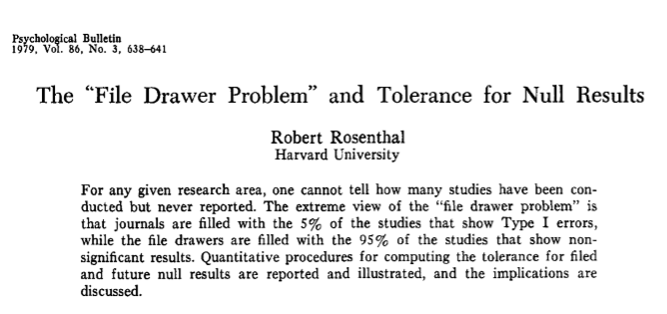
http://datacolada.org/wp-content/uploads/2016/12/3386-Rosenthal-1979-The-file-drawer-problem-and-tolerance-for-null-results.pdf

Slide 30
And to be absolutely clear here…
We are not advocating getting rid of p-values.
We are not speaking for the American Statistical Association.
The 2016 ASA Statement is a statement of the association
The 2019 special issue of The American Statistician is a publication of the ASA but not an official statement of the ASA.

Slide 31
But why does it matter?
Let’s explore two examples.

Slide 32
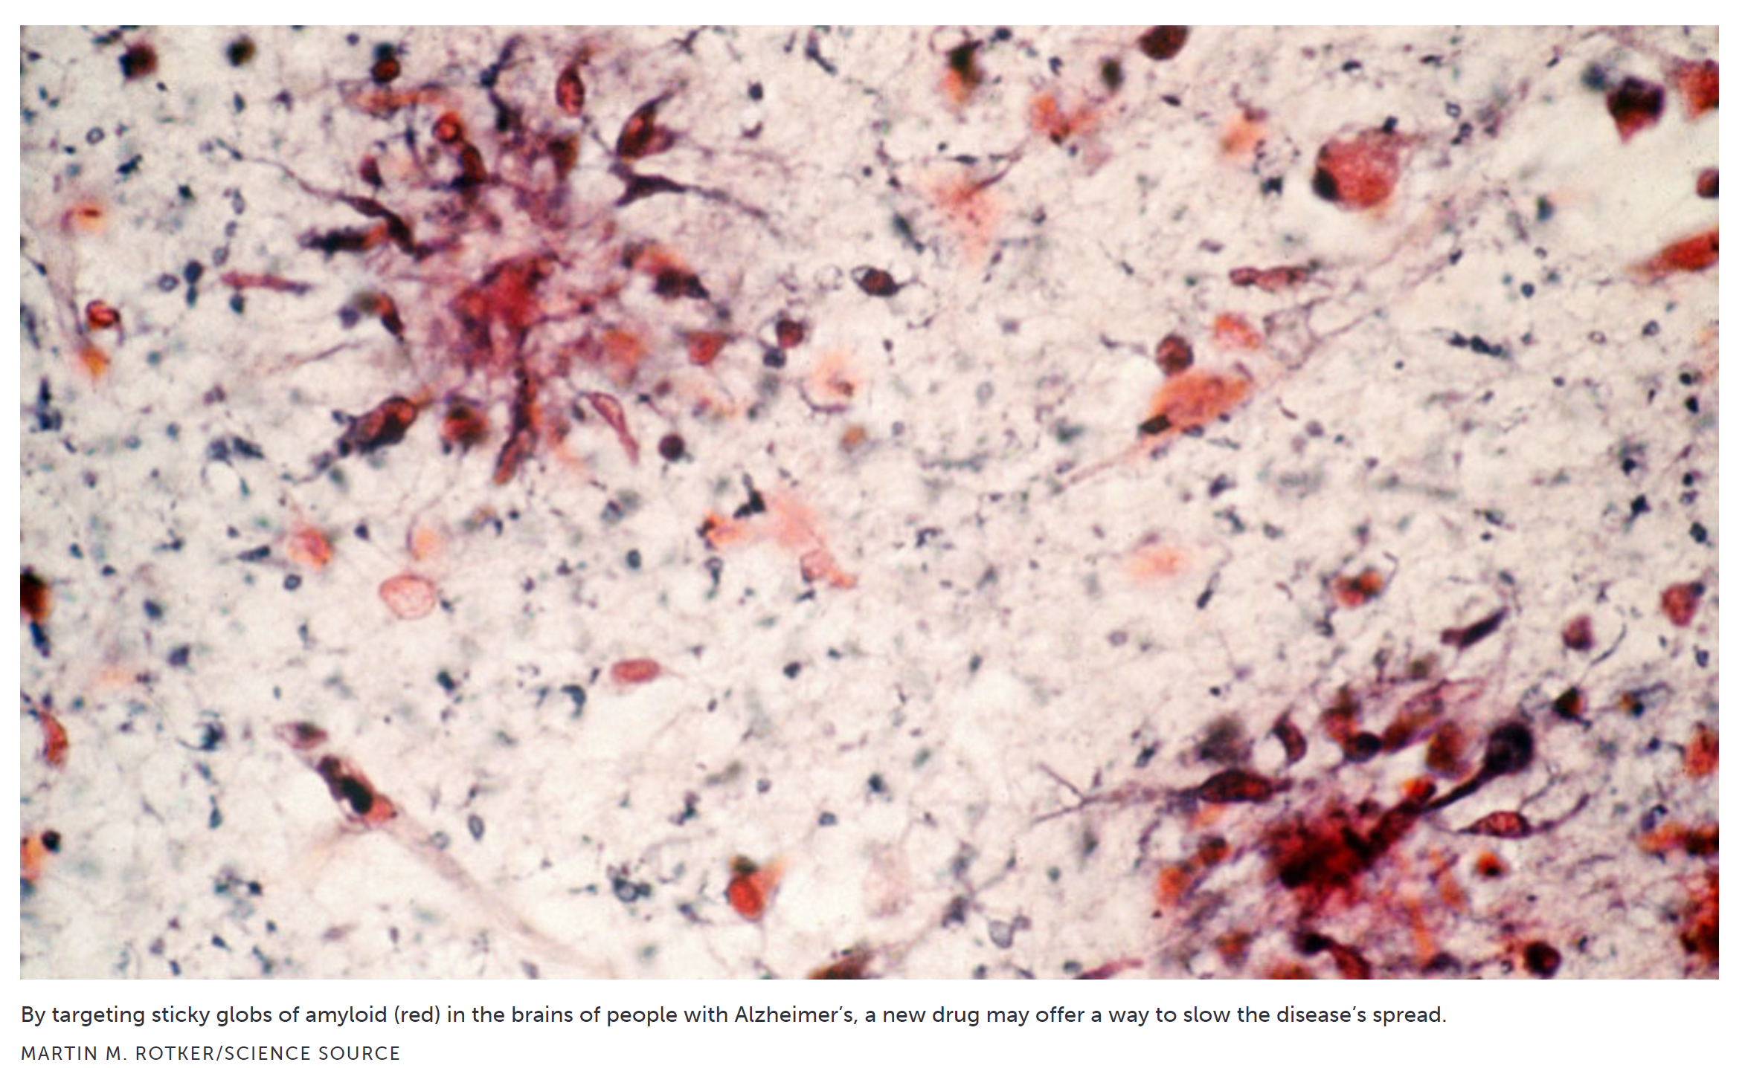
Aducanumab as a treatment for Alzheimer’s Disease
https://www.sciencenews.org/article/once-scrapped-alzheimers-drug-aducanumab-may-work-after-all

Slide 33
The plot elements
The drug aducanumab, an antibody, has been shown to remove amyloid clusters from the brain.
Such buildup on the brain is associated with Alzheimer’s Disease.
The question is whether removal of amyloids would reduce the effects of Alzheimer’s
No drug has thus far succeeded in doing this

Slide 34
The plot elements
Biogen stopped two simultaneous clinical trials on the effectiveness of aducanumab in March 2019 after futility analysis indicated the study would not likely demonstrate efficacy
However, data continued to come in from the study even though it had been halted
“Between December 2018, when data were cut for the futility analysis, and March 2019, when the trials were discontinued, an additional 179 EMERGE and 139 ENGAGE participants completed 18 months of follow-up”
Howard, R., and Liu, K. Y. (2019), “Questions EMERGE as Biogen claims aducanumab turnaround,” Nature Reviews Neurology, 1–2. https://doi.org/10.1038/s41582-019-0295-9.

Slide 35
The plot elements
A subset analysis was undertaken of those participants who received the full, uninterrupted treatment
In ONE of the two trials, statistical significance was achieved. The higher dose led to 23% less cognitive decline than a placebo after 78 weeks.

Slide 36
The plot thickens
Biogen didn’t actually report the absolute difference for CDR-SB, the primary endpoint (Cognitive Dementia Rating Scale - Sum of Boxes)
They report the p-value and the % change from placebo for the larger datasets collected after the futility analysis. The relative change tells us nothing about the actual change or the clinical significance, so they're basically asking people to rely on the statistical significance for importance.

Slide 37
The plot thickens
Biogen argues that the difference in the results can be explained by a protocol change, but this is based on post hoc subgroup analysis, not the best place to focus on p-values
What can be inferred from the (minimal) information provided is that the effect sizes may not actually meet a threshold of clinical significance.

Slide 38
What to do?
Approve the drug?
Ask for an additional trial?
What is the effect of focusing on statistical significance?

Slide 39
Remdesivir

Slide 40
What it is and what do we know so far
An experimental drug to treat the effects of covid-19
Preliminary results indicate that patients who received remdesivir had a 31% faster time to recovery than those who received placebo (p<0.001).
Specifically, the median time to recovery was 11 days for patients treated with remdesivir compared with 15 days for those who received placebo.
Results also suggested a survival benefit, with a mortality rate of 8.0% for the group receiving remdesivir versus 11.6% for the placebo group (p=0.059).

Slide 41
Good news. But this happened…
https://abcnews.go.com/Politics/trump-fauci-tout-good-news-remdesivir-drug-trial/story?id=70407208

Slide 42
Dr. Anthony Fauci mentions “statistical significance” multiple times
He refers to the reduction in time to recovery as being “highly significant,” which in the context of the press conference and general understanding of “statistical significance” confounds the size of the p-value (around .001) with the size of the effect.
Worse still, he refers to the result that was not statistically significant, reduction in mortality, as “trending” toward significance, going on to say that “it has not yet reached statistical significance but the data needs to be further analyzed."
Statements such as the latter, which are common, reinforce the erroneous belief that the threshold dividing significant from not significant also divides true/real from false/spurious.
Furthermore, it risks implying that the threshold can be crossed simply by manipulating the data or analyses, even when further analyses are well justified and not just p-hacking.

Slide 43
And to what end?
We know the estimated difference (11.6% placebo vs. 8.0% treatment)
(It would be nice to have a confidence interval on the difference, and we will eventually)
We know the p-value (0.059)
Slapping a label on this adds no new information, but clearly it adds confusion

Slide 44
Change is indeed needed, as these examples suggest
But change is never easy…

Slide 45
Change won’t be easy
“The basic explanation is neither philosophical nor scientific, but sociologic; everyone uses them. It’s the same reason we can use money. When everyone believes in something’s value, we can use it for real things; money for food, and p-values for knowledge claims, publication, funding, and promotion. It doesn’t matter if the p-value doesn’t mean what people think it means; it becomes valuable because of what it buys.” (Goodman – 2019 (TAS))

Slide 46
What do we do instead?
Look for some answers in the March 2019 special issue of The American Statistician (online and open access)

Slide 47
Five relatively easy changes
Lead with (focus on) effect sizes and related measures of uncertainty (for instance, interval estimates)
Focus on the substantive implications of those estimates. (For example, don’t focus on whether the interval contains zero, but on whether the interval bounds have qualitatively different practical consequences.)

Slide 48
Five relatively easy changes
Interpret confidence intervals as compatibility intervals (that is, describing how compatible the data are with your hypothesized model)

Slide 49
Five relatively easy changes
When presenting p-values, present them as continuous values (not categorized into significant or not), and along with the standard p-value (null hypothesis), report p-values for other pre-specified hypotheses.
(One example: instead of assuming no effect, assume the minimum meaningful effect size.)

Slide 50
Five relatively easy changes
Interpret p-values as (uncertain) descriptive measures of compatibility with the model, and recognize that the value of p is impacted not just by the assumption of the null hypothesis, but by the many other assumptions/choices data analysts make
(The Tinder example helps here in indicating not to rush to fall in love with a low p-value)

Slide 51
Example of compatibility interval interpretation
Study: Covid-19 patients received lopinavir–ritonavir in addition to standard care or standard care alone (randomized trial) (NEJM, March 18, 2020, DOI: 10.1056/NEJMoa2001282)
Result: Mortality difference at 28 days of –5.8 percentage points, 95% CI (–17.3, 5.7)
Conclusion: “Mortality at 28 days was similar in the lopinavir–ritonavir group and the standard-care group (19.2% vs. 25.0%). … In hospitalized adult patients with severe Covid-19, no benefit was observed with lopinavir–ritonavir treatment beyond standard care.”

Slide 52
Example of compatibility interval interpretation
A better statement of this result:
“Our estimate of the mortality difference at 28 days was –5.8 percentage points (= 19.2% – 25.0%); thus, adding lopinavir-ritonavir to standard care could result in a clinically large decrease in mortality. However, possible mortality differences that are highly compatible with our data, given our model, ranged from –17.3 (a very large decrease in mortality) to 5.7 (a large increase in mortality). Our trial was small, including only 199 patients, all with severe Covid-19. Further study of this potentially effective treatment is needed.”
This result should be discussed in the context of the plausibility of the causal mechanism for a beneficial effect (based on prior evidence), the high consistency of results across different study outcomes, study limitations (including but not limited to the large imprecision of the estimates), potential adverse effects of lopinavir-ritonavir, and other relevant considerations.

Slide 53
And one more change, a little harder, but maybe most important
Encourage researchers not to focus on the statistical measure alone (for example, the p-value) but also to consider
related prior evidence
plausibility of mechanism
study design and data quality
real world costs and benefits
novelty of finding
other factors that vary by research domain
(per McShane et al)

Slide 54
Thanks. I look forward to your questions.
ron@amstat.org
(and my colleagues:
nlazar@stat.uga.edu
allenschirm@gmail.com

