Slide 1
Estimands for recurrent events in the presence of a terminal event – Considerations and simulations for chronic heart failure trials
Arno Fritsch
Patrick Schlömer

Slide 2
Acknowledgements
Qualification opinion consortium:
Franco Mendolia (Bayer)
Mouna Akacha, Jiawei Wei, Frank Bretz, Heinz Schmidli, Tobias Mütze (Novartis)
James Roger (London School of Hygiene and Tropical Medicine)
Antje Jahn (Darmstadt Universtiy of Applied Sciences)
Philip Hougaard (Lundbeck)
Henrik Ravn (Novo Nordisk)

Slide 3
Outline
Motivation: Heart Failure Trials
Recurrent Events EMA Qualification Opinion
Submitted Version
Estimands
Methods
Simulation Study
Follow-Up Interactions

Slide 4
Heart Failure Trials
Motivation

Slide 5
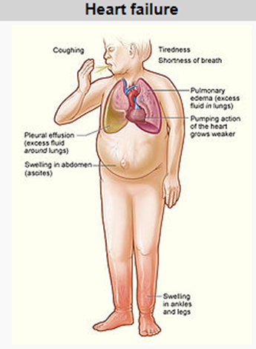
Background: Heart Failure
Major public health issue with increasing prevalence
In 2015: 40 million people affected globally
Two major subtypes:
Heart failure with reduced and with preserved ejection fraction HFrEF and HFpEF
Several treatments approved for HFrEF, none for HFpEF
Heart failure = Inability of the heart to pump sufficiently to maintain the blood flow that the body needs
Source: Wikipedia

Slide 6
Primary Endpoint in Heart Failure Trials (1)
Standard (composite) primary endpoint in heart failure trials
Time-to-first hospitalization for heart failure (HHF) or cardiovascular death (CVD)
Time-to-first composite event analysis ignores 40-50% of all CVDs and HHF events (Anker & McMurray, 2012)

Slide 7
Primary Endpoint in Heart Failure Trials (2)
Interest to include recurrent events into primary endpoint. Driven by
promising post-hoc analyses published (Borer et al., 2012, Rogers et al., 2012, 2014)
non-significant trials in HFpEF indication using time-to-first as primary, e.g. CHARM-Preserved (Yusuf et al., 2003), TOPCAT (Pitt et al., 2014)
Recurrent primary endpoint used in PARAGON-HF trial in HFpEF (Solomon et al, 2019)
Also in device trials (eg, CHAMPION-HF, Abraham et al, 2011)
Investigate use of recurrent HHF for planning a potential heart failure trial
Evaluate power gains/sample size savings in a simulation study
Considering the ICH E9 addendum, investigate potential estimands and methods to address them

Slide 8
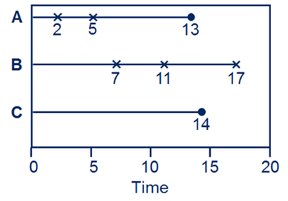
Challenges with Recurrent Events in Heart Failure Trials
Challenge of two types of events: HHFs & CVD
Risks cannot be assumed to be independent
CV death is terminal
Two main analysis options
Analyse recurrent HHF and CVD separately, use recurrent HHF as primary endpoint
Ignore or adjust for potential treatment effect on CVD
Combine both into a recurrent composite endpoint, use composite HHF+CVD as primary endpoint

Slide 9
Submitted Version
Recurrent Events EMA Qualification Opinion

Slide 10
EMA Qualification Opinion
EMA Qualification Opinion
Qualification of novel methods for medicine development (e.g. biomarkers)
First statistical method MCP-Mod (Novartis)
Process similar to typical drug approval submission

Slide 11
EMA Qualification Opinion
Estimands, case studies, efficiency comparison etc. on 80 pages + additional 85 pages appendix
Submitted January 2018

Slide 12
Estimands

Slide 13
Estimand Concept
According to Draft ICH E9 Addendum an estimand has four attributes
Population
Variable
Intercurrent Events
Summary Measure

Slide 14
Estimand HHF
Population
Defined according to inclusion/exclusion criteria
Variable
Number of HHF events
Intercurrent events
Treatment discontinuation: Treatment policy strategy
Events after treatment discontinuation are collected and analysed
CV death and non-CV death: While alive strategy
All events up until time of death are included

Slide 15
Estimand HHF+CVD
Population
Defined according to inclusion/exclusion criteria
Variable
Number of HHF and CVD events
Intercurrent events
Treatment discontinuation: Treatment policy strategy
Events after treatment discontinuation are collected and analysed
Non-CV death: While alive strategy
CV death: Composite strategy

Slide 16
Summary Measure (Both Estimands)
Summary Measure
Let $N_{i}=$ number of events patient$i$ has during study, $T_{i}=$ time that patient$i$ is in the study and $R_{i}={N_{i}}/{T_{i}}$ the individual rate
We consider
$$\frac{\sum_{i=1}^{m}{N_{i}}}{\sum_{i=1}^{m}{T_{i}}} = \frac{N_{1}}{T_{1}}\frac{T_{1}}{\sum_{i=1}^{m}{T_{i}}}+…+\frac{N_{m}}{T_{m}}\frac{T_{m}}{\sum_{i=1}^{m}{T_{i}}}=\frac{1}{\sum_{i=1}^{m}{T_{i}}}\sum_{i=1}^{m}{{T_{i}∗R}_{i}}$$
an exposure-weighted rate
Treatments are compared by the rate ratio between treatment groups

Slide 17
Methods

Slide 18
Methods Investigated (1)
Cox proportional hazards model for time-to-first event
Negative binomial regression (NB)
Proportional intensity model with constant baseline intensity function
Poisson-Gamma mixture process (conditional: Poisson, marginal: NB)
Lin-Wei-Yang-Ying (LWYY)
Proportional rate model with arbitrary baseline rate function
Andersen-Gill model with robust standard errors
Extension of Cox proportional hazards model

Slide 19
Methods Investigated (2)
Wei-Lin-Weissfeld (WLW)
Total time approach (time to 1st, time to 2nd, time to 3rd, …)
Marginal stratified Cox models
Prentice-Williams-Peterson (PWP)
Gap time approach (time to 1st, time from 1st to 2nd, time from 2nd to 3rd, …)
Conditional stratified Cox models

Slide 20
Methods Investigated (3)
Joint frailty model (JFM) (Rogers et al, 2016)
Separately model effect on HHF and CVD (linked by patient specific frailties $Z_{i}$)
CVD: $h\left(t | Z_{i}\right)=h_{0}\left(t\right) Z_{i}^{α} exp⁡(x_{i}β_{CVD})$
HHF: $λ\left(t | Z_{i}\right)=λ_{0}\left(t\right) Z_{i} exp⁡(x_{i}β_{HHF})$
Common choices for distribution of $Z_{i}$ are log-normal and gamma
Estimates are conditional on $Z_{i}$, marginal interpretation not straightforward
Fit via penalized likelihood (R package frailtypack) or Gaussian Quadrature (Liu and Huang, 2008) SAS code

Slide 21
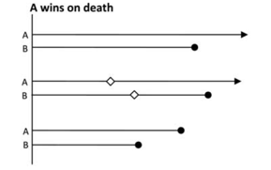
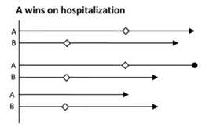
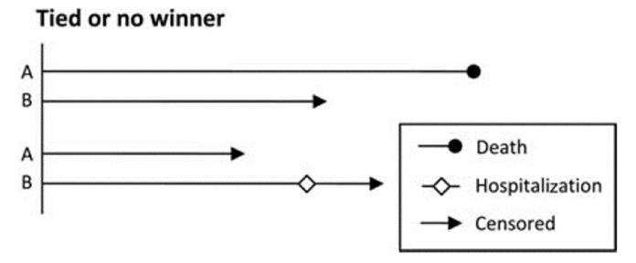
Methods Investigated (4)
WinRatio approach (Pocock et al, 2012)
Based on pairwise comparison of patients between treatment groups (winner, looser, tie)
Compare based on time to CVD
If no winner or looser: Compare based on time-to-first or rate of HHF
Win ratio: $WR={N_{W}}/{N_{L}}$, where $N_{W}$, $N_{L}$ = number of winners/losers in treatment group
We look at unmatched pairs approach

Slide 22
Simulation Study

Slide 23
Simulation Study – Set-Up
Model situations as observed in previous heart failure trials (preserved ejection fraction)
Time to HHFs within patient as well as CVD process and HHF process highly correlated
Joint gamma frailty model to incorporate dependency
Annualized placebo rate of CVD 4.0 (events / 100 patient-years)
CHARM-Preserved 3.9; TOPCAT BNP Stratum 3.9
Annualized placebo rate of first composite event 9.0
CHARM-Preserved 9.1; TOPCAT BNP Stratum 8.5
Overall observed ratio of recurrent to first composite events = 1.8 (Anker and McMurray, 2012)
Choose frailty variance so that this ratio results

Slide 24
Simulation Study – Set-Up (Cont.)
Study duration 5 years / Patient recruitment 3 years
It is assumed that 5% of patients discontinue treatment each year
Treatment effects varied indepently
${RR}_{HHF}:$ Rate ratio for HHF
${HR}_{CVD}$: Hazard ratio for CVD
Sample size: $N=4350$, i.e. 2175 patients per treatment arm
90 % power for LWYY at 5% alpha level when ${HR}_{CVD}=0.8$and ${RR}_{HHF}=0.7$ on HHF+CVD

Slide 25
Simulation Study – Estimand Value
Have noted that mean effect of LWYY same as exposure-weighted estimand
Confirmed by simulation with n=100,000
${RR}_{HHF}$= 0.7
Can also be proven mathematically under joint frailty model and $α=1$
 | Exposure-weighted rate based estimand |  |  | Method | Estimate
HR_{CVD} | 0.8 | 1.0 | 1.25 |  | 0.8 | 1.0 | 1.25
 |  |  |  | Cox | 0.841 | 0.799 | 0.782
HHF | 0.783 | 0.722 | 0.688 | NB | 0.752 | 0.700 | 0.684
 |  |  |  | LWYY | 0.784 | 0.722 | 0.687
 |  |  |  | Cox | 0.875 | 0.898 | 0.935
HHF+CVD | 0.809 | 0.806 | 0.822 | NB | 0.766 | 0.814 | 0.885
 |  |  |  | LWYY | 0.809 | 0.806 | 0.821

Slide 26
Simulation Study – Type I Error
Results shown based on simulating 10,000 studies
Type I error (2-sided)
${RR}_{HHF}=1 \&{ HR}_{CVD}=1$
Relevant null hypothesis for HHF+CVD and part of null hypothesis for HHF
Type I error by all methods controlled both when looking at HHF and HHF+CVD
${RR}_{HHF}=1 \&{ HR}_{CVD}≠1$
Part of null hypothesis for HHF, but not for HHF+CVD
Increased Type I error for ${RR}_{HHF}=1 \&{ HR}_{CVD}>1$

Slide 27
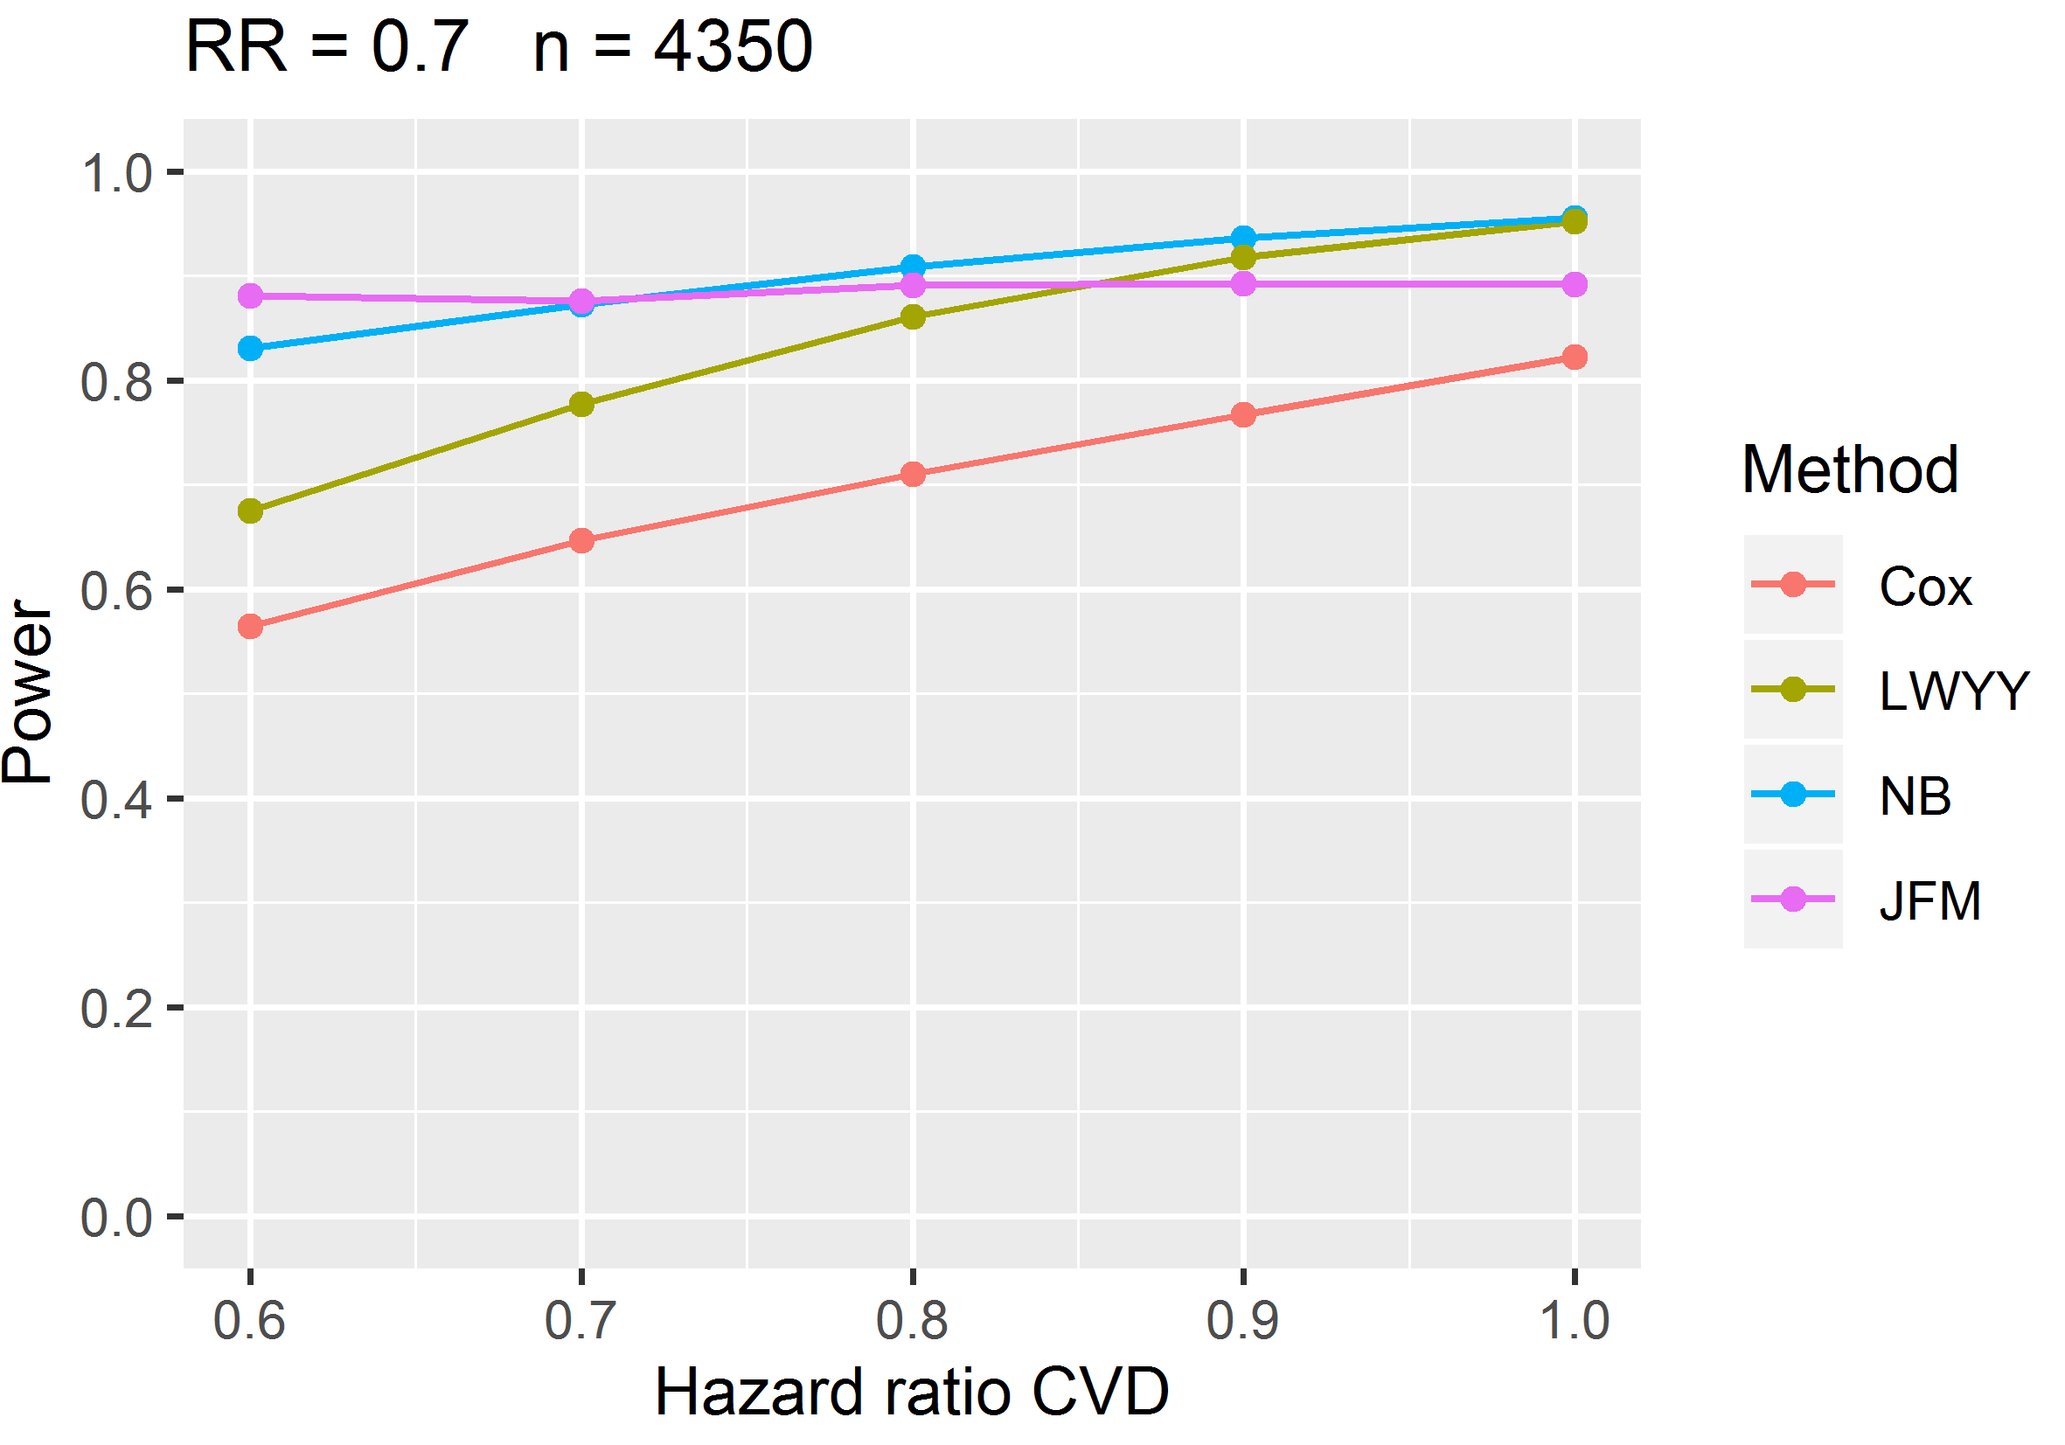
Simulation Study – Power HHF
Fixed treatment effect on HHF ${RR}_{HHF}$=0.7, varying effect on CVD ${HR}_{CVD}$
Substantial power gains for recurrent event methods
Higher power if effect on CVD is lower
Advantage for treatment with worse effect on CVD - undesirable
Joint frailty model seems to be able to adjust for this

Slide 28
Why advantage for treatment with worse CV death effect?
Severely ill patients
Experimental treatment
Moderately ill patients
Mildly ill patients
Severely ill patients
Control treatment
Moderately ill patients
Mildly ill patients
0
HHF
CV Death
End of Follow-up (1 year)

Slide 29
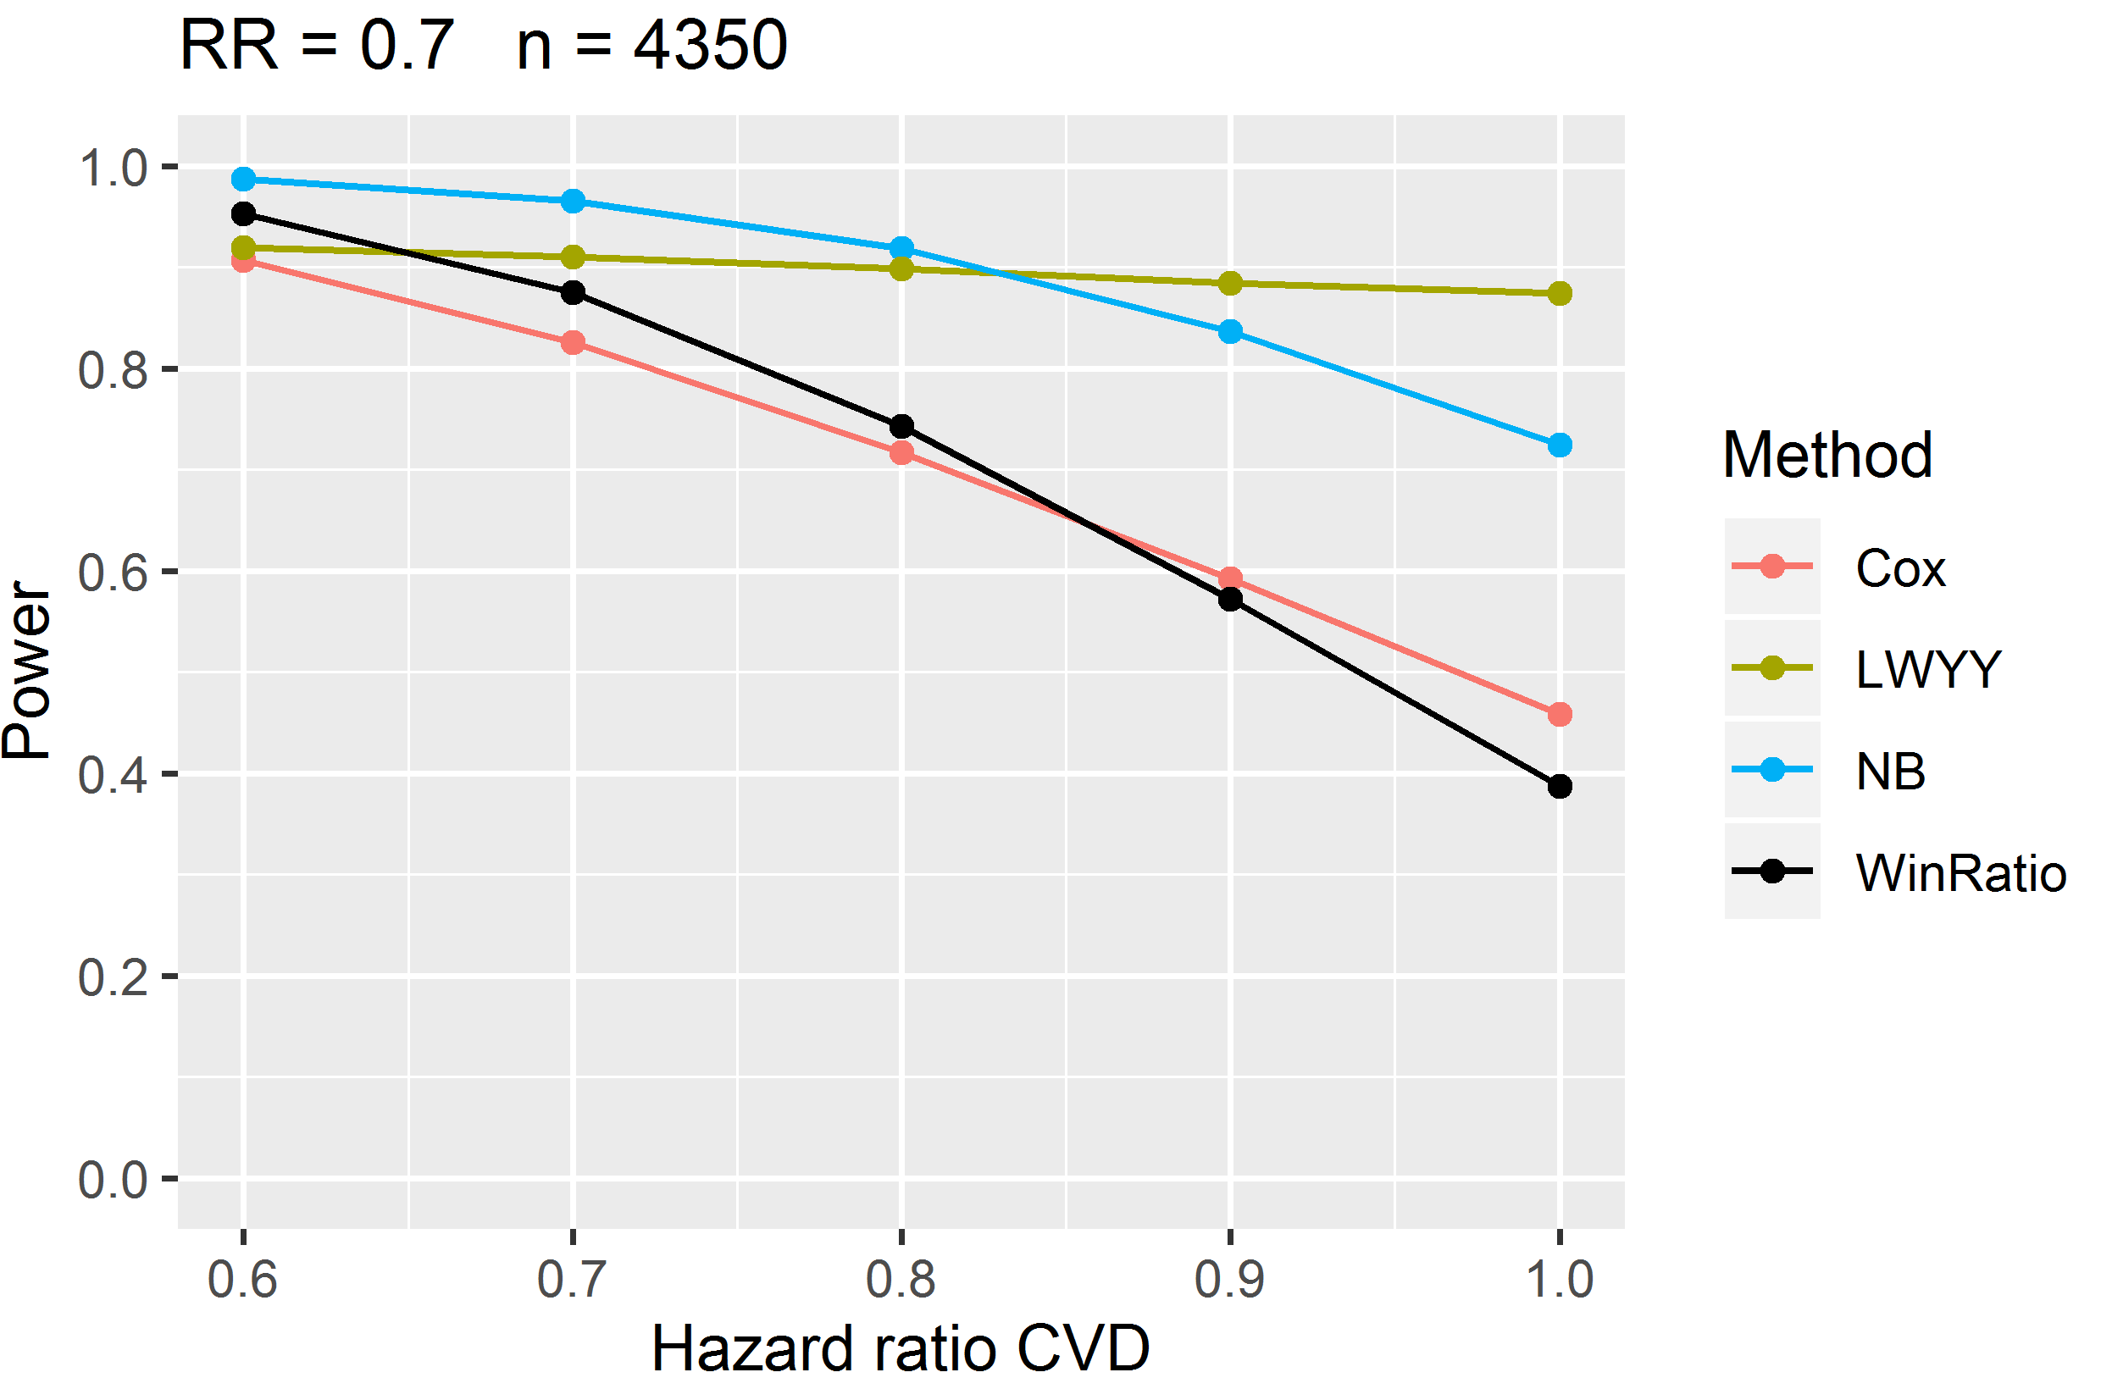
Simulation Study – Power HHF+CVD
Fixed ${RR}_{HHF}$=0.7, varying ${HR}_{CVD}$
Substantial power gains for recurrent event methods
Lower/similar power if effect on CVD is lower
Counting additional event for CVD counteracts effect seen for HHF alone
Also seen in other realistic simulation scenarios
WinRatio has generally a lower power than recurrent event methods
Has higher power than time-to-first event approach when effect on HHF is small and effect on CVD is large

Slide 30
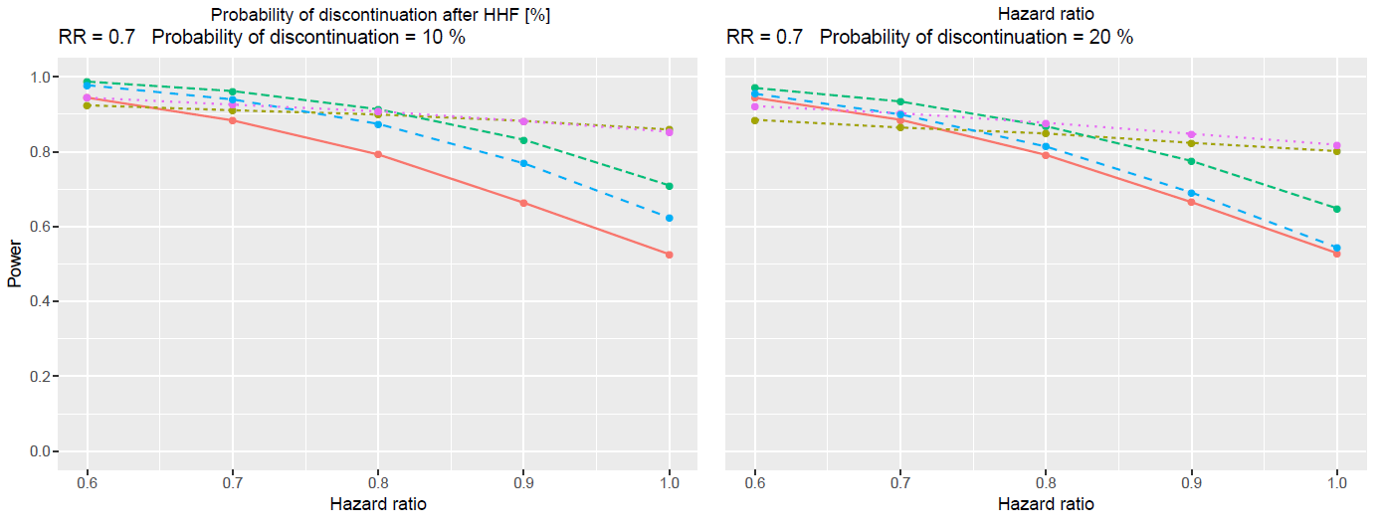
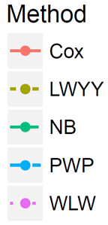
Simulation Study – Treatment Discont. after HHF – HHF+CVD
Clagett et al (2018) also showed that recurrent event methods have higher power, if treatment discontinuation after first event was less than 30%

Slide 31
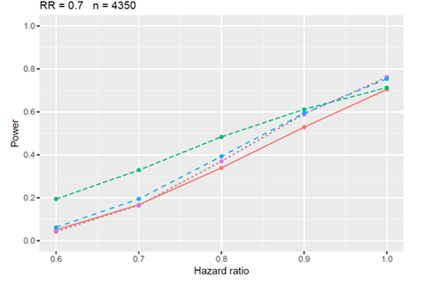
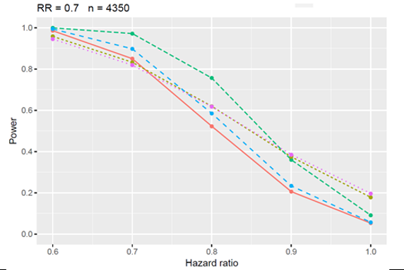
Simulation Study – Increased Mortality Rate
Increased overall mortality rate in study from 12.5% to up to 40%
Behaviour shown on previous slides more pronounced for both estimands
HHF, Mortality rate 40%
HHF+CVD, Mortality rate 40%

Slide 32
Simulation Study – Summary
LWYY method targets ratio of exposure-weighted rate
Type I error controlled if ${RR}_{HHF}=1 \&{ HR}_{CVD}=1$
Higher power for recurrent event methods for both HHF and HHF+CVD
Undesirable behavior for HHF: Power gain with lower effect on CV death
Overcome by using either joint frailty model or composite endpoint HHF+CVD

Slide 33
Interlude: Trial results
HHF+CVD - observed treatment effects RR/HR (with 95% CI)
 | LWYY | NB | Cox
ValHeFT | 0.83 (0.75 - 0.93) p= 0.0012 | 0.84 (0.72 - 0.95) p=0.0176 | 0.89 (0.81- 0.98) p=0.0204
CHARM-Preserved | 0.78 (0.65 – 0.93) p=0.006 | 0.75 (0.62 – 0.91) p=0.003 | 0.86 (0.74 – 1.00) p=0.050
CHARM-Added | / | 0.75 (0.62 – 0.91) p=0.003 | 0.83 (0.74 - 0.94) p=0.003
CHARM-Alternative | / | 0.65 (0.51 - 0.82) p<0.001 | 0.77 (0.67 - 0.89) p<0.001
PARAGON-HF | 0.87 (0.75 – 1.01) p=0.06 | 0.87 (0.74 – 1.01) p=0.07 | 0.92 (0.814 – 1.03) p=0.15

Slide 34
Follow-Up Interactions
Recurrent Events EMA Qualification Opinion

Slide 35
Discussion Qualification Opinion - History
Submitted January 2018
Several rounds of questions in 2018
F2F meeting at EMA in July 2018
Draft qualification published for public consultation June 2019
Commenting was possible until Oct 9

Slide 36
EMA Qualification Opinion
Claim acceptable in situations with no/very low terminal event rate
More skeptical when terminal rate is higher

Slide 37
Discussion points terminal events - Mortality
Concern by EMA that sample sizes get to small to assess mortality, both overall and in subgroups
Arguments brought forward by consortium
Not a different order of magnitude, eg in a typical example provided, recurrent events lead to n=4200 instead of n=5500 patients
Gain in efficiency could be used for gain in power instead of gain in sample size
Requirement for excluding detrimental effect on mortality could be made explicitly, either in general or for individual studies

Slide 38
Discussion points terminal events – HHF+CVD (1)
Recurrent composite endpoint (HHF+CVD):
EMA: Has no clear clinical interpretation, since HHF and CVD have the same weight
Arguments brought forward by consortium
Seen as natural extension of a time-to-first composite event analysis
Argument of equal weights would also apply to time-to-first
Although CVD is worse than HHF, finding a generally agreed weighting is very challenging
Ordinal ranking might be more feasible, WinRatio being a (not efficient) example

Slide 39
Discussion points terminal events – HHF+CVD (2)
Recurrent composite endpoint (HHF+CVD):
Treatment effect is not easy to interpret, need to consider components in addition
Not that different from time-to-first composite
Good operating characteristics
Keeps type I error level
Does not favor a treatment with worse effect on CV death across a range of realistic scenarios
Seems to be appropriate as efficient proof of efficacy

Slide 40
Discussion points terminal events – Exposure-weighted vs. Patient-weighted estimand (1)
Have seen that LWYY targets $\frac{1}{\sum_{i=1}^{m}{T_{i}}}\sum_{i=1}^{m}{{T_{i}∗R}_{i}}$, the exposure-weighted rate
EMA proposes use of $\frac{1}{m}\sum_{i=1}^{m}{R_{i}. }$as summary measure in estimand
A patient-weighted rate
None of the established methods targets this rate
Investigated using non-parametric plug-in estimators and bootstrap standard errors

Slide 41
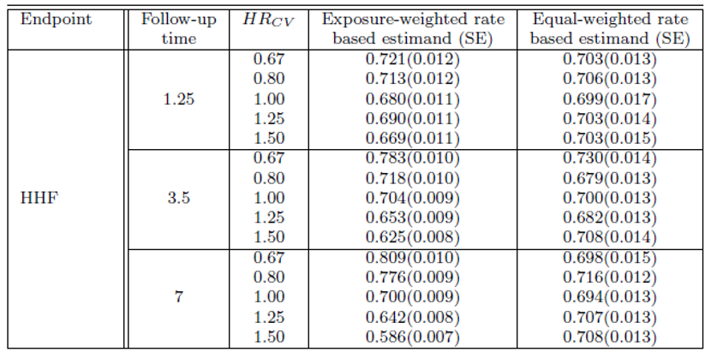
Discussion points terminal events – Exposure-weighted vs. Patient-weighted estimand (2)
For HHF patient-weighted rate targets true value ${RR}_{HHF}=0.7$independent of follow-up and${ HR}_{CVD}$
Ratio of standard errors 1.08 – 1.86, width of CIs would have same ratio
Patient-weighted much less efficient, large weight for patients with short follow-up, which have high variability

Slide 42
Discussion points terminal events – Exposure-weighted vs. Patient-weighted estimand (3)
Patient-weighted rate
Interpretation as reduction in rate of HHF independent of CVD rate and follow-up seems sensible
Probably not of practical use because of variability
Exposure-weighted rate
Dependence on CVD no issue for HHF+CVD
Dependence on follow-up major issue?
„In a study with 3 years mean-follow up event rate per 100 patient-years was reduced from 11 in control to 8 in treatment group“

Slide 43
Summary interactions on qualification opinion
Claim acceptable in situations with no/very low terminal event rate
Differing views on terminal event case with respect to
Mortality assessment,
Recurrent composite HHF+CVD
Exposure-weighted vs. Patient-weighted rate
Will be interesting to see discussion of public consultation
Remark qualification opinion and estimand discussions in general
Too much focus on what should ideally be estimated, and too little focus on efficiency?

Slide 44
Outlook - FDA
FDA draft guidance on endpoints in heart failure (June 2019)
“Acceptable approaches to quantifying hospitalization (and outpatient interventions) for use as an endpoint include binary endpoints (hospitalization (yes/no)), number of hospitalizations, time-to-initial hospitalization, time alive (or at home) and out of the hospital, and time to recurrent hospitalizations.”

Slide 45
Thank you!
Any questions?
arno.fritsch@bayer.com
patrick.schloemer@bayer.com

Slide 46
References
Abraham, W.T., Adamson, P.B., Bourge, R.B., Aaron, M.F. et al. (2011): Wireless pulmonary artery haemodynamic monitoring in chronic heart failure: a randomised controlled trial. Lancet, 377, 658-666.
Andersen, P. K. and Gill, R. D. (1982): Cox’s regression model for counting processes: a large sample study. Ann. Stat., 10: 1100–1120.
Anker and McMurray (2012). Time to move on from “time-to-first”: should all events be included in the analysis of clinical trials? Eur. Heart J. 33, 2764-2765.
Borer, J. S., Böhm, M., Ford, I., Komajda, M., Tavazzi, L., Lopez Sendon, J., Alings, M., Lopez-de Sa, E., and Swedberg, K. (2012). Effect of ivabradine on recurrent hospitalization for worsening heart failure in patients with chronic systolic heart failure: the SHIFT Study. Eur. Heart J., 33, 2813–2820.
Clagett, B., Pocock, S., Wei, L.J., Pfeffer, M.A., McMurray, J.J.V, and Solomon, S.D. (2018). Comparison of Time-to-First Event and Recurrent Event Methods in Randomized Clinical Trials. Circulation, 138, 570-577.
Lin, D. Y., Wei, L. J., Yang, I. & Ying, Z. (2000): Semiparametric regression for the mean and rate functions of recurrent events. J. R. Stat. Soc., B, 62, 711–730.
Liu, L. and Huang, X. (2008).The use of Gaussian quadrature for estimation in frailty proportional hazards models. Stat. in Med., 27, 2665-2683.
Pitt, B., Pfeffer, M. A., Assmann, S. F., Boineau, R., Anand, I. S., Clagett, B., Clausell, N., Desai, A. S., Diaz, R., Fleg, J. L., Gordeev, I., Harty, B., Heitner, J. F., Kenwood, C. T., Lewis, E. F., O’Meara, E., Probstfield, J. L., Shaburishishvili, T., Shah, S. J., Solomon, S. D., Sweitzer, N.K., Yang, S., and McKinlay, S.,(2014): Spironolactone for heart failure with preserved ejection fraction. New Engl. J. of Med. 370, 1383-1392

Slide 47
References
Pocock, S. J., Ariti, C. A., Collier, T. J. and Wang, D. (2012): The win ratio: a new approach to the analysis of composite endpoins in clinical trials based on clinical priorities. Eur. J. Heart Failure, 33, 176-182.
Rogers, J. K., McMurray, J. J., Pocock, S. J., Zannad, F., Krum, H., van Veldhuisen, D. J., Swedberg, K., Shi, H., Vincent, J., and Pitt, B. (2012). Eplerenone in patients with systolic heart failure and mild symptoms: Analysis of repeat hospitalizations. Circulation, 126:2317–2323.
Rogers, J. K., Pocock, S. J., McMurray, J. J. V., Granger, C. B., Michelson, E. L., Östergren, J., Pfeffer, M. A., Solomon, S. D., Swedberg, K., and Yusuf, S. (2014). Analysing recurrent hospitalizations in heart failure: a review of statistical methodology, with application to CHARM-Preserved. Eur. J. Heart Failure, 16, 33–40.
Rogers, J. K., Yaroshinsky, A., Pocock, S. J., Stokar, D., and Pogoda, J. (2016). Analysis of recurrent events with associated informative dropout time: Application of the joint frailty model. Stats in Med., 35, 2195-2205.
Solomon, S.D., McMurray J.J.V., Anand I.S., Ge J., Lam C.S.P., Maggioni A.P., et al. (2019) Angiotensin-Neprilysin Inhibition in Heart Failure with Preserved Ejection Fraction. N Engl J Med., 2019
Yusuf, S., Pfeffer, M. A., Swedberg, K., Granger, C. B., Held, P., McMurray, J. J. V., Michelson, E. L., Olofsson, B., Östergren, J. (2003): Effects of candesartan in patients with chronic heart failure and preserved left-ventricular ejection fraction: the CHARM-Preserved trial. Lancet, 362, 777-781

Slide 48
Back-Up

Slide 49
Simulation study details
Frailties $z_{i}$ gamma distributed with mean 1 and variance $θ$
Control rates $λ_{CV}$ and $λ_{HHF}$ and frailty variance $θ$ such that previous CHF trials are emulated
Basecase:
Inter-event time are exponential
$λ_{CV}=0.07032$, $λ_{HHF}=0.15444$, $θ=5.7$
$α=0.75$ frailty correlation between two processes (Rogers et al., 2106)
10,000 iterations used, unless otherwise specified
Exception: Joint frailty model results use 1000 iterations due to long-run time in SAS
Non-CVD as censoring event ➔ non-CVD was about 30% of all-cause death

Slide 50
Simulation Study – Type I Error
Type I error (1-sided)
${RR}_{HHF}≥1 \&{ HR}_{CVD}≥1$
One-sided null hypothesis for HHF+CVD
Type I error by all methods controlled for HHF+CVD
${RR}_{HHF}≥1$
One-sided null hypothesis for HHF
Type I error controlled for ${RR}_{HHF}≥1 \&{ HR}_{CVD}≤1$
Increased 1-sided Type I error for ${RR}_{HHF}=1 \&{ HR}_{CVD}>1$

Slide 51
Simulation study results: Type 1 error (1-sided)
${RR}_{HHF}=1.0$
Type I error controlled for both HHF and HHF+CVD under null hypothesis ${RR}_{HHF}=1.0$ and ${HR}_{CVD}=$1
Increase of type I error under null hypothesis ${RR}_{HHF}=1.0$ and ${HR}_{CVD}$>1
HHF
HR_{CVD} | Method | Estimate | Type I error
0.8 | Cox | 1.027 | 0.010
 | NB | 1.035 | 0.010
 | LWYY | 1.058 | 0.005
 | JFM | 1.010 | 0.019
1.0 | Cox | 1.002 | 0.023
 | NB | 1.002 | 0.025
 | LWYY | 1.002 | 0.023
 | JFM | 1.002 | 0.028
1.25 | Cox | 0.973 | 0.058
 | NB | 0.964 | 0.057
 | LWYY | 0.942 | 0.100
 | JFM | 0.991 | 0.031
HHF + CVD
HR_{CVD} | Method | Estimate | Type I error
1.0 | Cox | 1.002 | 0.022
 | NB | 1.001 | 0.024
 | LWYY | 1.001 | 0.024
 | WinRatio | 1.000 | 0.024

Slide 52
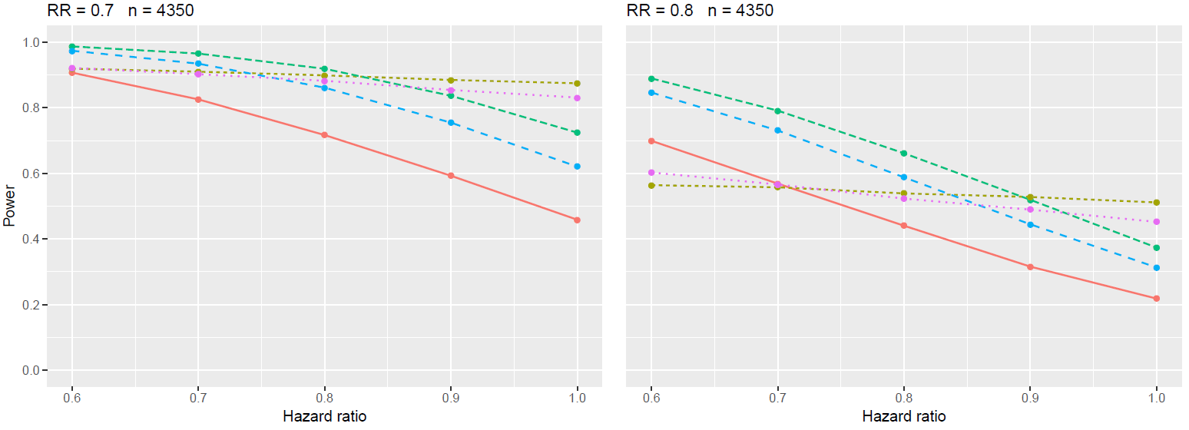
Power for recurrent composite – further methods
LWYY = Andersen-Gill, NB = Negative Binomial, PWP = Prentice, Williams, Peterson, WLW = Wei, Lin, Weissfeld

Slide 53
WinRatio
Matched version of WinRatio form pairs of patients from treatment and control group with similar baseline factors – matching needs prespecification
Unmatched version considers all possible pairs
Subjects within each pair are compared as described before to determine winner/loser/tie
Number of winners in treatment group: $N_{W}$
Number of losers in the treatment group: $N_{L}$
Win ratio: $WR=\frac{N_{W}}{N_{L}}$
Interpretation difficult and formulation in Estimands framework unclear

Slide 54
WinRatio - Criticism
Dependence on follow-up and censoring time
For shorter follow-up time most wins will be on hospitalizations, for longer shift to deaths
Lack of transitivity
B wins over A, because of longer survival
C wins over B, because of longer time to first HHF
Should follow: C wins over A
But actually A wins over C, because of longer time to first HHF
Death
Hospitalization
Censored

