Slide 1
Statistics and Clinical Trials
Careers in Mathematics
Created and funded by PSI

Slide 2
What job does Maths lead to?
What you Study
Job
Law
Lawyer
Engineering
Engineer
Veterinary Sciences
Vet
Medicine
Medic
Maths
Mathematician

Slide 3
What is a ‘Maths’ job?
Finance…
Trader
Bank manager
Accountant

Slide 4
What is a ‘Maths’ job?
Finance…
IT & Computing…
Trader
Bank manager
Accountant
Data scientist
Website or game designer
Analyst

Slide 5
What is a ‘Maths’ job?
Finance…
IT & Computing…
Trader
Bank manager
Accountant
Data scientist
Website or game designer
Analyst
Something else… Statistician
Engineer
Teacher
Modeller
(weather or climate forecasts)
Codebreaker

Slide 6
What is Statistics?
Statistics is a type of maths
Really, it’s the study of data
How do we collect data?
How do we summarise and analyse data?
How do we present data?
What’s the difference between Maths and Statistics?

Slide 7
Maths vs Statistics
Question: What is the perimeter of the square?
A
2
0 cm
5 cm
B
5 cm
5 cm

Slide 8
Maths vs Statistics
Question: Describe the age of people in this room.
Age: 9
Possible answers
9
9
10
10
12
14
Median (middle age) = 10
Mode (most common age) = 9
Range = 9 to 14
Multiple answers and all answers are correct!

Slide 9
Maths vs Statistics
Mathematics
Statistics
In Maths, there is a single answer
In Statistics, there are lots of answers!

Slide 10
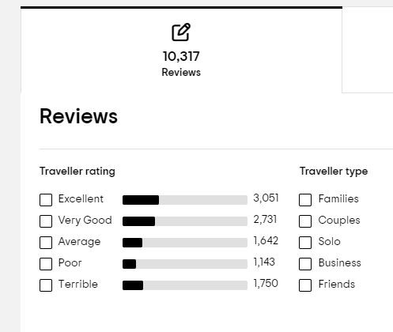
Statistics is all around us!
Reviews you see online are all statistics, summarizing data
Recommendations generated by prediction models

Slide 11
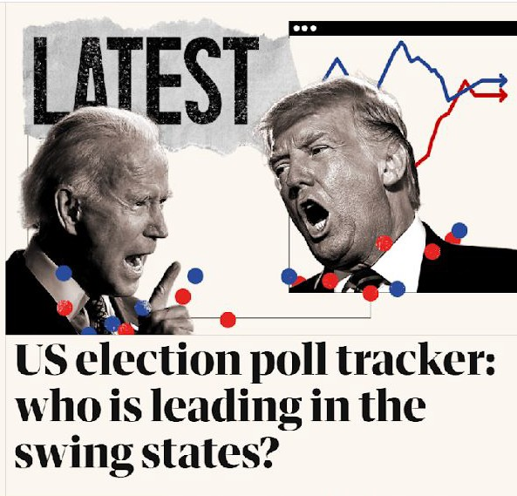
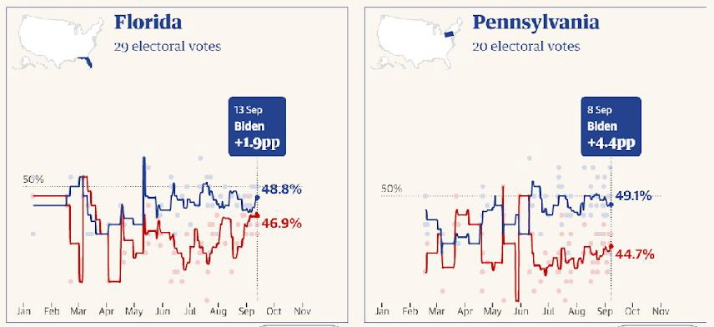
Statistics is all around us!
Additional examples
Statisticians try to predict what will happen in elections by asking people questions.
This is called opinion polling - and is very difficult to get right!

Slide 12
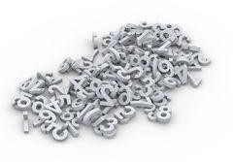
Statistics is all around us!
Statisticians use data to estimate how quickly coronavirus is spreading, which helps politicians make decisions about fighting the virus

Slide 13
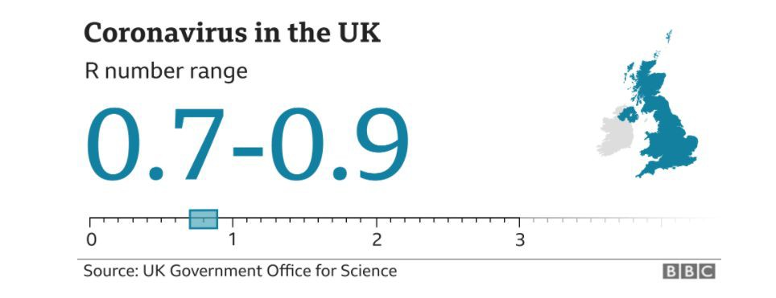
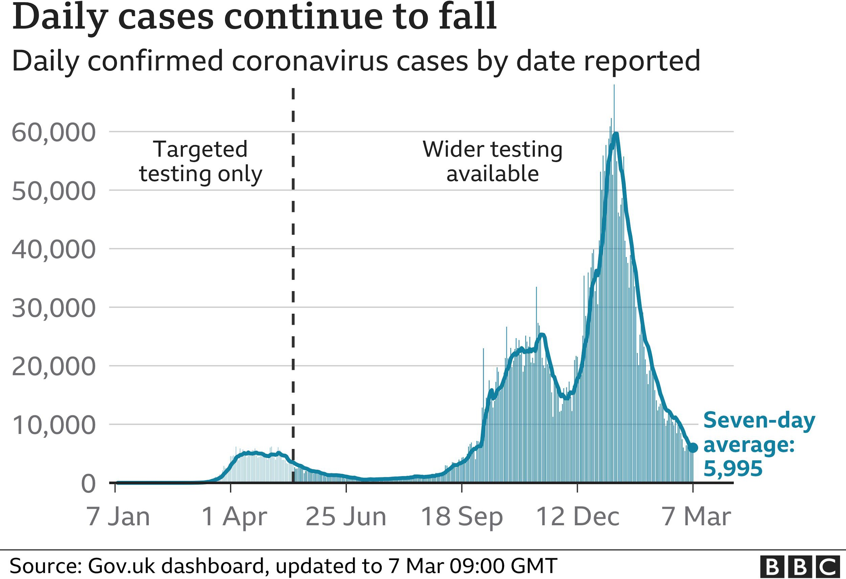
Statistics is all around us!
Additional examples
Statisticians use data to estimate how quickly coronavirus is spreading, which helps politicians make decisions about fighting the virus

Slide 14
What do I do with Statistics?
….I use statistics to find new medicines and help improve the lives of patients

Slide 15
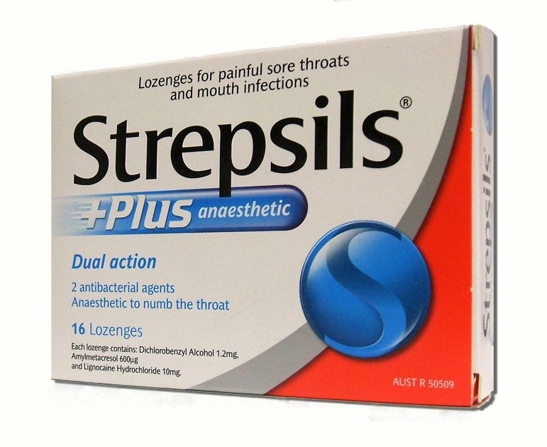
Do any of these look familiar?

Slide 16
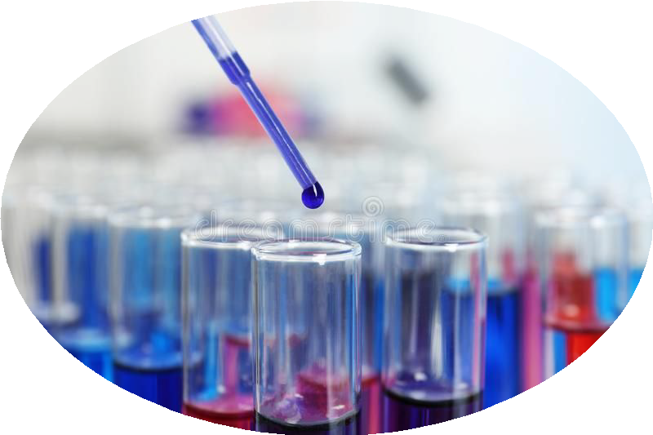
How is Statistics Used in Medicine?
When we find potential new medicines we want to see if they work
We run a clinical trial to collect data
We use statistics to analyse the data to assess if the medicine works

Slide 17
Questions we can answer with Statistics…
Phase 4: Does it work for children and adults?
Phase 3: Is it better than any existing treatment?
Phase 2: Which is the best dose?
Phase 1: Is the drug safe to take?

Slide 18
Why I became a Medical Statistician
School & Education
e.g.
What did you study?
– What did you enjoy at school?
What is your current job?
Interesting Fact / Motivation
e.g.
Why did you continue studying maths/stats?
Do you have any fun or interest highlights from work you could share? Interesting trials, unusual
Placeholder slide to be updated by presenter
– What does the company do? results, breakthrough medicines.
– What do you do?
– How do you use maths / statistics?
Insert a relevant photo:
e.g. you / company / university / product worked on

Slide 19
Activity Slides Placeholder
Placeholder slide to insert any activity slides
Some useful workshops are available for use on the PSI website:
https://psiweb.org/careers/schools-education/classroom-workshops

Slide 20
Summary
Maths doesn’t have to be boring!
Studying maths further can lead to many interesting jobs and careers.
Statisticians can work in a variety areas, including medicine.

