Slide 1
Supplementing randomized clinical trials with historical data via Bayesian dynamic borrowing:
A framework to engage with regulatory authorities
BDB - framework
EFSPI / PSI Special Interest Group Historical Data
13 June 2022

Slide 2
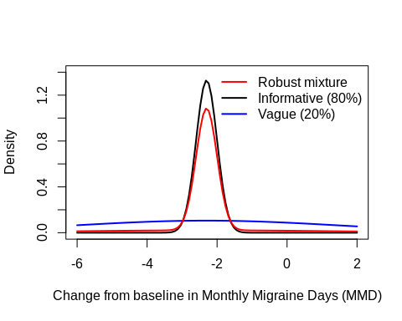
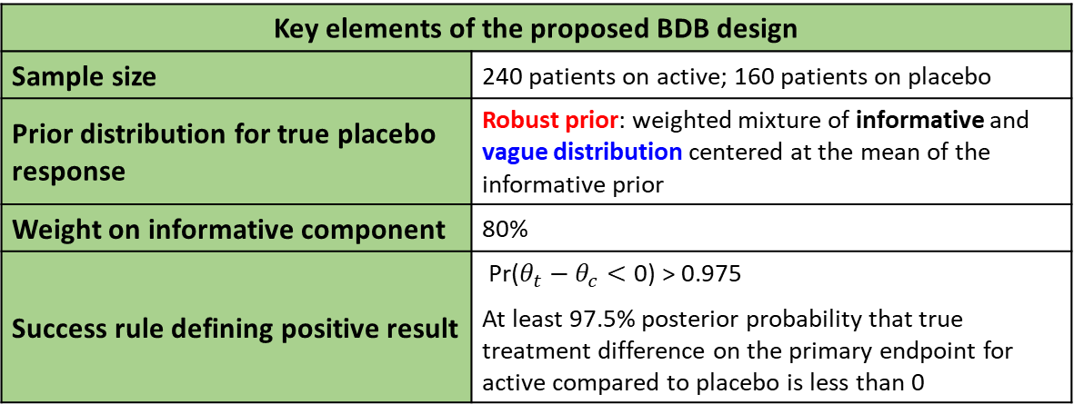
Phase 3 Study A: borrowing historical control data
Double-blind, randomised study, experimental vs placebo (3:2 ratio)
Primary endpoint: change from baseline in monthly migraine days (MMD)
  Improvement = negative values (fewer monthly migraine days)
  Assumed normally distributed
Historical data: ph 2 control arm (153 patients on placebo)
Objective of using a BDB design: take advantage of the available evidence to estimate the treatment effect with precision while reducing the number of patients exposed to placebo
Key elements of the proposed BDB design
Sample size | 240 patients on active; 160 patients on placebo
Prior distribution for true placebo response | Robust prior: weighted mixture of informative and vague distribution centered at the mean of the informative prior
Weight on informative component | 80%
Success rule defining positive result | $\text{Pr}\text{(}θ_{t}−θ_{c}<\text{0)}\text{ > }\text{0.9}\text{7}\text{5}$ At least 97.5% posterior probability that true treatment difference on the primary endpoint for active compared to placebo is less than 0

Slide 3
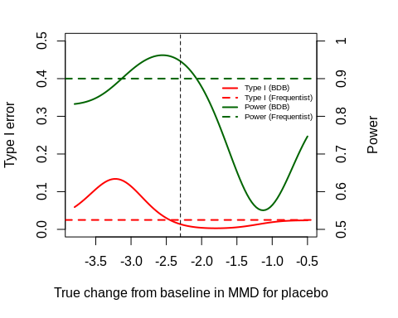
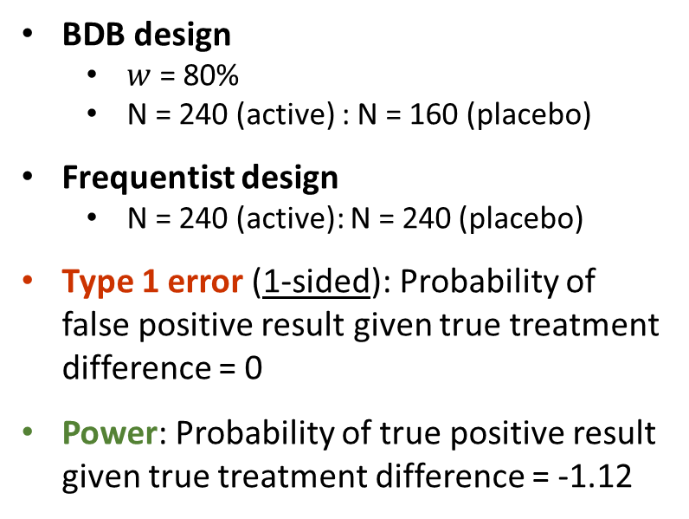
Presentation of design characteristics
BDB design
  $w$ = 80%
  N = 240 (active) : N = 160 (placebo)
Frequentist design
  N = 240 (active): N = 240 (placebo)
Type 1 error (1-sided): Probability of false positive result given true treatment difference = 0
Power: Probability of true positive result given true treatment difference = -1.12
Walley RJ, Grieve AP. Optimising the trade-off between type I and II error rates in the Bayesian context. Pharm Stat. 2021 Jul;20(4):710-720.

Slide 4
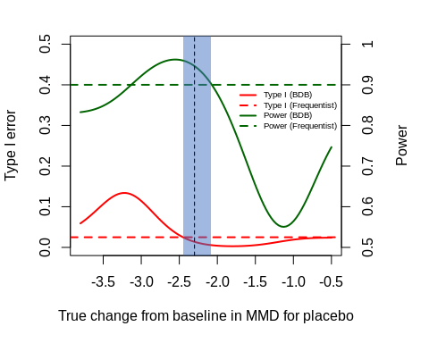
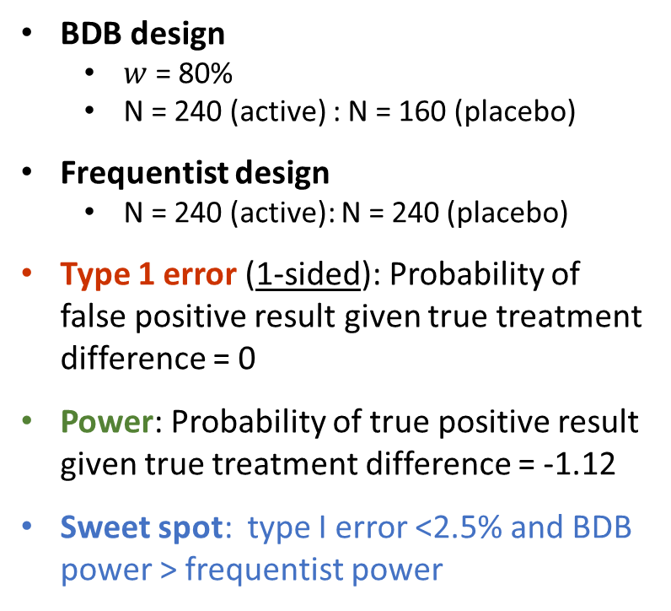
Presentation of design characteristics
Power given no drift
BDB design
  $w$ = 80%
  N = 240 (active) : N = 160 (placebo)
Frequentist design
  N = 240 (active): N = 240 (placebo)
Type 1 error (1-sided): Probability of false positive result given true treatment difference = 0
Power: Probability of true positive result given true treatment difference = -1.12
Sweet spot: type I error <2.5% and BDB power > frequentist power
Max type I error
Type 1 error given no drift
Type I error > 5%
Sweet spot
Walley RJ, Grieve AP. Optimising the trade-off between type I and II error rates in the Bayesian context. Pharm Stat. 2021 Jul;20(4):710-720.

Slide 5
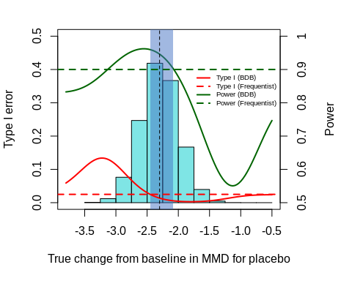
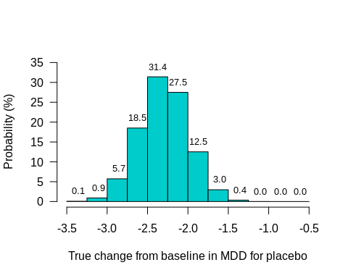
Presentation of design characteristics
Based on the MAP prior
0.1% risk of true pbo effect ≤ -3.22 (max type I error)
12.2% risk of type 1 error >5%
46.0% probability for the sweet spot
What we know on the placebo effect:
Informative component density histogram
Max type I error
Type I error > 5%
Sweet spot
✓ Basis for discussion with health authorities
(“Are these probabilities acceptable in this case?”)

Slide 6
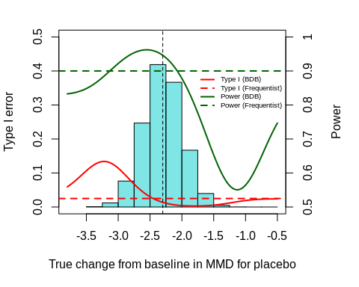
Focus on Type I error metrics
Pointwise and average type 1 error (1-sided)
BDB design Pointwise type 1 error | no drift Max pointwise type 1 error Average type 1 error, over informative prior Average type 1 error, over robust prior Frequentist design | 1.4% 13.4% 2.3% 2.5% 2.5%
Power given no drift
Averaged over
plausible distributions
Analogy with power and average power*
BDB design Power | no drift Max power Assurance*, i.e. average power, over informative prior Assurance*, i.e. average power, over robust prior Frequentist design | 95% 96% 92% 90% 90%
Max type I error
Type 1 error given no drift
* refers to “assurance” averaging over prior for control (conditional on point prior for treatment difference)
Discussion with health authorities to agree what scenarios are possible
Summarises the risk of making an incorrect decision in favour of treatment benefit

Slide 7
Summary
‘Calibrated Bayes’ approach: select design points that achieve ‘desirable’ frequentist operating characteristics
Design points to be specified in a BDB design with an informative prior may include:
  Informative and vague components of the robust mixture prior
  Initial weight on the historical data (informative prior component)
  Decision rule
  Sample size
In general, there are several combinations of these design points that will achieve ‘desirable’ frequentist operating characteristics
The proposed framework supports the pre-specification of these design points, with scientific and technical rationales
We recommend that sponsors present this framework to enable a robust discussion with health authorities to evaluate the risk-benefit of a BDB design

Slide 8
Topic 4: Structured evaluation & presentation of results
Proposed framework
Results of primary analysis
  Tabular/graphical summaries of data, prior and posterior, including estimated treatment effect based on (i) posterior using historical data; (ii) current data alone
  Prior & posterior probability of efficacy
  Prior & posterior weight on evidence informed by the historical data
  Assessment of concordance between historical and current data
Sensitivity analyses
  Should be pre-specified to avoid ‘cherry picking’ results based on post-hoc assumptions
  Designed to assess robustness to key assumptions:
  Tipping point analysis varying prior weight allocated to historical data
  Discussion of main potential sources of bias (drift) and sensitivity analysis to reasonable assumptions
  Additional supportive analyses as needed to characterise e.g. time trends, differences in background therapy, assessment procedures etc. between historical and current setting

Slide 9
Reporting of primary analysis: Summaries of data, prior & posterior
Key elements to be included when reporting results of primary analysis in each MAA:
Evidence source | Treatment difference: Active-Placebo |  | Active effect |  | Placebo effect
Primary analysis - posterior | -0.9 | (-1.5, -0.3) | -2.9 | (-3.3, -2.5) | -1.0 | (-2.4, -1.6)#
Current study only | -1.0 | (-1.6, -0.5) | -2.9 | (-3.3, -2.5) | -1.8 | (-2.3, -1.4)
Historical informative prior for placebo effect | - | - | - | - | -2.3 | (-2.9, -1.7)
Robust prior for placebo effect | - | - | - | - | -2.3 | (-6.7, 2.1)
Posterior median and equal-tailed Bayesian posterior 95% credible interval (CrI) are reported for the primary analysis and the historical placebo response, and maximum likelihood estimate and Wald 95% confidence intervals (CI) are reported for the separate analysis based on the current study data only.
# Posterior weight (informative:vague): 0.95:0.05
Permits comparison of primary Bayesian analysis (row 1) with:
    result of a classical frequentist analysis of current study data alone (row 2)
    result based on the prior information alone (rows 3 & 4)
    to enable transparent assessment of contribution of each source of evidence

Slide 10
Additional material

Slide 11
Points to consider for discussion with regulatory authorities
Considering the information above, discuss in your team what pros / cons you see with the proposed approach. Do you feel comfortable with the proposal and agree to approach regulators?
What would you include in a Company position to support the use of the Phase 2 data as a historical control in the analysis of Study B?
Are there any other Tables or Figures you would provide to support the use of HC data in the analysis of Study B?
What other information would you provide to support the use of HC data as part of a pivotal Phase 3 program?
What other questions would you ask a regulatory agency when using HC data as part of a regulatory approval?
What if now there was just Study B in the confirmatory package – what implication would that have? Would it change your position?
Now imagine you were on the regulatory side, what (other) questions would you ask?

Slide 12
Additional points for discussion
Proposal to borrow from historical data on treatment effect rather than borrowing on the control group rate
Differences in IN/EX criteria, covariate distribution, timeliness of historical data
Historical data available from external trial or literature rather than Sponsor Ph2 study
Availability of multiple historical data sources instead of a single one
Availability of observational data / RWD rather than randomized clinical trial data
Availability of HC data at the design stage (i.e., awareness of HC results) versus HC data generated in parallel to pivotal trial
Other borrowing approaches
Adjustment for prognostic factors
Borrowing for a pivotal phase III trial in adults vs. pediatric phase III vs. rare disease phase III setting vs. borrowing for a non-pivotal trial

Slide 13
Other sources of data
Wang, X et al. Efficacy and Safety of Monoclonal Antibody Against Calcitonin Gene-Related Peptide or Its Receptor for Migraine: A Systematic Review and Network Meta-analysis. Front Pharmacol. 2021
  18 trials, all placebo-controlled, timepoint: week 12 (13), week 24 (5);
2 randomly picked trials showed placebo response -1.9 and -2.2, respectively

Slide 14
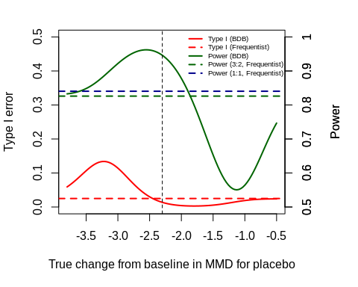
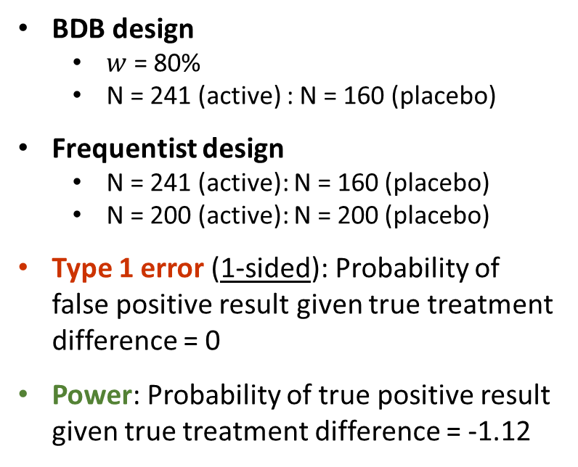
Comparison of design characteristics – Frequentist with same overall sample sizes as Bayesian (3:2, 1:1)
BDB design
  $w$ = 80%
  N = 241 (active) : N = 160 (placebo)
Frequentist design
  N = 241 (active): N = 160 (placebo)
  N = 200 (active): N = 200 (placebo)
Type 1 error (1-sided): Probability of false positive result given true treatment difference = 0
Power: Probability of true positive result given true treatment difference = -1.12
Walley RJ, Grieve AP. Optimising the trade-off between type I and II error rates in the Bayesian context. Pharm Stat. 2021 Jul;20(4):710-720.

Slide 15
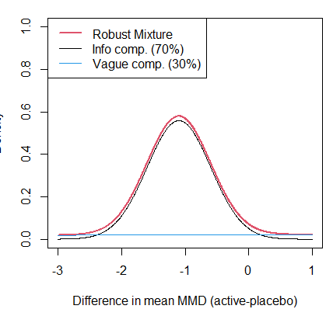
Phase 3 Study A: borrowing historical data on treatment difference
Double-blind, randomised study, experimental vs placebo (1:1 ratio targeting total sample size N=480)
Primary endpoint: change from baseline in monthly migraine days (MMD)
  Improvement = negative values (fewer monthly migraine days)
  Assumed normally distributed
Historical data: ph 2 treatment difference (105 patients on active (dose 3) v 153 patients on placebo)
Objective of using a BDB design: take advantage of the existing evidence on the treatment difference to estimate the Ph3 treatment effect with precision while reducing the overall sample size and duration of trial
ESS of RMP = 74 per arm
Sample size in proposed Ph3 study | 166 patients on active; 166 patients on placebo
Prior distribution on true placebo response | Robust mixture prior: weighted mixture of posterior distribution of treatment effect from Ph2 study and vague distribution centered on 0
Weight on Ph2 component of the mixture prior | 70%
Success rule defining positive result | At least 97.5% posterior probability that true treatment difference on the primary endpoint for active compared to placebo is less than 0

Slide 16
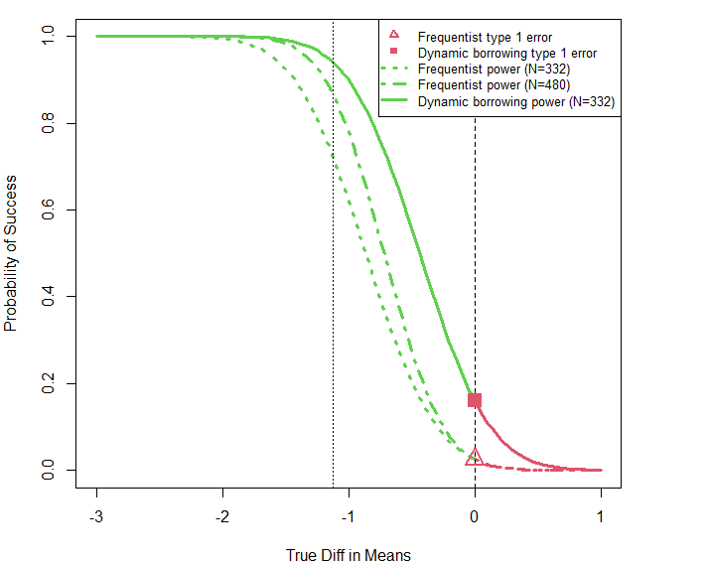
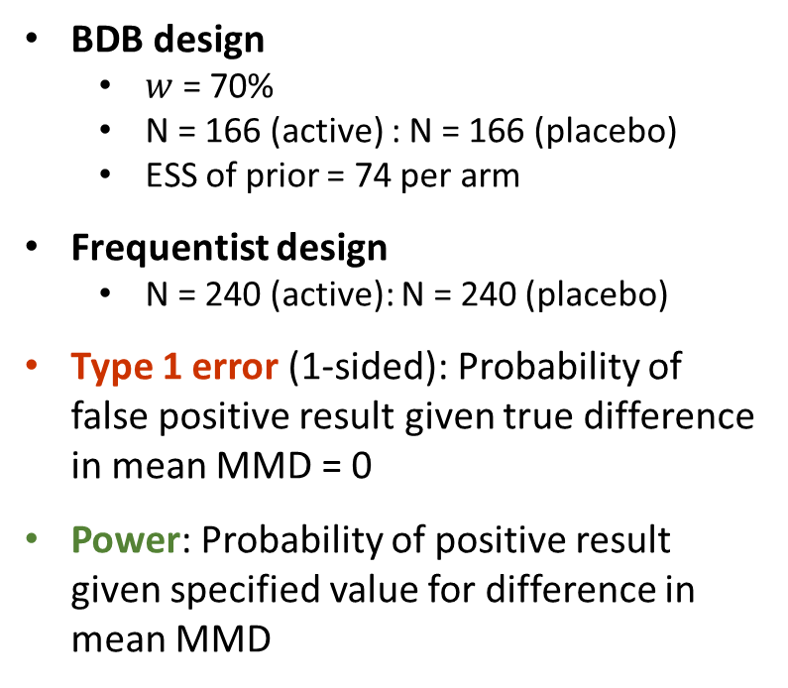
Presentation of design characteristics
BDB design
  $w$ = 70%
  N = 166 (active) : N = 166 (placebo)
  ESS of prior = 74 per arm
Frequentist design
  N = 240 (active): N = 240 (placebo)
Type 1 error (1-sided): Probability of false positive result given true difference in mean MMD = 0
Power: Probability of positive result given specified value for difference in mean MMD
94%
86%
72%
Ph2 Treatment effect
Null treatment effect
16%
Note: borrowing information on the treatment effect inevitably increases the type 1 error (no sweet spot)
2.5%

Slide 17
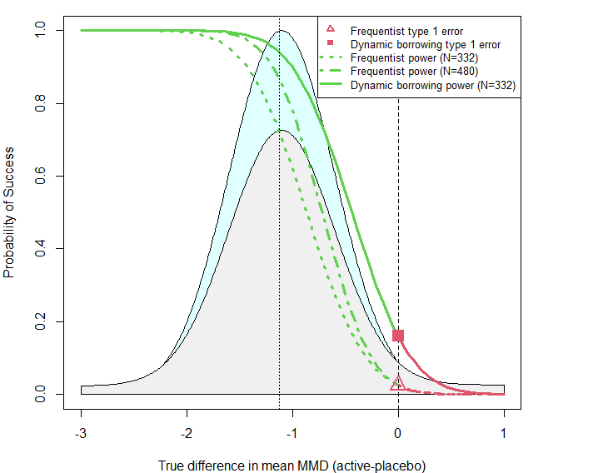
Presentation of design characteristics
Operating characteristics
Type 1 error (1-sided) | True diff = 0 | BDB design Frequentist design (n=480) | 16% 2.5%
Prior probability of no treatment benefit: Pr(True diff ≥ 0) | Under Ph2 prior Under robust mixture prior | 1.4% 16%
Probability of obtaining a false positive result (Probability of Ph3 treatment diff ≥ 0 AND obtaining a false positive result) | Under Ph2 prior Under robust mixture prior | 0.2% 2.5%
Power and Assurance (average power)
BDB design: Power | no drift (True treatment difference = -1.12) Assurance (average power, over Ph2 prior) Assurance (Average power, over robust mixture prior) Frequentist Power | no drift (True treatment difference = -1.12) Design Assurance (Average power, over Ph2 prior) (n=480): Assurance (Average power, over robust mixture prior) | 94% 84% 73% 86% 64% 58%
Adult prior
Robust adult prior
Discussion with health authorities to agree what scenarios are possible
Summarises the risk of making an incorrect decision in favour of treatment benefit
Prob diff ≥ 0 = AUC of prior above 0

Slide 18
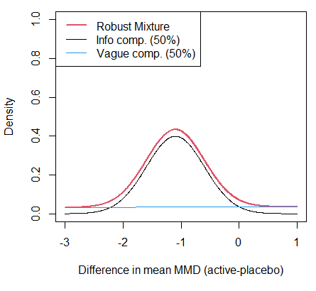
Phase 3 Study A: borrowing historical data on treatment difference
Double-blind, randomised study, experimental vs placebo (1:1 ratio targeting total sample size N=480)
Primary endpoint: change from baseline in monthly migraine days (MMD)
  Improvement = negative values (fewer monthly migraine days)
  Assumed normally distributed
Historical data: ph 2 treatment difference (105 patients on active (dose 3) v 153 patients on placebo)
Objective of using a BDB design: take advantage of the existing evidence on the treatment difference to estimate the Ph3 treatment effect with precision while reducing the overall sample size and duration of trial
ESS of RMP = 45 per arm
Sample size in proposed Ph3 study | 195 patients on active; 195 patients on placebo
Prior distribution on true placebo response | Robust mixture prior: weighted mixture of posterior distribution of treatment effect from Ph2 study and vague distribution centered on 0
Weight on Ph2 component of the mixture prior | 50%
Success rule defining positive result | At least 97.5% posterior probability that true treatment difference on the primary endpoint for active compared to placebo is less than 0

Slide 19
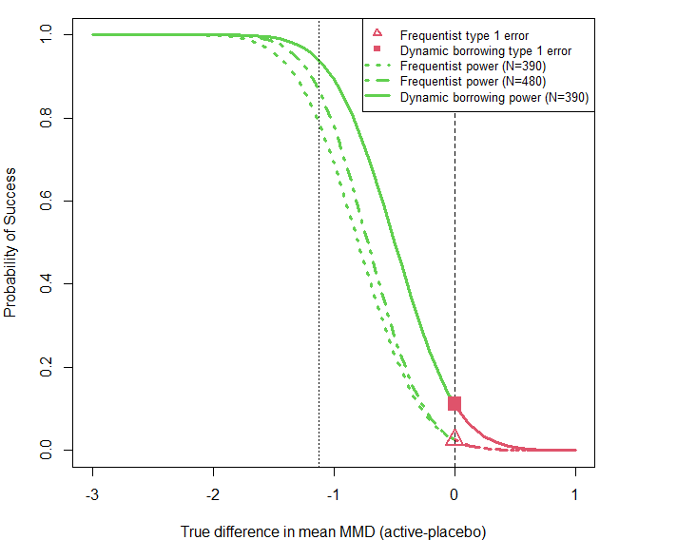
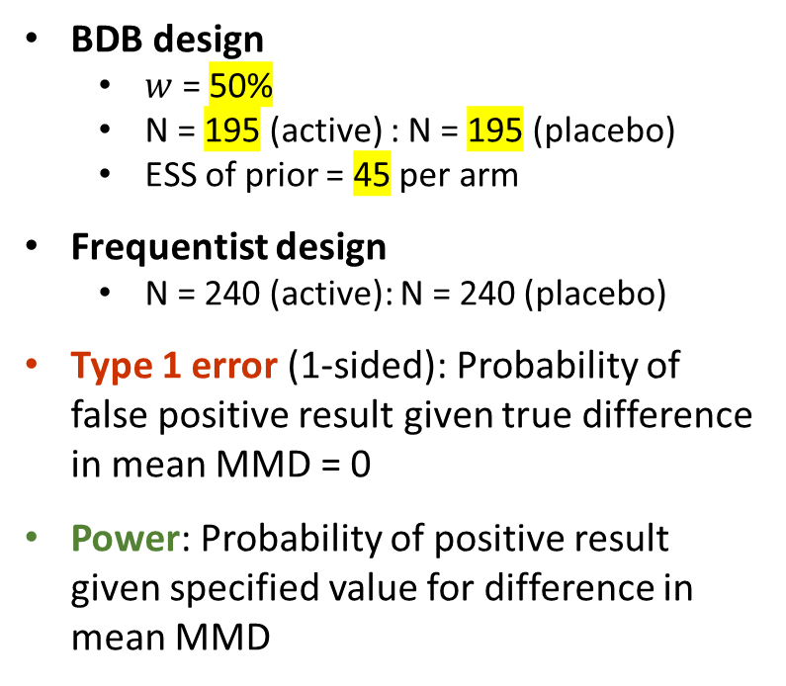
Presentation of design characteristics
BDB design
  $w$ = 50%
  N = 195 (active) : N = 195 (placebo)
  ESS of prior = 45 per arm
Frequentist design
  N = 240 (active): N = 240 (placebo)
Type 1 error (1-sided): Probability of false positive result given true difference in mean MMD = 0
Power: Probability of positive result given specified value for difference in mean MMD
94%
86%
72%
Ph2 Treatment effect
Null treatment effect
11%
Note: borrowing information on the treatment effect inevitably increases the type 1 error (no sweet spot)
2.5%

Slide 20
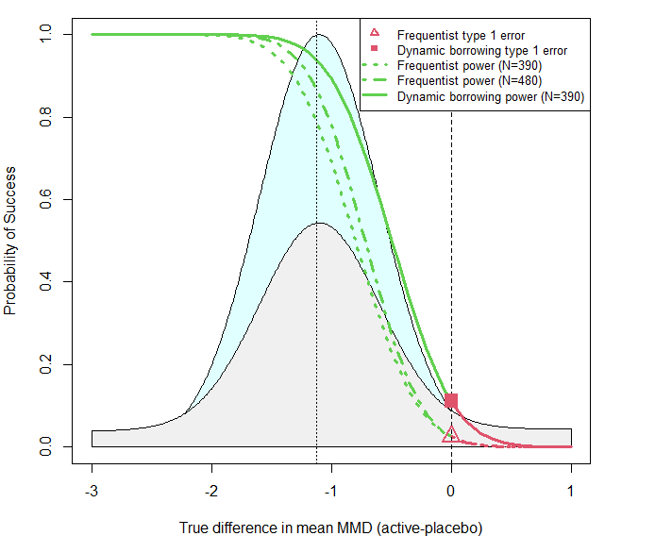
Presentation of design characteristics
Operating characteristics
Type 1 error (1-sided) | True diff = 0 | BDB design Frequentist design (n=480) | 11% 2.5%
Prior probability of no treatment benefit: Pr(True diff ≥ 0) | Under Ph2 prior Under robust mixture prior | 1.4% 26%
Probability of obtaining a false positive result (Probability of Ph3 treatment diff ≥ 0 AND obtaining a false positive result) | Under Ph2 prior Under robust mixture prior | 0.15% 2.9%
Power and Assurance (average power)
BDB design: Power | no drift (True treatment difference = -1.12) Assurance (average power, over Ph2 prior) Assurance (Average power, over robust mixture prior) Frequentist Power | no drift (True treatment difference = -1.12) Design Assurance (Average power, over Ph2 prior) (n=480): Assurance (Average power, over robust mixture prior) | 94% 84% 65% 86% 64% 53%
Adult prior
Robust adult prior
Discussion with health authorities to agree what scenarios are possible
Summarises the risk of making an incorrect decision in favour of treatment benefit
Prob diff ≥ 0 = AUC of prior above 0

