Slide 1
NextGen is now!
How to inspire the future workforce of pharmaceutical statistics
11th September 2023

Slide 2
Before We Start...
Voice: Audience is automatically muted as default
Q&A: Please do ask questions! Click ‘Like’ to upvote a question. If question is relevant for our panel, we will look to answer
these at the end during the panel discussion.
Technical issues: please raise your hand / use the Chat box

Slide 3
Welcome! (and Agenda)
12:00-12:05 | Welcome and Introduction from PSI Schools Chair
12:05-12:25 | Introduction to how PSI is supporting Schools Outreach
12:25-12:55 | Panel discussion
12:55-13:00 | Top 5 things you can do to inspire NextGen

Slide 4
Intro to PSI Careers

Slide 5
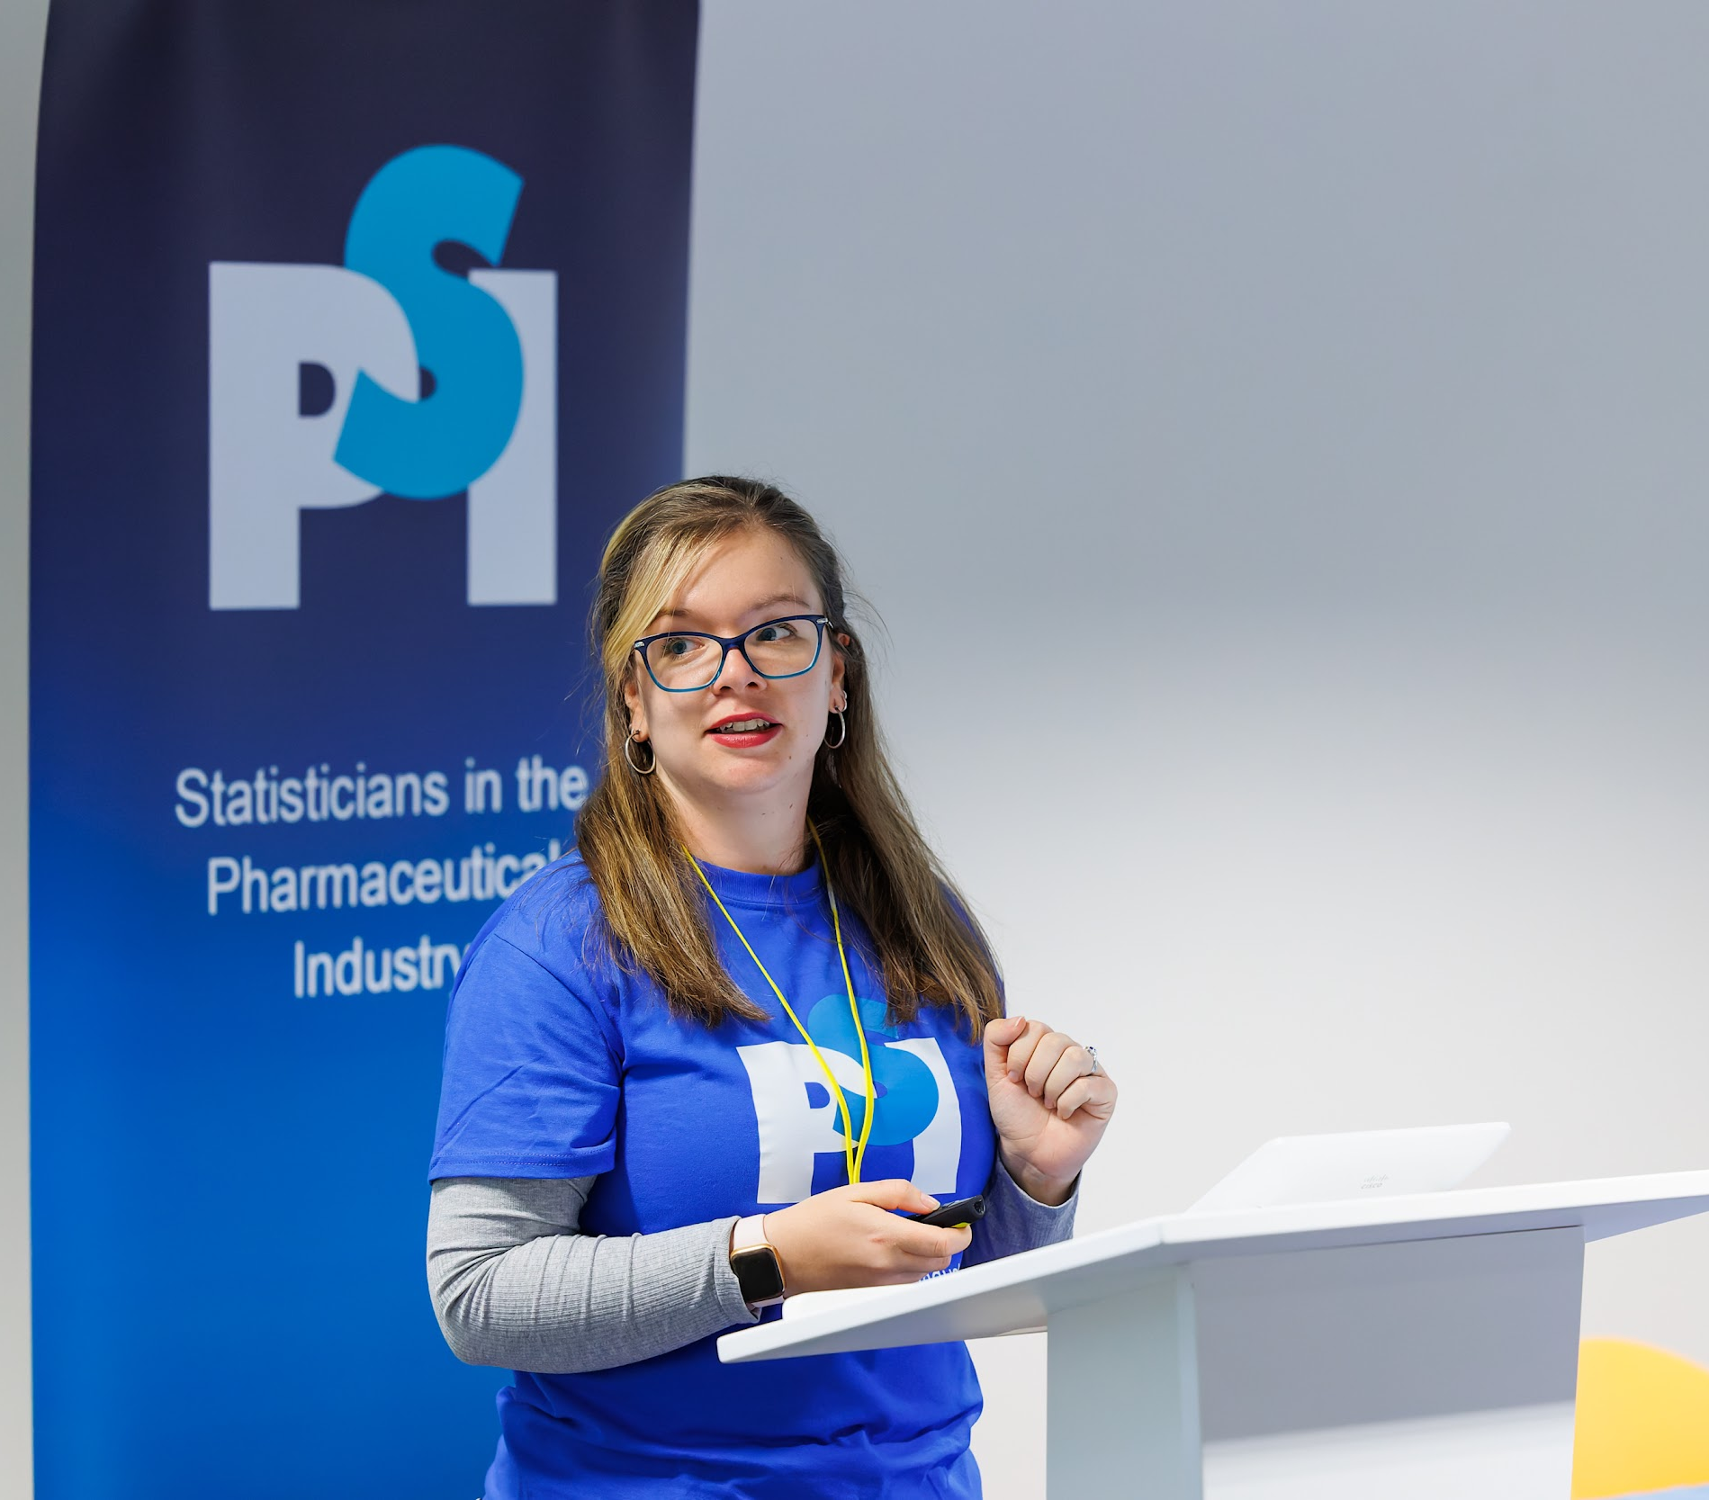
Emma Crawford
Role & Company
Your career journey
BSc Maths, MSc Medical Stats
9 years + 1 year industry placement
CROs, late-phase
Pharma, HTA
Associate Principal Biostatistician
BARDS HTA Statistics, MSD
Your journey with schools outreach
How did you discover the pharma industry?
STEM ambassador
Supported previous PSI school events
Chair of PSI Careers Schools Team
When applying for roles for my industrial placement year!

Slide 6
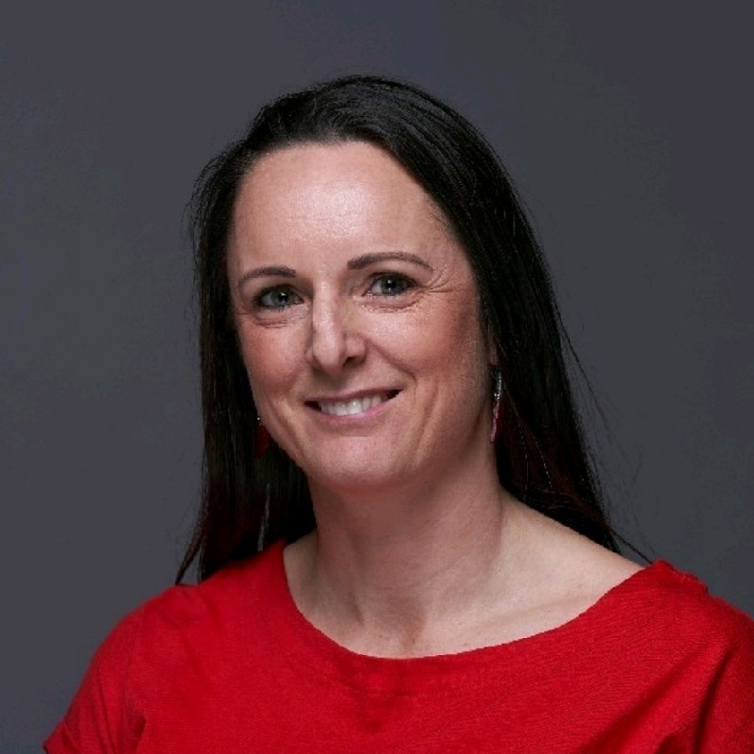
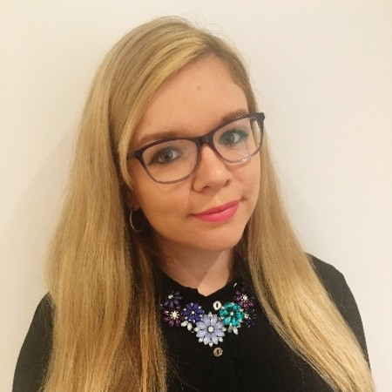
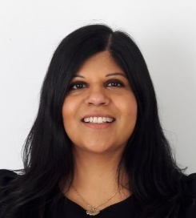
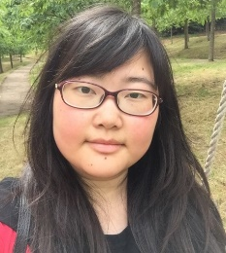
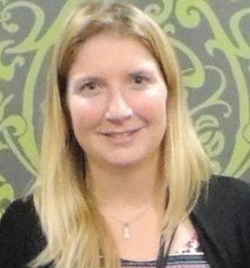
Careers Re-Structure
Careers Director
Kim Hacquoil
Schools
Emma Crawford
Universities*
Amanda Darekar
Professional
Development Xinyi Zhu
Training (ITIT)
Zelie Bailes
Outreach (promotion of PSI material)
Events (STEM events, PSI schools event)
Outreach (podcasts, videos, placement opportunities, undergraduate prizes, student newsletter)
Events (MEDMaths, Careers Event)
Apprenticeships
Mentoring
Book club
Lunch and Learns
Career Young Networking
Career profiles & webinars
Interview support
Introduction to Industry Training (ITIT) - Six 2-day course
* i.e. CALC’s main focus in recent years
Notes:
New focus on schools as a key area within the careers section of PSI and that we see NextGen as a key to PSI success

Slide 7
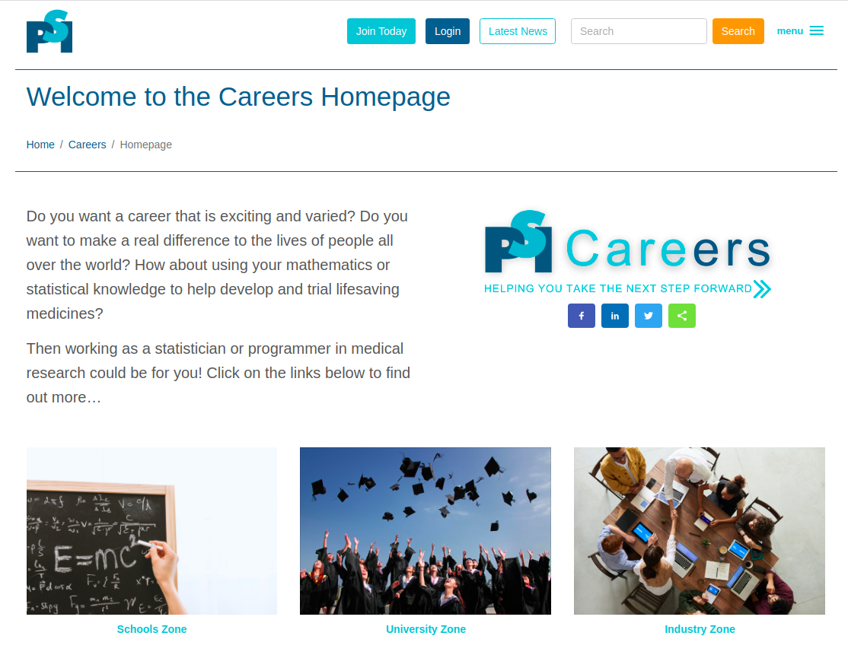
www.psiweb.org/careers
For more information on what we do visit our website.

Slide 8
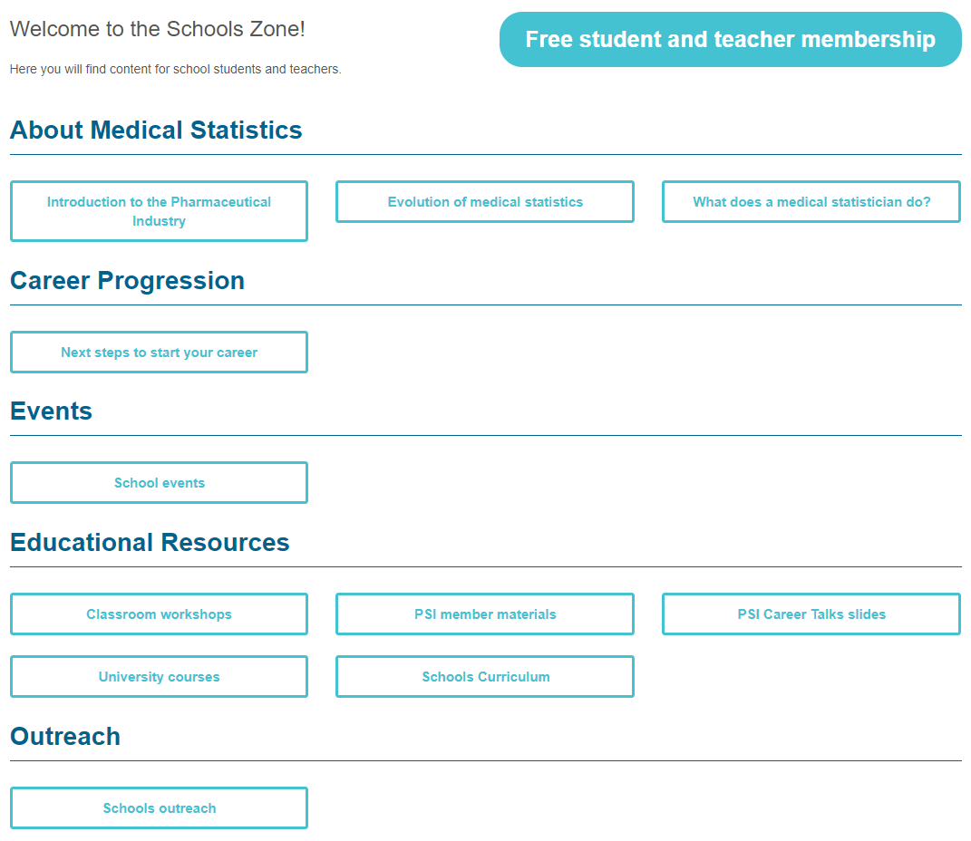
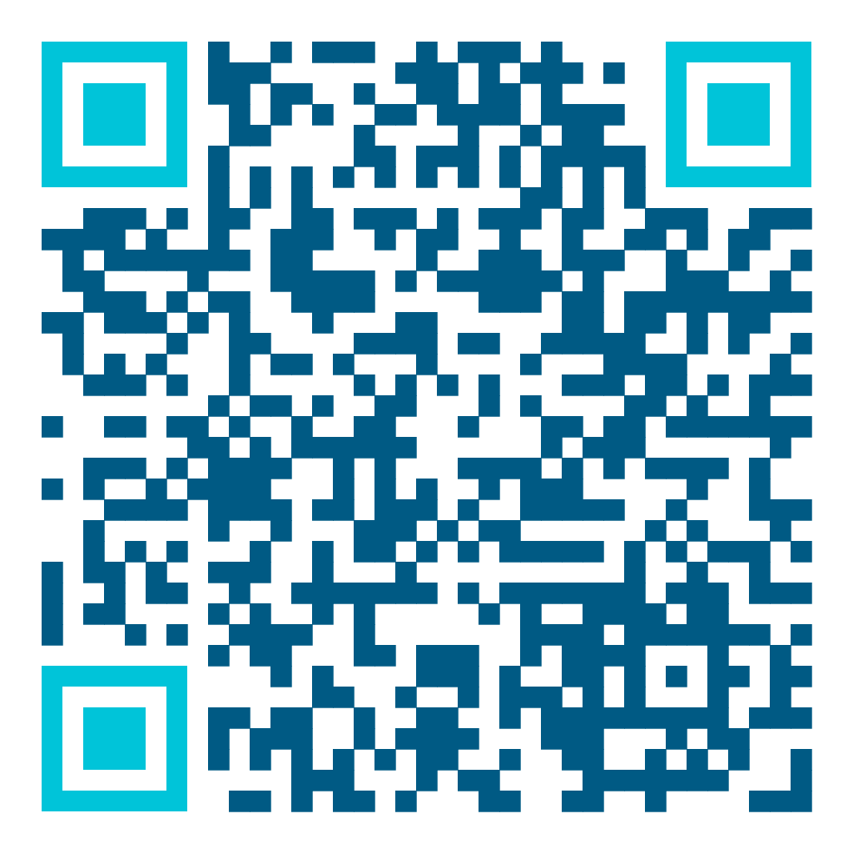
www.psiweb.org/careers/schools-zone
Newly launched Schools Zone pages for 2023/24:
PSI member materials
PSI Career Talk slides
Schools Curriculum
Schools Outreach

Slide 9
Let’s find out about you!
How did you find out about jobs in the industry? [School, University, Family/Friends, Job advert, Other]
Have you engaged in a schools outreach activity before? [Yes/ No]
If yes, what school year groups have you engaged with before? [Early Years, Primary (KS1/KS2), Secondary (KS3/KS4), College (KS5)]
If yes, how have you got involved in schools outreach activities? [Via STEM engagement scheme, via employer, via personal networks]
Did you know that PSI had schools workshops available to download from our website? [No, Yes but not used, Yes and used]

Slide 10
Schools Outreach

Slide 11
What is Schools Outreach?
A school outreach program builds partnerships between educational institutions and sponsoring organizations to open up new pathways for growth and success. It paves a better road to the future for students, sponsors, and their communities.
PSI supporting Schools Outreach:
Promoting opportunities in pharmaceutical/ healthcare industry
Sharing working with data and use of numeracy skills in industry
Encouraging relevant STEM studies to inspire NextGen into industry
Notes:
The Purpose of a School Outreach Program
School outreach programs are partnerships between schools and corporations, organizations, governmental agencies, or municipalities. These partnerships help bring the resources of the partnering entity into the classroom. In turn, the partnership helps fulfill a strategic initiative or mission for the partnering entity. Community outreach programs for schools develop deeper relationships between students and the communities they live in. It creates community connections for the sponsoring partner to shape the local area and nurture goodwill.
Overall a school outreach program is a win-win partnership for schools, sponsors, and communities. The bridges built between the partnering sponsor and the educational institution support community improvement. It is a partnership that works in strengthening communities and forging better futures. Students are provided the opportunity to work for the betterment of their community. Partnering sponsors are provided the opportunity to affect the local community so their organizations can thrive.

Slide 12
This scheme will aim to recognise PSI members who have made exceptional outreach contributions throughout the year.
The award will recognise the top individual members who completed the highest number of outreach activities during the academic year.
At PSI Conference 2024 we will announce:
The top 10, who will receive a certificate.
The winner, who will win:
£50 voucher of their choice,
£250 STEM grant for a participating school

Slide 13
Want to enter the scheme?
Submit activity completion form from the website each time you complete an outreach activity within a School.
We will keep a running total of activities you submit, and if you make it into the top champions each month, you’ll find yourself displayed on the leaderboard on our website!
What counts as an activity?
F2F workshop, virtual workshop, school assembly, careers talk, other type of careers event/ activity etc.
On your own or as part of a team?
Either is fine! But if you wish for your involvement to be considered for the incentive scheme each member of the team will need to submit an activity completion form!

Slide 14
How to find an activity?
STEM Specific
Female Focussed
General
Member Led
STEMnet
I’m a scientist, get me out of here
BeScience STEM
The Big Bang
DIG Data
Stemettes
Code First Girls
Girls in data
Maths4Girls
The Access Project
Inspiring for the future
Enterprise Advisers
University/ Alumni networks
Employer
Personal connections
Use our letter template!
Notes:
Many employers offer volunteering hours - check if your company offers such a scheme?
Personal connections could be local school and/or child’s school

Slide 15
What materials to use?
PSI Materials
6 classroom workshops currently available on our website
2 sets of careers talk slides (Yr6+, Yr11+)
If you use PSI materials, you will be sent a feedback form to complete!
Create your own
Adapt to the needs of your activity/ schools requirements
Take inspiration from our Member Materials Library
Submit your materials to be added to our Member Materials Library after use!

Slide 16
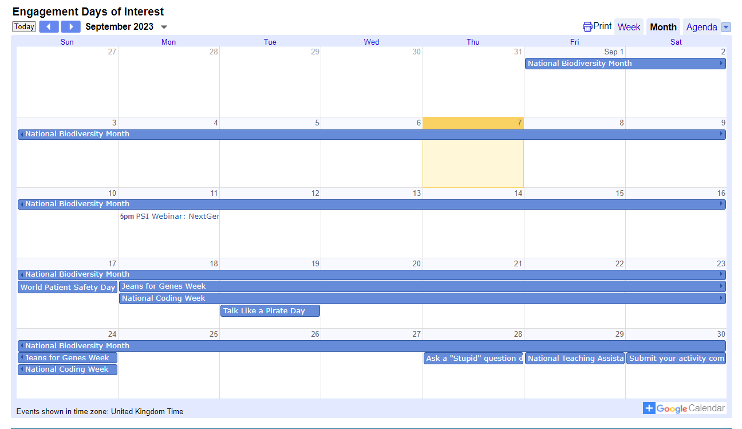
Dates for the Diary
View our calendar of engagement days of interest on our Schools Outreach webpage!
Or you can view it directly here!
Remember to submit your activity completion forms by the end of each month to be considered for the monthly leaderboard updates!

Slide 17
Benefits of Outreach
For the PSI community:
Strengthen the PSI brand identity
Encourage improved education on numeracy skills
Inspire more students to continue their STEM education beyond GCSEs
For the PSI member:
Develop presentation and communication skills
Demonstrate leadership and organisational skills
Additional variety into daily work activities

Slide 18
Panel Discussion

Slide 19
Please submit your questions by using the Q&A function on Zoom. Click ‘Like’ to upvote a question!

Slide 20
Introduce yourself!

Slide 21
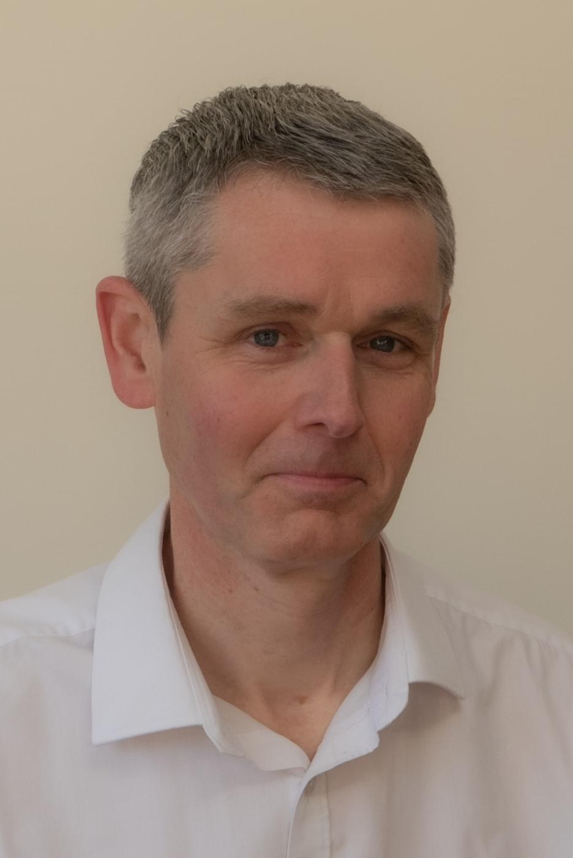
Steve Mallett
Role & Company
Your career journey
Senior Manager Statistics
Veramed
BSc/MPhil Biochemistry
Parexel (programmer)
GSK (programmer=>stats)
MSc Applied Stats (part time)
Veramed
Your journey with schools outreach
How did you discover the pharma industry?
PSI/CALC committee 2013-2016
CALC/STEM events
GSK/STEM events
Local school STEM activities
Advert in New Scientist for Contract Research Organisation (had no idea what that meant, but was attracted by “research” and the salary was good!)

Slide 22
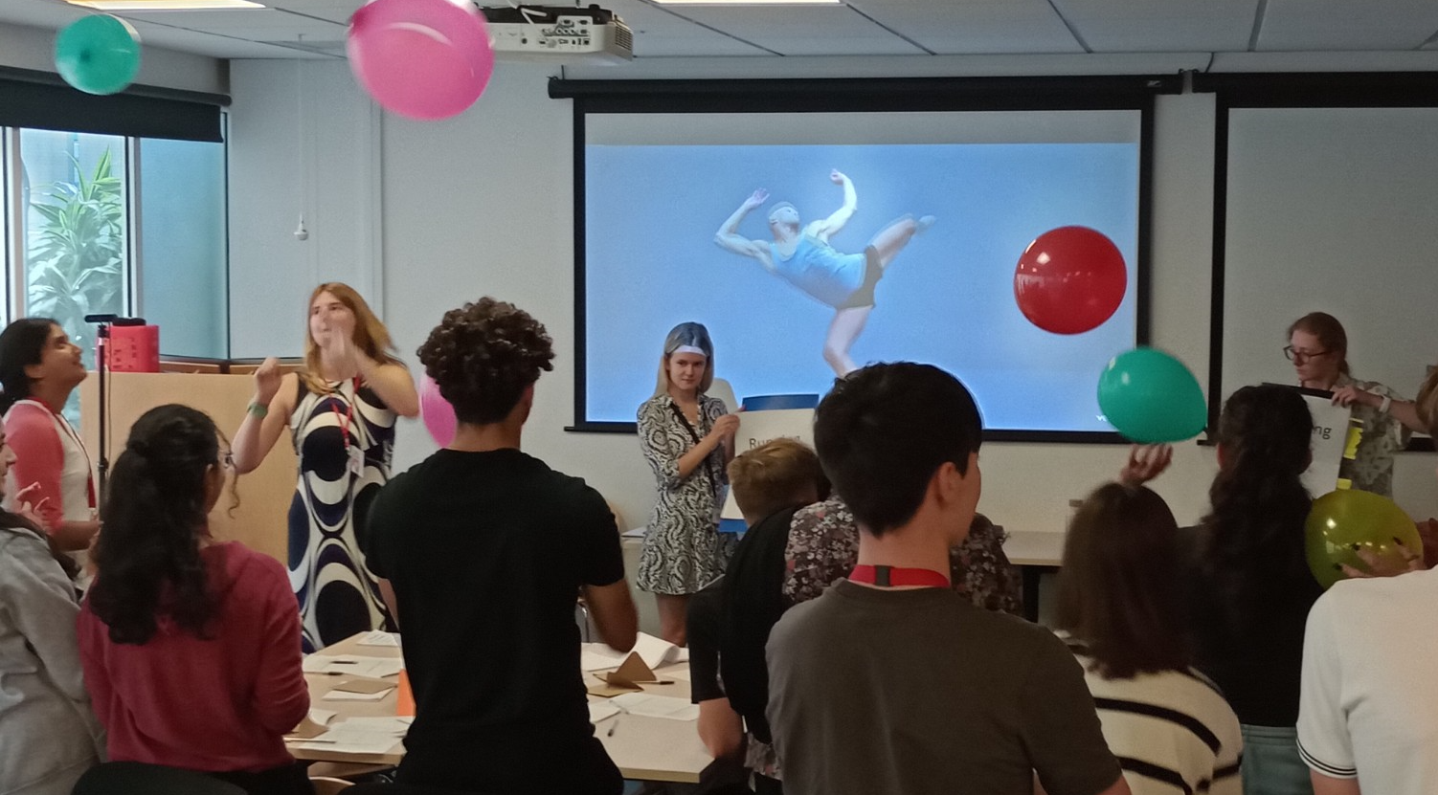
Claire Brittain
Role & Company
Your career journey
<Insert photo - preferable if one from an outreach activity!>
Statistician Early Development
UCB
MSc Southampton
Kendle (CRO), GSK, Eli Lilly, UCB -> BioNTech
Your journey with schools outreach
How did you discover the pharma industry?
CALC committee supported previous PSI school events including Big Bang events
Co-wrote workshops including Maths in Medicine
A lucky discussion I had with university lecturer when trying to get out of taking a finance module in my 3rd BSc

Slide 23
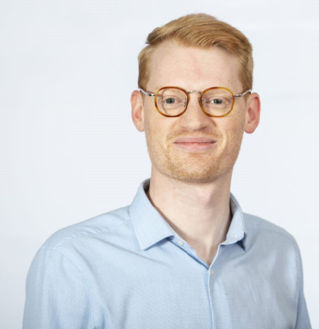
Doug Thompson
Role & Company
Your career journey
Statistics and Predictive Modelling Director, GSK
BSc University of Glasgow
PhD University of Edinburgh
GSK (~10 years)
Your journey with schools outreach
How did you discover the pharma industry?
Collaboration with the Data Inspiration Group earlier this year bringing virtual work experience to students from school age to Uni age
University lecturer who had worked in Pharma prior to accademia. Most his lectures had examples from pharma - I was hooked!

Slide 24
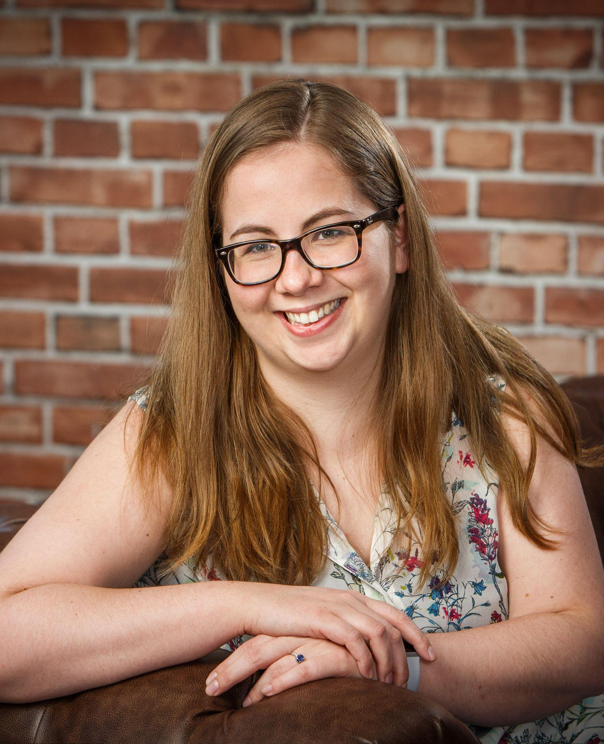
Nicola Voyle
Role & Company
Your career journey
<Insert photo - preferable if one from an outreach activity!>
Statistical Data Scientist
Roche
BSc in Maths at Bath with placement year at Roche
PhD in Biostatistics at KCL
7 years experience primarily in late phase neuroscience
Your journey with schools outreach
How did you discover the pharma industry?
Roche STEM ambassador network and local events
Enterprise Advisor
My dad!

Slide 25
What is your most memorable outreach activity?

Slide 26
What benefits have you experienced when engaging with outreach?

Slide 27
What challenges do you face when engaging with outreach?

Slide 28
What skills have you learnt by engaging with outreach?

Slide 29
How much time do you spend engaging with outreach activities?

Slide 30
How do you sell outreach involvement to your line manager?

Slide 31
What are your thoughts on the future of the medical stats workforce?

Slide 32
Questions from Q&A

Slide 33
What is your top tip to inspire NextGen?
Notes:
Commit to a minimum of one schools outreach activity per year
Bring up your career in conversation when you speak to your friends / family with children
Encourage your company to consider a STEM engagement program / If they have one, how can you ensure your department is represented?
Be passionate whenever you speak to someone about your career - you never know who your story might be shared with!
Volunteer with the PSI Careers Schools team to help shape the future of PSI Schools outreach efforts (contact careers@psiweb.org if interested)
NB: Remember you don’t need to start from scratch - check out the PSI materials/ members materials library. Also you don’t need to do this alone, why not buddy up with a colleague (or placement student?) or get the rest of your department involved!

Slide 34
Thank you for listening!

Slide 35
Back-Up Questions

Slide 36
What do you enjoy about engaging with outreach?

Slide 37
Does your company facilitate any outreach schemes?

Slide 38
How did you get started with outreach?

Slide 39
Back-Up

Slide 40
Logistics for Webinar
Task | Details | Responsible
Recording | Yes via Zoom. Link available from Zoom to download after webinar. | Emily@MCI
Video | Video on with PSI background (Slide 43)
Time Keeping | 5mins: Intro to PSI Careers 20mins: How is PSI supporting schools outreach 30mins: Panel discussion 5mins: Close/ Top 5 things to inspire next gen | Hayley
Questions | Audience ask questions and upvote via Q&A box Questions about presentation details to be answered by team via chat Questions for panellists will be considered to be asked during the panel Download Q&A log from zoom after webinar to keep a record of all questions. | Jennifer Emily@MCI
Follow-up | Add recording and slides to schools outreach webpage | PSI Careers Website Team Emily@MCI

Slide 41
Links For Chat
Item | Link
PSI Careers Homepage | https://psiweb.org/careers
PSI Schools Zone | https://psiweb.org/careers/schools-zone
Schools Outreach | https://www.psiweb.org/careers/outreach/schools-outreach
Educational Resources (Careers Talk, Curriculum, Member Material Library, Workshops) | https://www.psiweb.org/careers/educationandresources

